Slide 1
Valuing and Supporting Kin Caregivers
A Training for Child Welfare Agencies
Training Template created by the Grandfamilies & Kinship Support Network: A National Technical Assistance Center
NOTE: please read and delete before you complete and use this training template:
This is a fillable Power Point template in which you can include specific information for your jurisdiction, as explained on the notes page connected to each relevant slide. It can be used for trainings of child welfare staff and partners in your area. Feel free to add your logo to our logos at the bottom of each slide, along with your relevant contact info and your website or other resource information, as noted.
This template is provided free of charge with the requirement that you do not alter our color scheme or logos where they appear.
This resource is made possible through a federal cooperative agreement (see last slide – which you also must keep).
Please reach out to us at info@gksnetwork.org if we can be of any help with your use of these slides.

Slide 2
Welcome!
What We’re Covering Today
Benefits of Kinship Care
How We Got Here
Children in Kinship/Grandfamilies
Financial Support for Kin
Supporting Kin Through Foster Care Licensing
The Value of Child Welfare Agencies in Supporting Kin
Additional Resources
Notes:
Purpose of this training is to provide background/context on the value of kinship families & why the option of licensing is important to them.
When delivering the training to your agency staff, it’s most effective if you ask an agency leader to kick off the training and show that the commitment to kin is coming from the top.
That leader can include comments that mention the agency’s commitment to kin:
Exciting time
Kin-specific licensing
Robust kin-finding
Permanency options
Kinship navigators
Generations United uses the terms grandfamilies and kinship families interchangeably to refer to families where grandparents and other relatives, and close family friends are raising children. Slides that refer to grandfamilies are inclusive of grandparents, aunts, uncles, siblings and other kin.

Slide 3
Key Takeaways
Children thrive with relatives – especially when they receive the support they need.
Empowering families with information and resources is essential to:
    Help them make the best decisions for the child.
    Ensure they can access the right support.
3
Notes:
Research shows (especially over the last couple of decades) that children thrive in kinship care when they get the support they need.
Empowering families with information and resources is essential- to make best decisions and get right support.
You are the ones that can empower the families with information to make the best decisions and get the support they need.
This is critical in implementing the new licensing standards.

Slide 4
Poll 1 – Benefits of Kinship Care
What are some of the benefits of kinship care that you’ve seen for the children?
Select all that apply.
  Better connection to siblings
  Less trauma
  Feel like they belong
  Feel connected to their culture
  Are in a more stable placement - less likely to need to be moved to another home
  Seems permanent - often go back to parents or go into guardianship or adoption with kin
  All of the above
  None of the above
4
Notes:
Virtually – as a poll. If people have anything that wasn't covered in the list to add anything in the chat
In person – raise your hand, shout it out. Someone will capture on white board/paper.

Slide 5
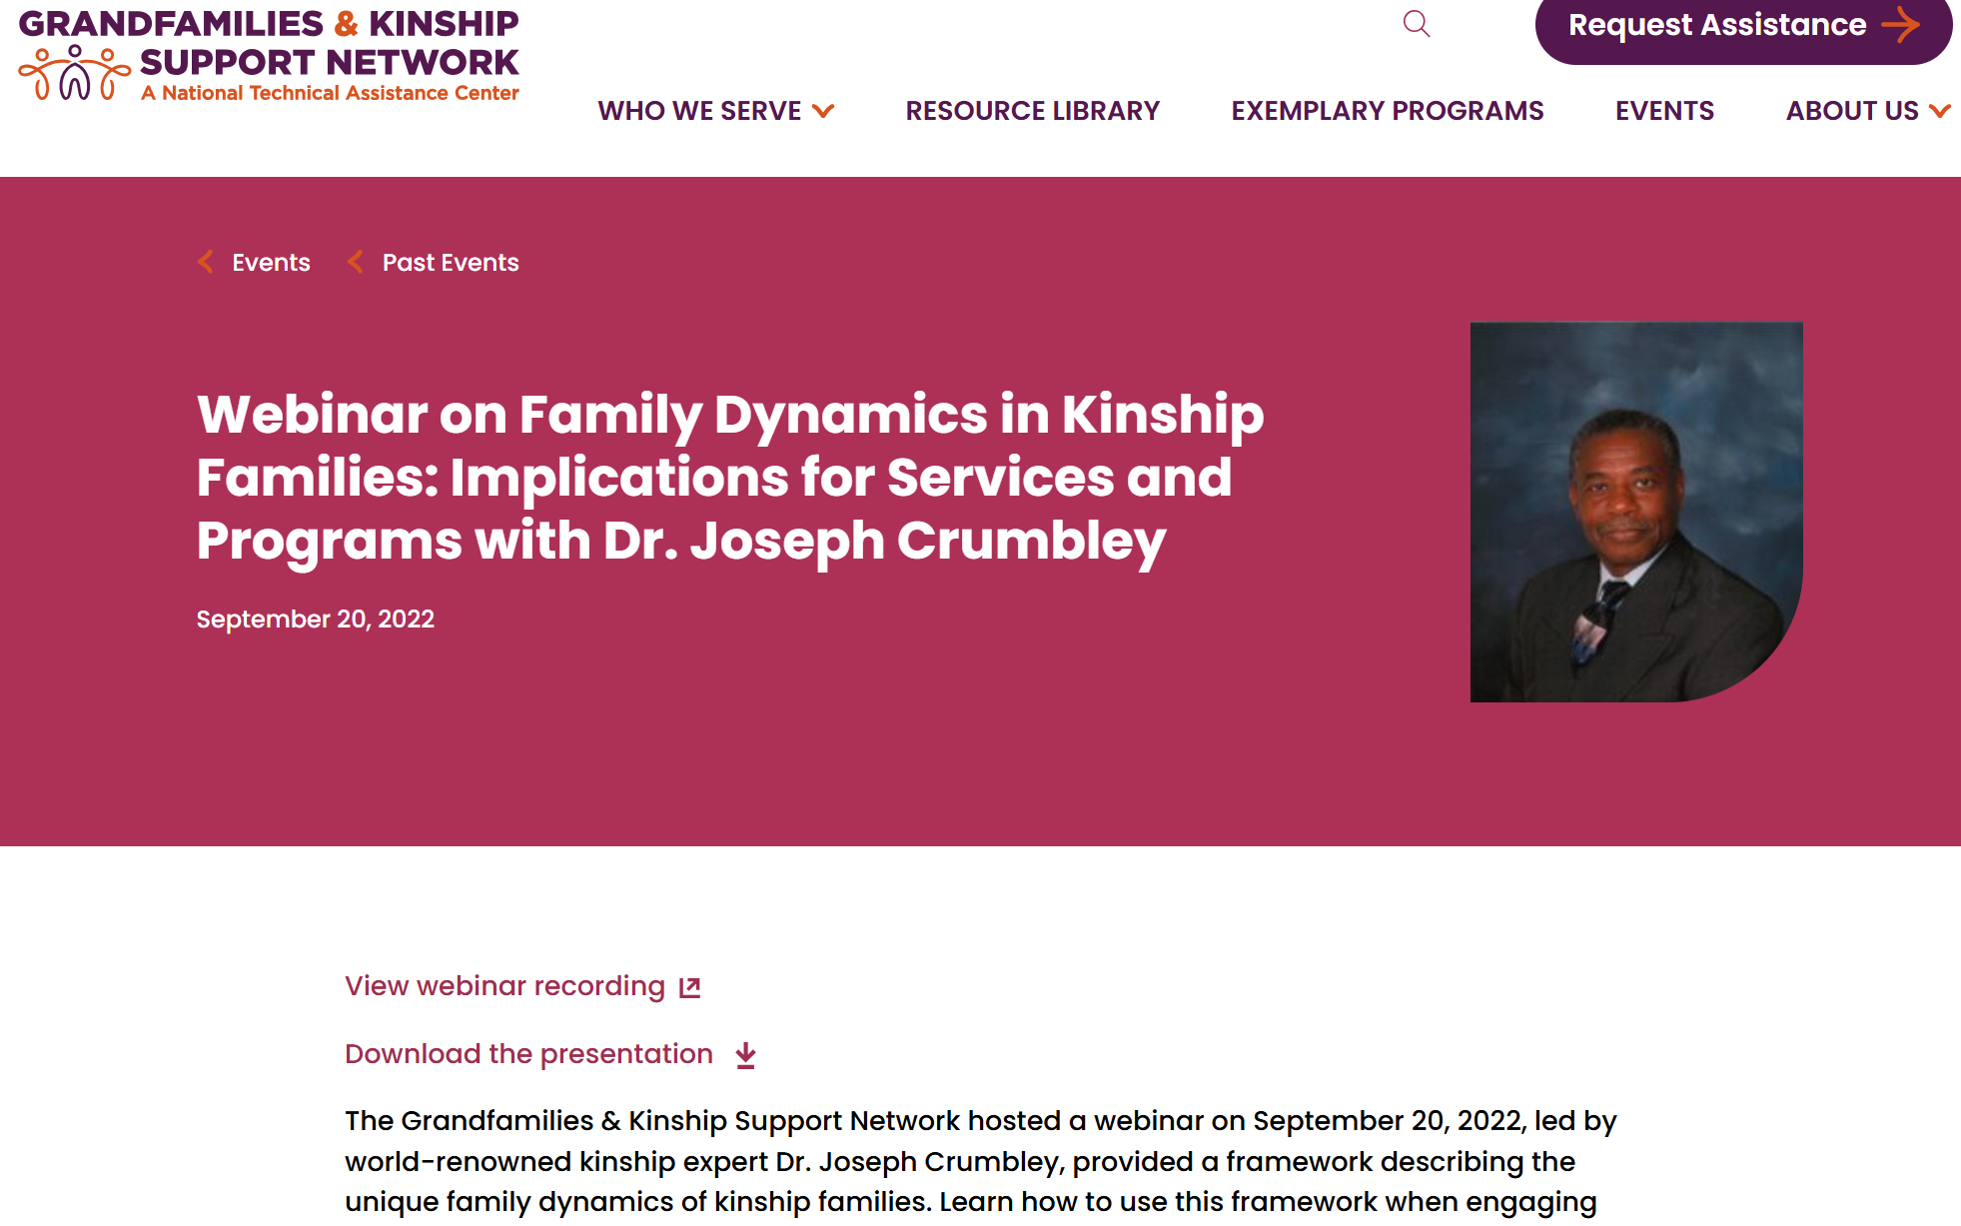
Webinar on Family Dynamics in Kinship Families
www.gksnetwork.org/events/webinar-on-family-dynamics-in-kinship-families/

Slide 6
Challenges and Solutions
Challenges | Solutions
Myths and assumptions, e.g., “the apple doesn’t fall far from the tree” | Work towards a culture shift Trainings
Unexpected responsibility of caring for additional children | Provide supports and concrete goods to meet unexpected needs
Access to accurate information Fear and mistrust of “systems” | Train kin staff Provide written materials
Unique barriers to foster care approval | Kin-specific standards!
6
Notes:
In person or in chat - In a short phrase, what’s a challenge you’ve experienced in working with a kin family?
Acknowledge/affirm comments and note that it has been time consuming to work with and license kin caregivers – work up front pays off with long-term stability and set up for kin-specific licensing going to make all of this easier.

Slide 7
Benefits of Kin-Specific Licensing
Staff save administrative time and effort that can be used for other priorities and supports
No need to obtain waivers for non-safety licensing standards
Easier Interstate Compact on the Placement of Children (ICPC) Process
100% equitable support for kin caregivers with placement
No more unsupported placements
More kin placements
More kin guardianship

Slide 8

How We
Got Here

Slide 9
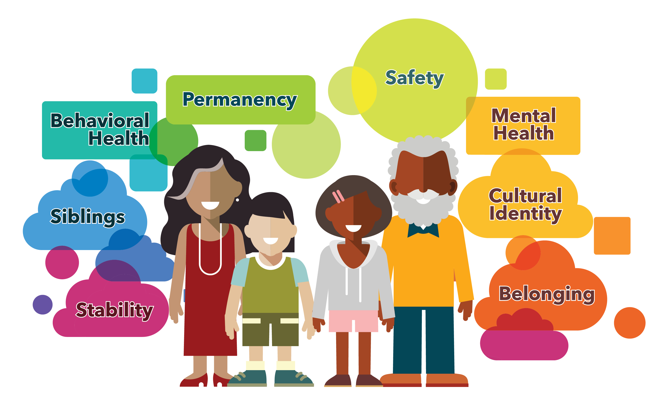
Kinship Strengths: Children Thrive
See: www.gu.org/resources/children-thrive-in-grandfamilies/ and www.gksnetwork.org/resources/grandfamilies-kinship-families-strengths-challenges/

Slide 10
Kinship Families Improve Outcomes For Children
Improved Placement Stability
Higher Levels of Permanency
Decreased Behavior Problems
Children placed into kinship families had fewer behavioral problems three years after placement than children who were placed into foster care.
Being placed in a kinship family has been found to decrease the risk of disruption.
33% of the children adopted from foster care are adopted by relatives; 11% of children exit to guardianship (AFCARS, 2022)
Children initially placed in kinship families as compared to family foster care were more likely to reunify or exit to guardianship.
See: www.gu.org/resources/children-thrive-in-grandfamilies/
10

Slide 11
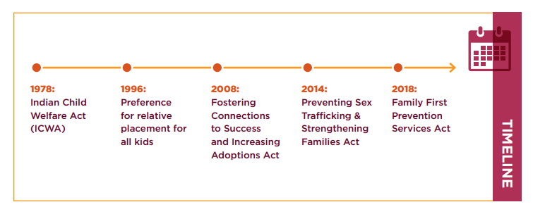
Decades of Federal Law Affirming the Importance of Kinship Care
11
Notes:
Also mention Supporting America’s Children by Strengthening Families Act, which was signed into law in January 2025.

Slide 12
Quote 1
Known as "child-only" cases…the largest group is children being raised by grandparents or other relatives because their parents are in jail, are on drugs or have lost custody as a result of abuse or neglect.”
Washington Post article from 1999–
Referring to “Country Club Grandmothers”
Notes:
25 years ago, major new outlets that like the Washington Post, and NPR were portraying these families – as lost generations, and asking if children were worse off going to kin.

Slide 13
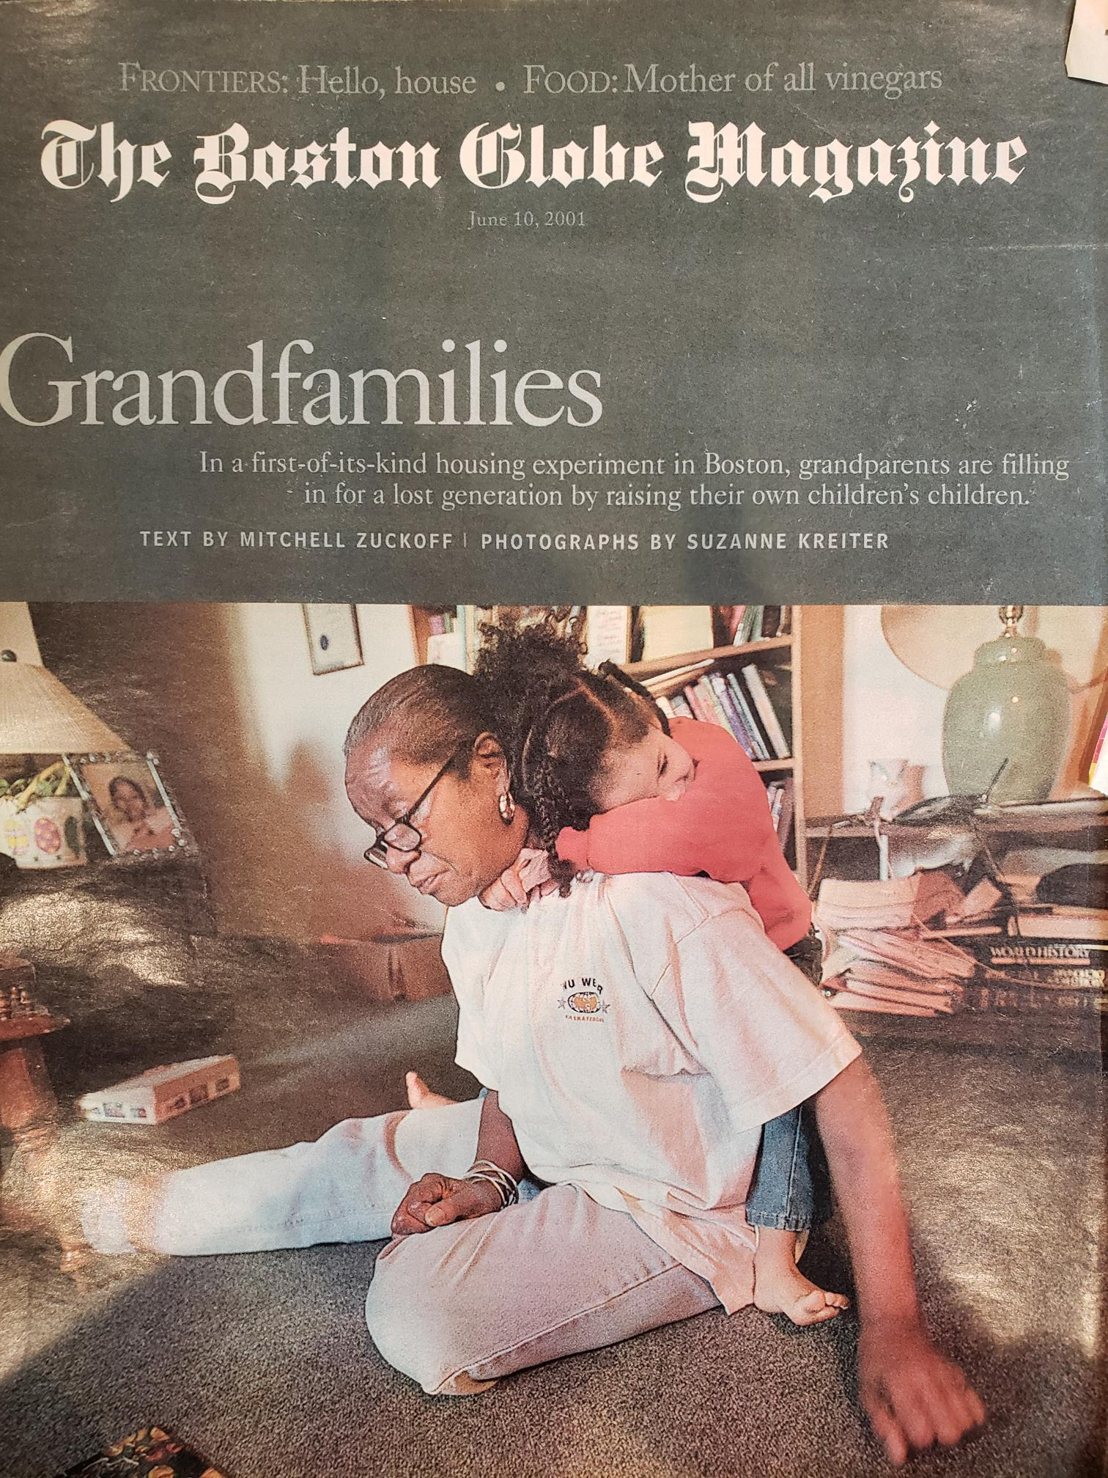
“lost generation”
Boston Globe - 2001

Slide 14
Quote 2
Is kinship care better than traditional foster care? Or worse?”
National Public Radio - 2001

Slide 15

Jamie Foxx quote
Any – emotional gaps, spiritual gaps – my [grandparents] filled them. So, I didn't skip a beat. I was never short on the love of a mother and father though it came from an earlier generation of family.”
Jamie Foxx
Notes:
Celebrities, in addition to the research, federal law, real stories, started to move the dial towards acknowledging that kinship care is a positive thing.

Slide 16
Grand Successes
16
Notes:
Use the Generations United “Grand Successes” publication at www.gu.org/resources/grand-successes-stories-of-lives-well-lived/
and/or search for celebrities or politicians or notable people raised by their grandparents to find individuals with a connection to your state to highlight on this slide

Slide 17
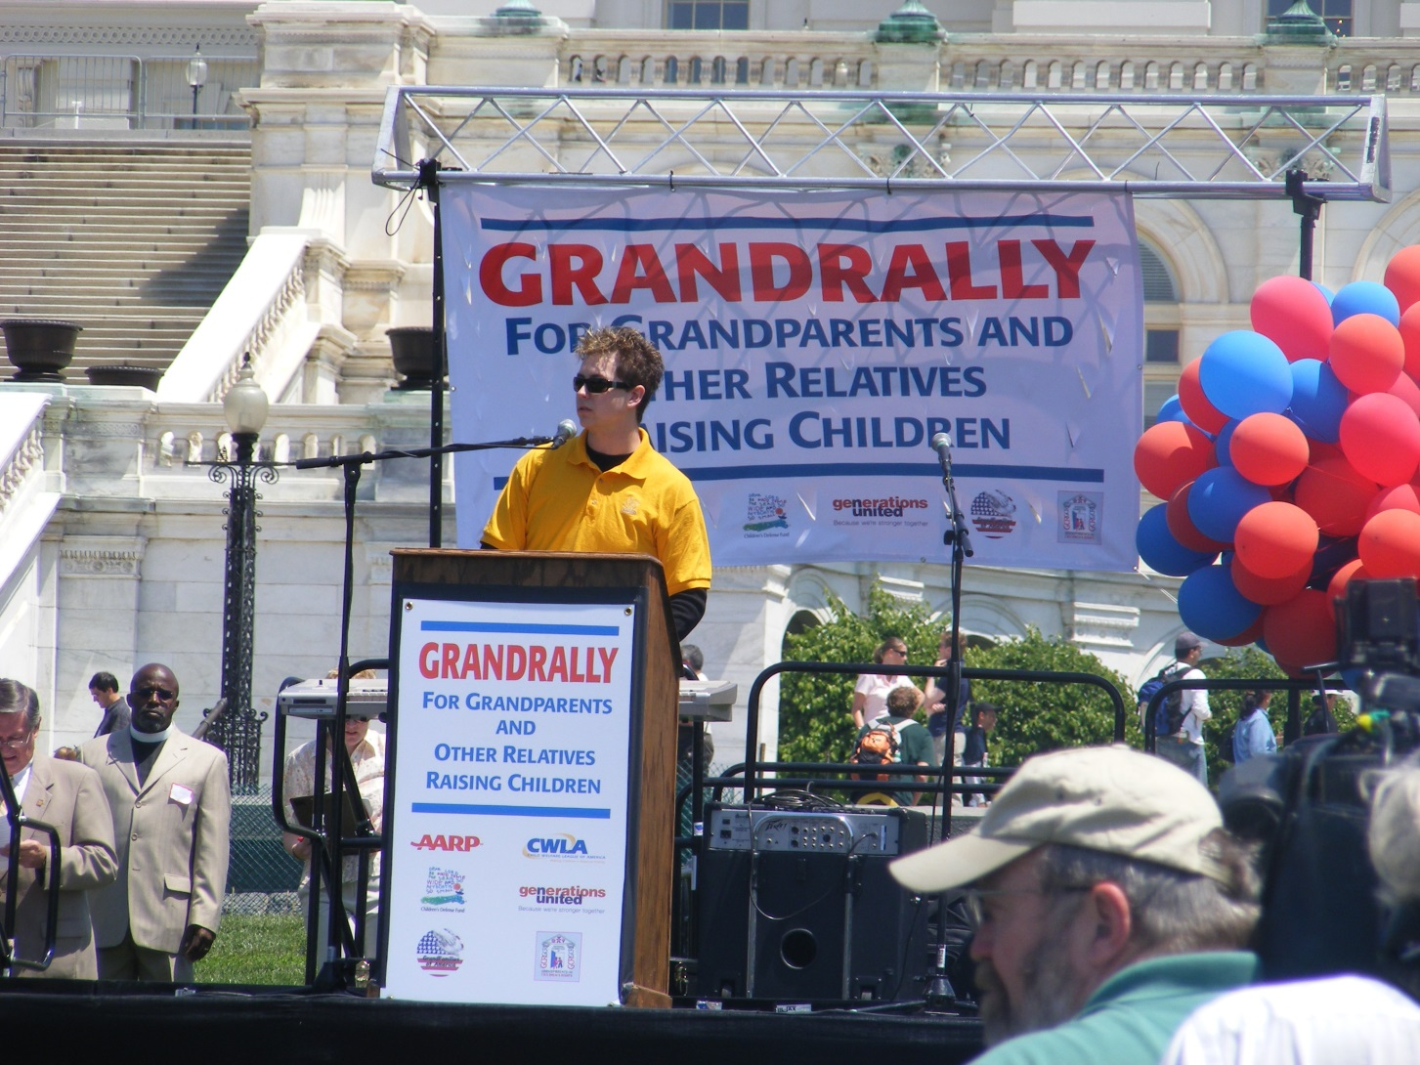

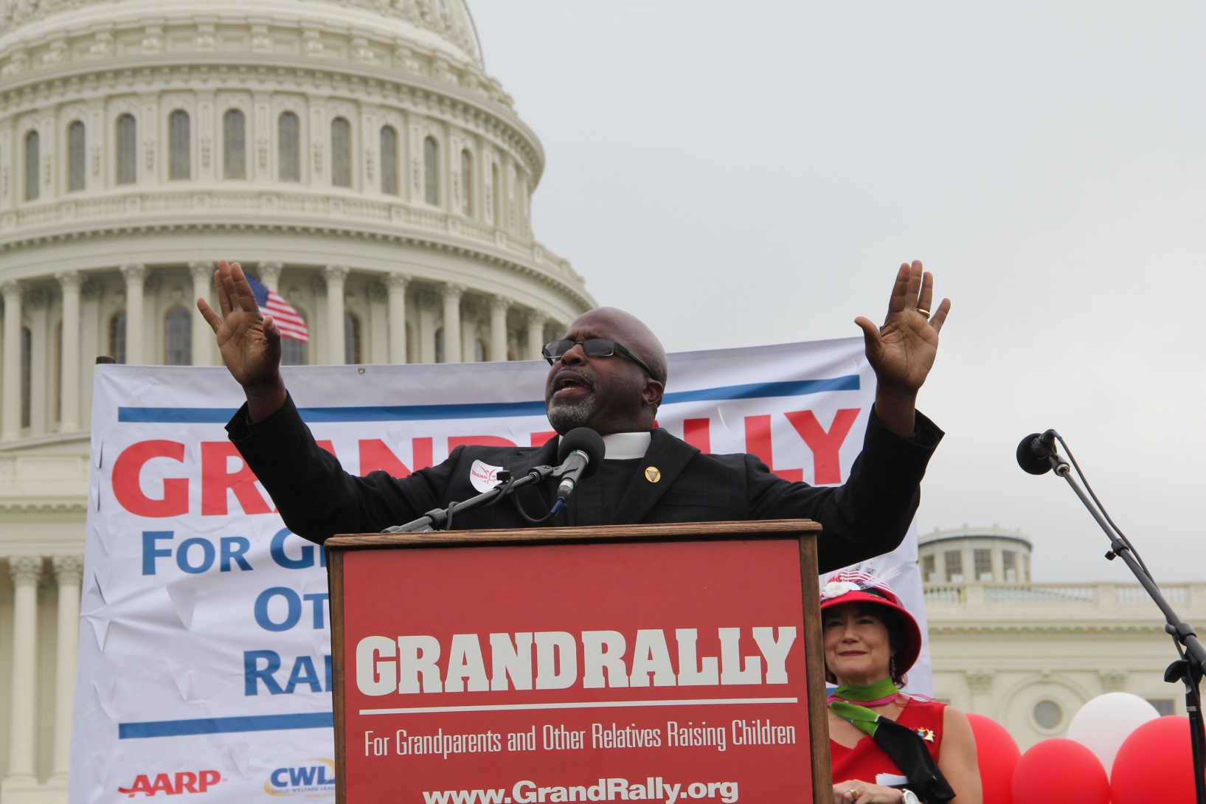
5 GRANDRALLIES – 2003 - 2017
Notes:
GrandRallies at the Nation’s Capital with kin caregivers raising their voices made a tremendous impact – several of those federal laws we mentioned earlier came after a GrandRally.

Slide 18
Sarah Smalls quote
Initially, my three grandchildren were scattered in various states. It was my husband and I’s goal to get all of our grandchildren together…We accomplished that. I think the joy for me was when I would go into their rooms at night and they were all sleeping peacefully and they were safe.”
GRAND Voice Sarah Smalls to NBC News, 2021
“When Black children are raised by relatives, resources are hard to find“
Notes:
Now – the media is talking to the caregivers, listening to them, and the discussion has shifted to how to help them meet the needs of the children.

Slide 19
Public Support
Harris National Poll
90% of Americans agree that child welfare agencies:
should identify extended family members to take in children before resorting to foster care with somebody the child doesn’t already know
should provide extended family members with similar supports and resources as provided to other foster parents

Slide 20

Ashley
Ashley is 7 years old. She and her 3 siblings are no longer able to live with their parents.
All four children were removed from their home and placed in the custody of the state.
Ashley enjoys playing with doll houses and is artistic. She especially loves painting!
Two days after she’s removed from her parents’ home, Ashley celebrates her 8th birthday.
20
Notes:
Virtually –walk through it and use the chat.
In person – could be done as 10-15 minute break-outs with discussion questions (see notes on slide 22)

Slide 21

Home 1 - Birthday
Ashley is placed in a non-kin foster home. She is placed with one of her sisters, but her other two siblings go to a foster home across town.
On the morning of her birthday, Ashley’s foster mom has a birthday breakfast of donuts waiting, the same special breakfast the foster family eats for all the children’s birthdays. The whole family sings happy birthday.
There are three presents for Ashley, which her foster mom went out and shopped for late the night before, hoping Ashley would like them.
Ashley’s foster mom reached out to the caseworker to arrange a visit with her two siblings. After school, they drive 45 minutes to meet at a supervised visit location. Ashley’s foster mom picks up a cake and all four children are together briefly while Ashley blows out her candles.
21

Slide 22

Home 2 - Birthday
Ashley and her three siblings are placed with their maternal aunt, Tonya.
The aunt knows that Ashley’s favorite breakfast food is pancakes and has them ready for her before school. She also sings happy birthday, but it’s the special family version of happy birthday that Ashley’s mom usually sings to her.
Ashley’s aunt tells Ashley about the day she was born; she pulls out photos from when Ashley was a baby, recalling how her eyes and lips favor her mom.
Tonya knows her niece loves to paint and even has two paintings she made last school year hung up on the fridge. Tonya told the caseworker that Ashley is interested in painting, and the caseworker was able to bring over art supplies from the agency’s gift closet.
After school, some of Ashley’s cousins and grandparents come over to see her. They celebrate with a cookout where the siblings and cousins all have a chance to play and be together.
22
Notes:
What is the difference between these situations?
What small and big differences do you recognize that may have made the birthday harder or easier for Ashley?
In both situations, Ashley misses her mom and is experiencing the trauma of grief & loss. In both situations she has a caregiver who cares about her wellbeing, and in both situations she is able to have a visit/be with her siblings. However, in the situation with her maternal aunt, there are familial connections such as knowing what she likes to eat, having photos available, and knowing her hobbies and interests. She is able to see extended family members and carry on family birthday traditions. A sense of belonging is linked to child well-being/mental health. Tangible benefits for sense of belonging, healthy attachment.
If doing the training in person, invite groups to share- start with volunteers or call on people –tell us ONE thing your group came up with for each question.
Ask remaining groups if they have anything to add that hasn’t been said.

Slide 23
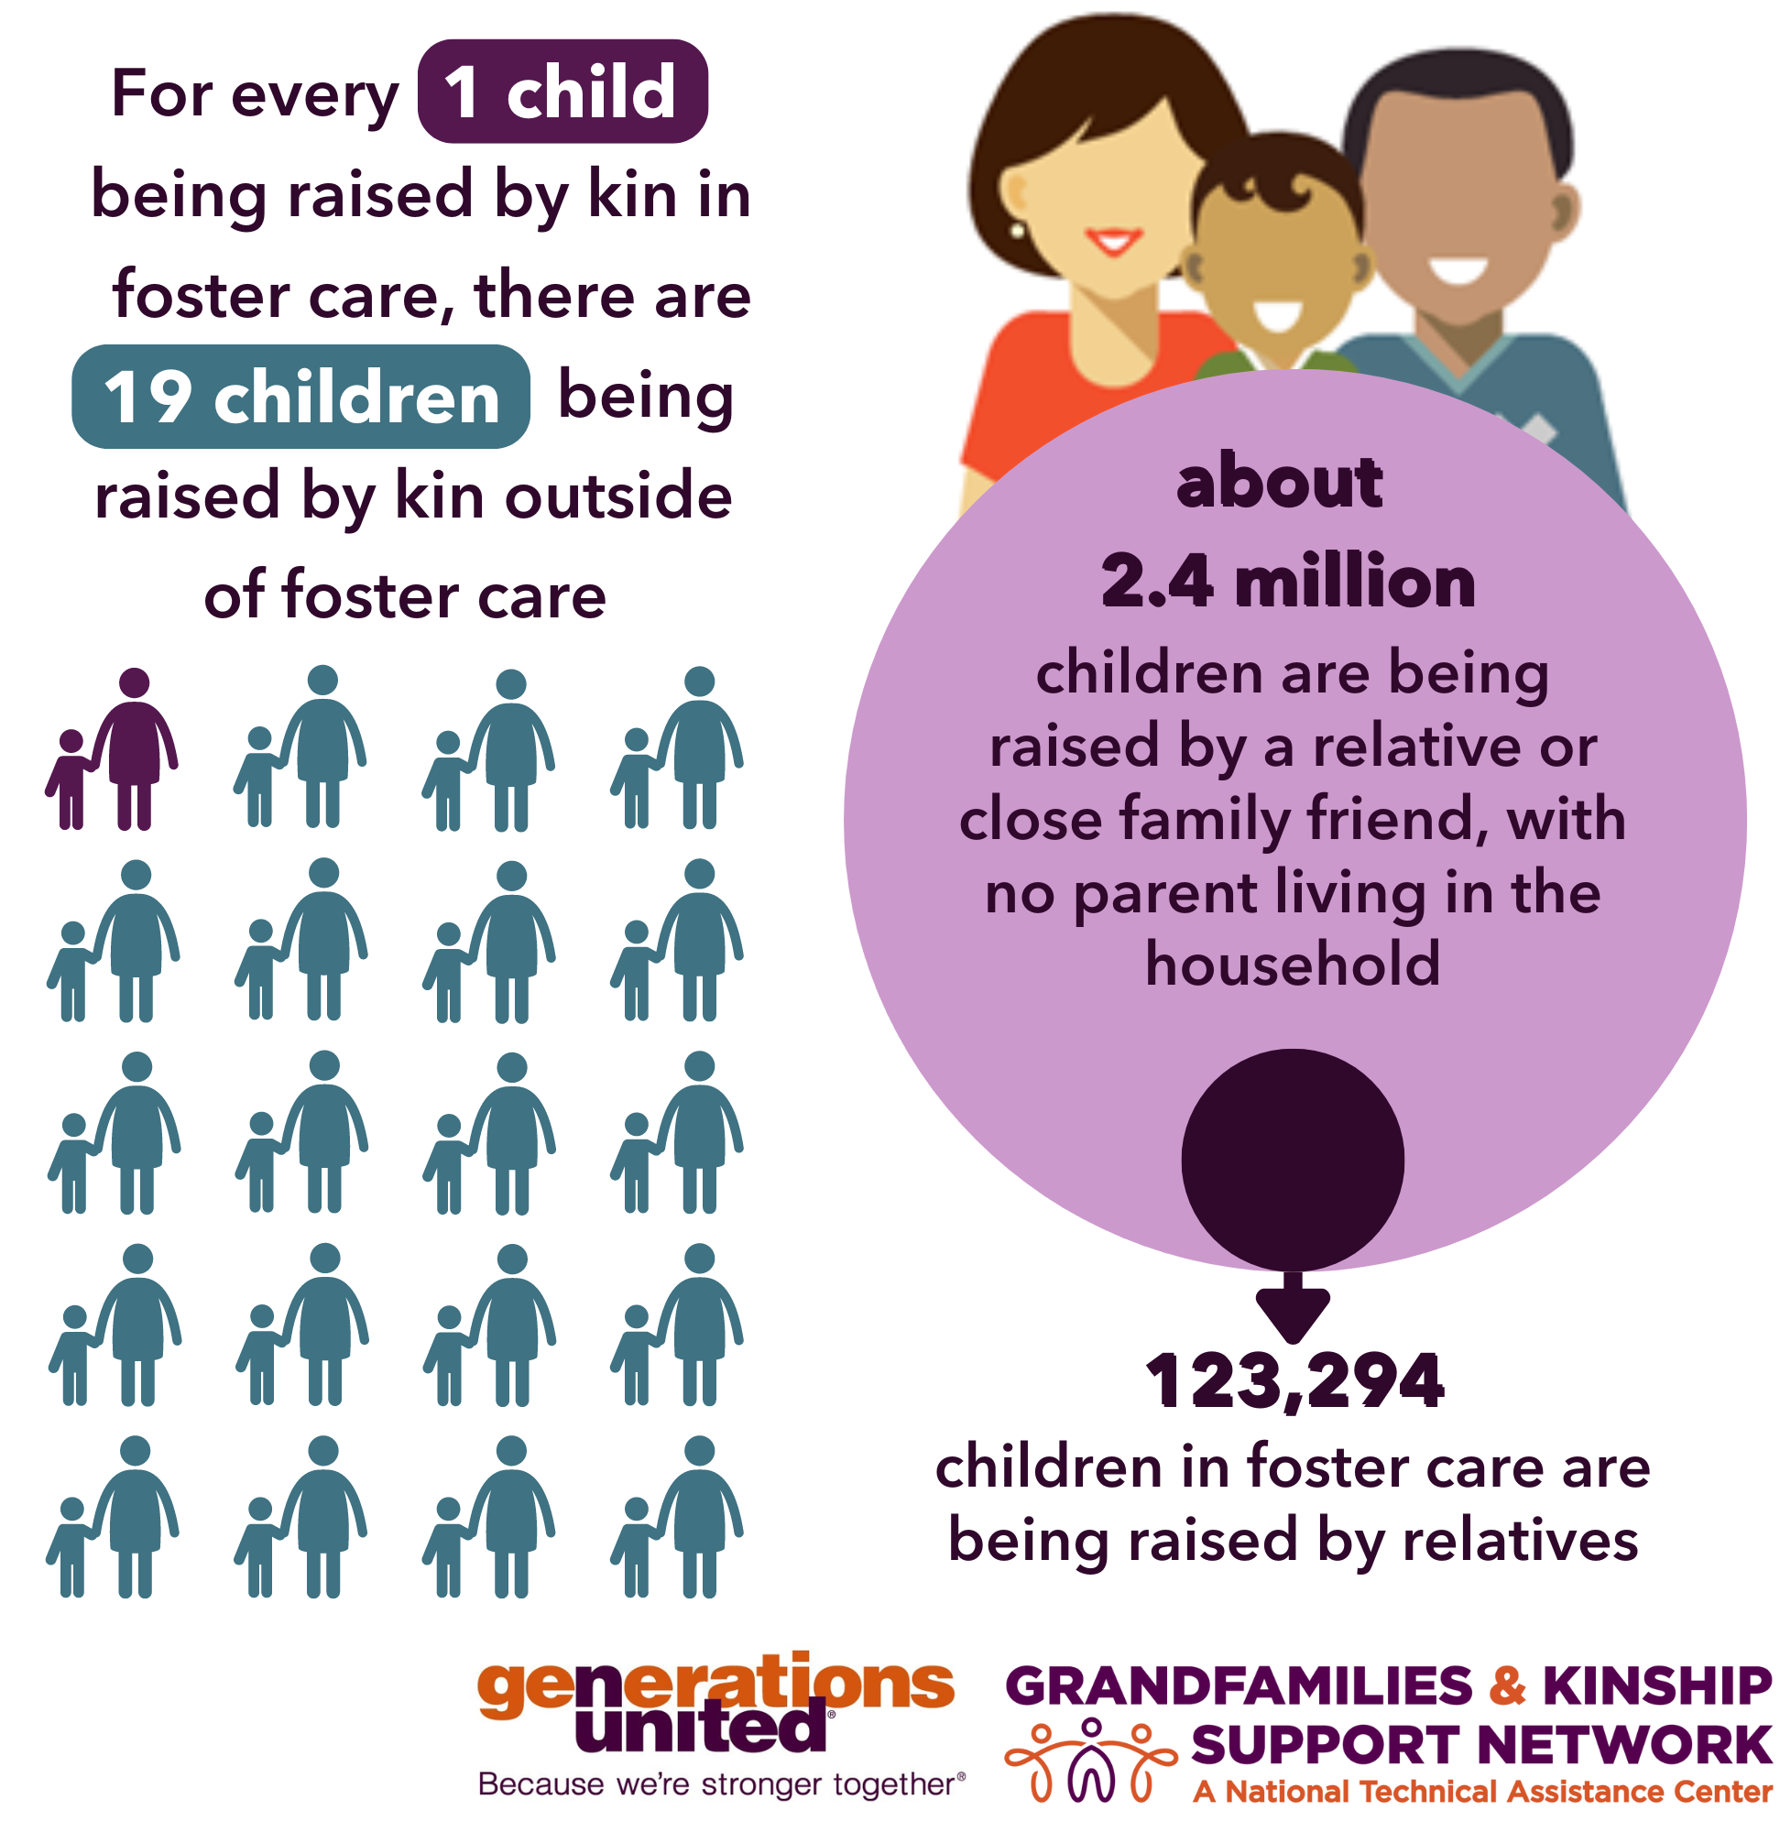
Children in Kinship/ Grandfamilies
See: www.gksnetwork.org/resources/grandfamilies-kinship-families-strengths-challenges/ and www.gksnetwork.org/kinship-data/
Notes:
These are National statistics.
States/tribes may want to make the data specific to you. The Network can help.

Slide 24
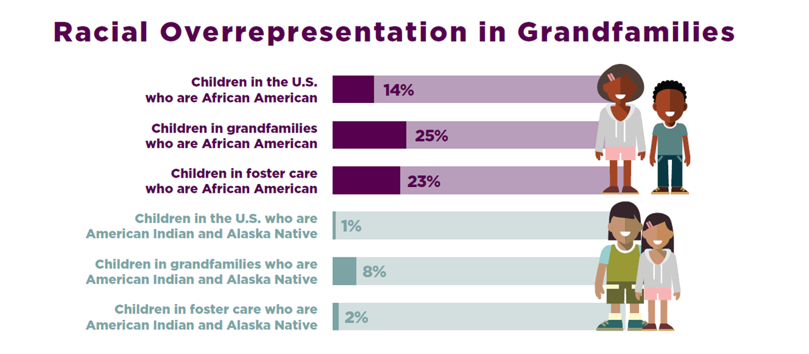
Racial Overrepresentation in Grandfamilies
Latino, Asian, and white children are not overrepresented in grandfamilies without parents in the home – they are either equally or more likely to live in parent-headed homes.
However, Latino, Asian, and Black children are more likely to live in multigenerational households than white children.
See: www.gksnetwork.org/resources/grandfamilies-kinship-families-strengths-challenges/ and www.gksnetwork.org/kinship-data/
Notes:
For this slide, it is important to emphasize that this overrepresentation is a result of policy decisions, not a reflection of characteristics of these groups.

Slide 25
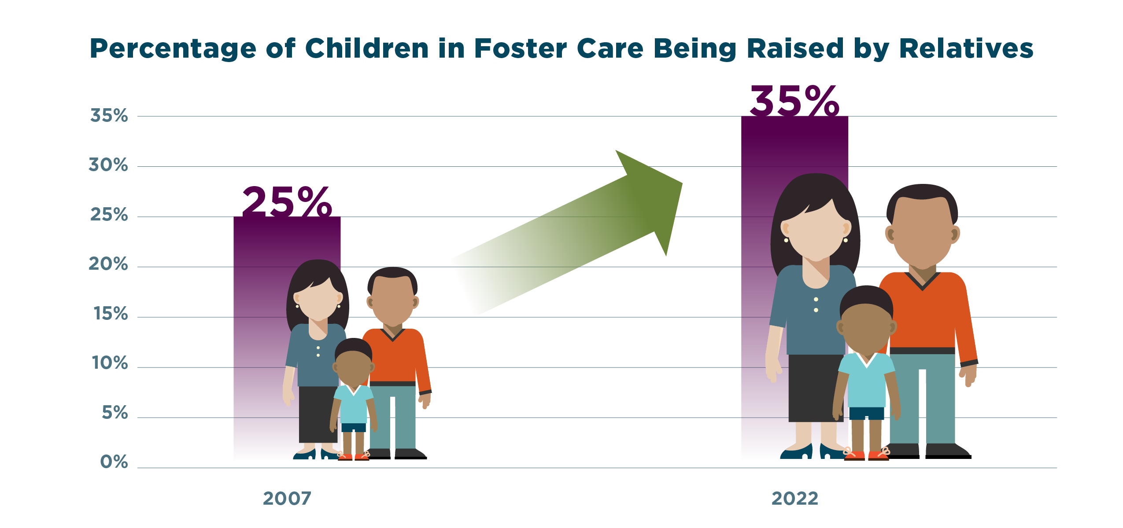
Percentage of Children in Foster Care Being Raised by Relatives
This data does not distinguish between children in licensed/approved foster homes and those who are in unlicensed homes. The majority of these children are in unlicensed/unsupported homes.
See: www.gksnetwork.org/resources/grandfamilies-kinship-families-strengths-challenges/ and www.gksnetwork.org/kinship-data/

Slide 26
Why Unlicensed/Unsupported?
Federal rule required foster home licensing standards to be the same for relatives and non-relatives
Agencies could make case-by-case exceptions for non-safety standards
Nationally, most kin caregivers were unlicensed; they had placement of children but no financial support or less financial support than non-kin foster homes
Prevented kin placement in some places
“Case-by-case” requirement for waivers meant more time and higher caseloads
Ultimately, agencies couldn’t implement fully supported kin-specific approval without an update to the federal rule

Slide 27
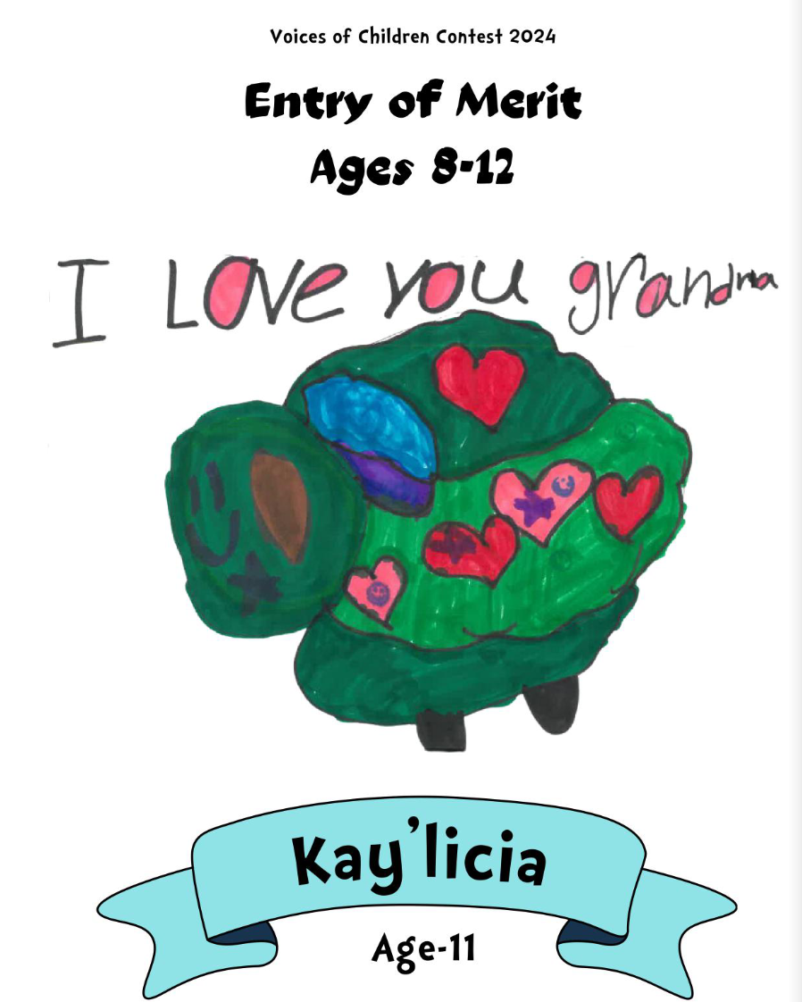
Financial Support for Kin

Slide 28
National – Support Comparison
Outside the Foster Care System or Outside Licensed Kinship Foster Care Temporary Assistance for Needy Families (TANF) “Child-Only” Grants | Licensed Kinship Foster Care Foster Care Maintenance Payments | Guardianship Assistance and Adoption Assistance for Eligible Children Exiting Foster Care
One Child $ 328 /month average Must apply for Medicaid separately or Automatic Medicaid with a TANF child-only grant | One Child $ 915 /month average Automatic Medicaid | One Child Up to $ 915 /month average Automatic Medicaid
Two Children $ 447 /month average Must apply for Medicaid separately or Automatic Medicaid with a TANF child-only grant | Two Children $ 1830 /month average Automatic Medicaid | Two Children Up to $ 1830 /month average Automatic Medicaid
Three Children $ 555 /month average Must apply for Medicaid separately or Automatic Medicaid with a TANF child-only grant | Three Children $ 2745 /month average Automatic Medicaid | Three Children Up to $ 2745 /month average Automatic Medicaid
Source: Child Trends using public data sources
Notes:
Here’s we have national averages.
You can use the template on the next slide to complete this chart with your state, territory or tribal name and dollar amounts. For Medicaid and TANF, pick which option is appliable to your area.
During your training, feel free to use both national and your jurisdiction or just one.

Slide 29
Insert Name of State – Support Comparison
Outside the Foster Care System or Outside Licensed Kinship Foster Care Temporary Assistance for Needy Families (TANF) “Child-Only” Grants | Licensed Kinship Foster Care Foster Care Maintenance Payments | Guardianship Assistance and Adoption Assistance for Eligible Children Exiting Foster Care
One Child $ /month average Must apply for Medicaid separately or Automatic Medicaid with a TANF child-only grant | One Child $ /month average Automatic Medicaid | One Child Up to $ /month average Automatic Medicaid
Two Children $ /month average Must apply for Medicaid separately or Automatic Medicaid with a TANF child-only grant | Two Children $ /month average Automatic Medicaid | Two Children Up to $ /month average Automatic Medicaid
Three Children $ /month average Must apply for Medicaid separately or Automatic Medicaid with a TANF child-only grant | Three Children $ /month average Automatic Medicaid | Three Children Up to $ /month average Automatic Medicaid
Notes:
You can use this template you can complete with your state, territory or tribal name and dollar amounts. For Medicaid and TANF, pick which option is appliable to your area. If you need help gathering the data, please contact info@gksnetwork.org

Slide 30
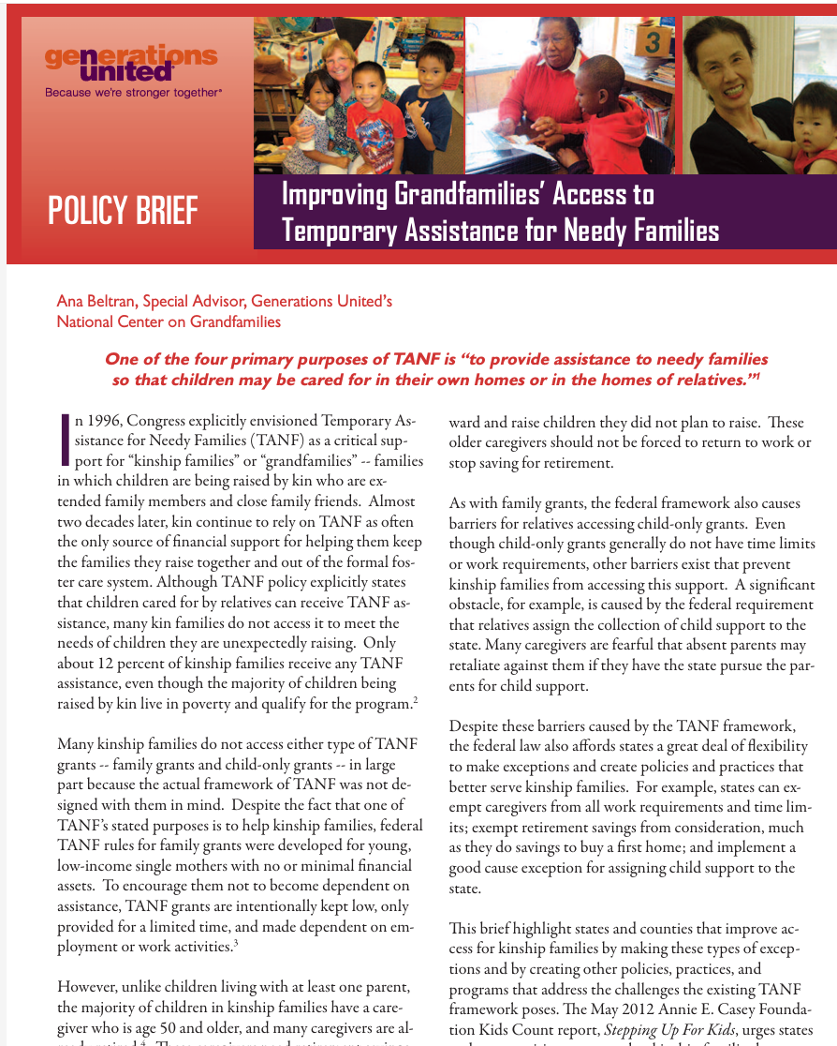
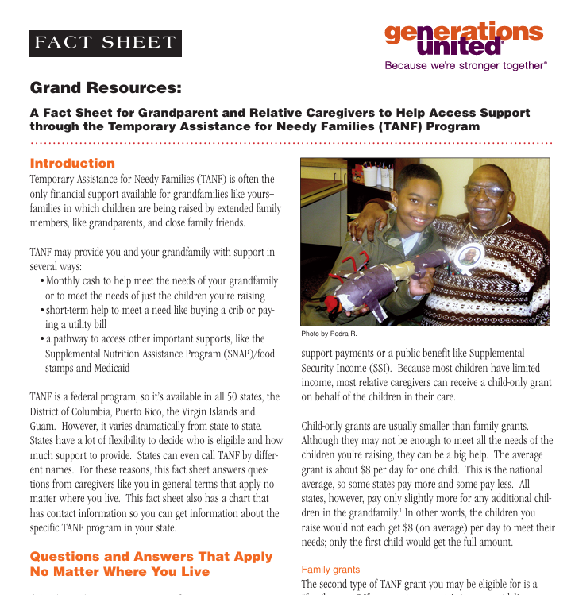
TANF Resources
www.gu.org
Notes:
There two resources from Generations United about TANF that may be helpful.
1st is a fact sheet to help families know what questions to ask at the TANF agency to get the help they need.
2nd has information about the “good cause” exemption.

Slide 31
Poll 2 – Foster Care
Maintenance Payments
What do foster care maintenance payments pay for? (Check all that apply.)
  Food
  Clothing
  Shelter
  Childcare/education
  Transportation
  Everything else – toothbrush/toothpaste, hair cuts, piano lessons, sports, video games, school supplies
  Pay caregivers for their time and effort
  All of the above
31
Notes:
Can do virtually or in person.
Answer does not include “pay caregivers for their time and effort,” so all of the above is incorrect.
Point here is that we’re not “paying” caregivers – we’re supporting children with their needs.
These aren't even "payments" -- they're reimbursements for expenses.
They're not taxed as income, because they're not income.
Virtually – poll.
In person – raise hand, shout out, and someone writes on white board/paper.

Slide 32
Quote 3
The term “foster care maintenance payments” means payments to cover the cost of (and the cost of providing) food, clothing, shelter, daily supervision, school supplies, a child’s personal incidentals, liability insurance with respect to a child, reasonable travel to the child’s home for visitation, and reasonable travel for the child to remain in the school in which the child is enrolled at the time of placement.”
42 USC 675(4)
Notes:
This comes straight from the law- payments are to cover costs

Slide 33

Cost of Raising a Child
See: www.washingtonpost.com/business/interactive/2022/cost-raising-child-calculator/
Notes:
Point here is that we’re not “paying” caregivers – we’re supporting children with their needs.

Slide 34
Additional Benefits for Kinship Families Exiting Foster Care
Pathway to ongoing Guardianship Assistance Payments (GAP) – must be caring for the kin child and licensed for 6 months prior to exiting foster care
Pathway to Adoption Assistance - only available to children who have been in foster care - although unlike GAP, the relative doesn’t have to be licensed as a foster parent
College/Tuition Assistance if age out of foster care
Considered “independent” for purposes of additional college financial aid if in foster care any time after age 13

Slide 35
Additional Considerations for Children Who Are Adopted by Their Kin
Benefits Available to Children who have been adopted privately or from foster care:
  Veterans Benefits
  Social Security Based on Caregiver (not just birth parent)
Not “independent” for purposes of college financial aid – adoptive parents income considered (unless adopted from foster care after age 13)

Slide 36

Supporting Kin Through Foster Care Licensing
Notes:
This section is with a national audience in mind – depending on your state and tribe and how far there are in the process to take up kin-specific standards, you may want to modify these or it may be most helpful to have a national overview if delivering this training to others.

Slide 37
Key Steps to Creating a Kin-First Culture
Lead with a kin-first philosophy
Develop written policies and protocols that reflect equity for children with kin and recognize their unique circumstances
Identify and engage kin for children at every step
Create a sense of urgency for making the first placement a kin placement
Make licensing kin a priority
Support permanent families for children
Create a strong community network to support kin families
Source: www.grandfamilies.org/wikiHow-for-Kinship-Foster-Care
37

Slide 38
Step 5 – Make Licensing Kin a Priority
As of November 27, 2023, there is an amended rule giving title IV-E agencies the option to have a kin-specific licensing or approval process that recognizes the unique strengths and needs of kin caregivers.
    The rule requires title IV-E agencies to ensure that licensed or approved kin foster family homes receive the same foster care maintenance payments as non-kin foster homes.

Slide 39
What the Rule Says
Encourages title IV-E agencies to establish kin-specific standards limited to long-standing federal law that requires title IV-E agencies to:
  Conduct criminal and child abuse background checks under the federal Adam Walsh Child Protection and Safety Act. 42 U.S.C. § 671(a)(20)
  Align their standards “reasonably in accord with recommended standards of national organizations… which shall permit the use of the reasonable and prudent parenting standard” 42 U.S.C. § 671 (a)(10)(A)
Federal law has long required that title IV-E agencies create and maintain their own foster care standards, and this new rule does nothing to change that state, territorial, and tribal flexibility

Slide 40

Kin-Specific Foster Home Approval: Recommended Standards of National Organizations
Focus on federal requirements
Serve as “recommended standards of national organizations”
Developed with input from:
100+ Kin Caregivers
45 Title IV-E Agencies
Other Subject Matter Experts
Available at www.grandfamilies.org and www.gksnetwork.org
40

Slide 41
Kin-Specific Foster Home Approval:
National Nonprofit Partners
A Second Chance, Inc.
American Bar Association Center on Children and the Law
Children’s Rights
Generations United and its Grandfamilies & Kinship Support Network: A National Technical Assistance Center
National Association for Regulatory Administration (NARA)
National Indian Child Welfare Association (NICWA)
New America’s Resource Family Working Group
Think of Us

Slide 42
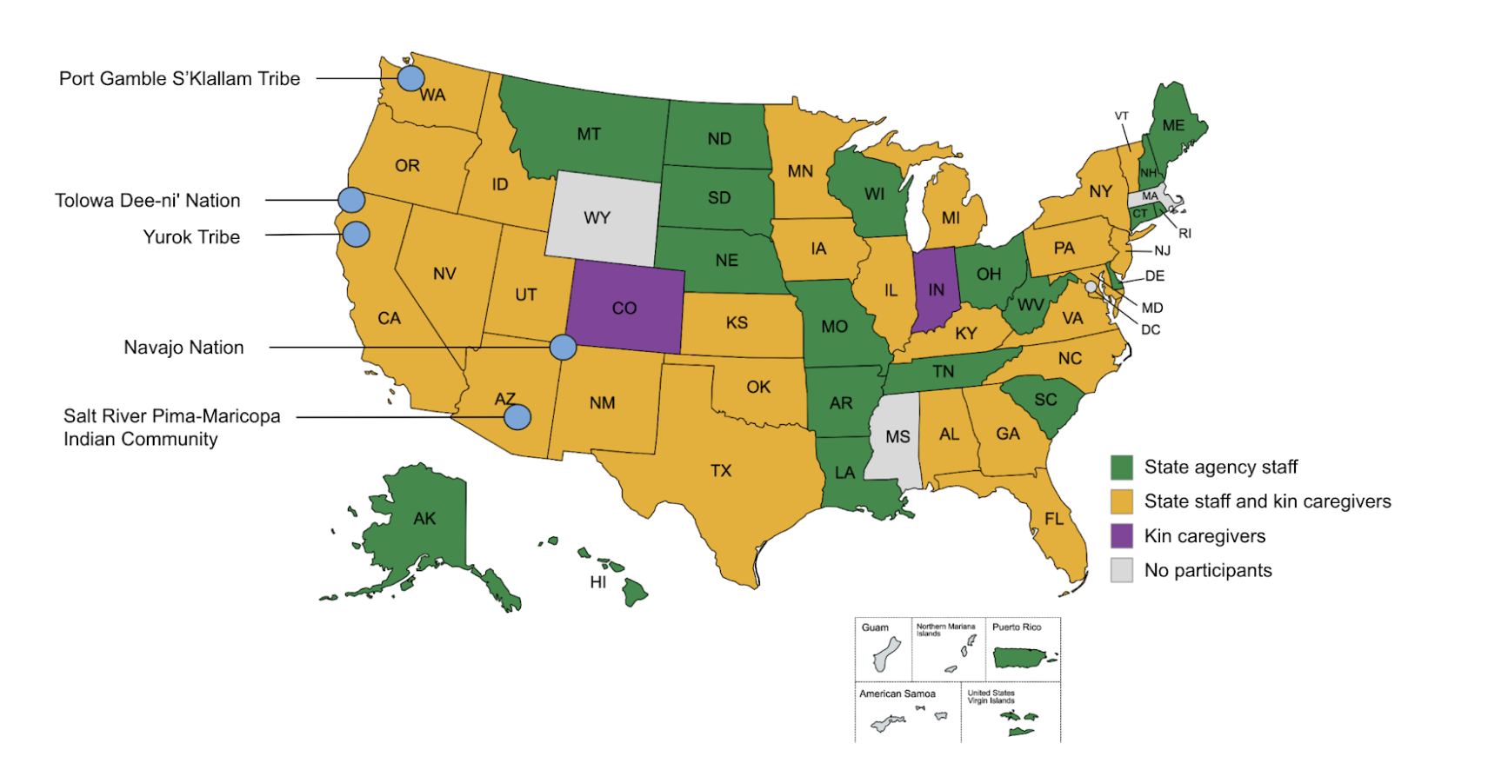
Co-Design of Standards

Slide 43
Kin-Specific Standards & Tools
Required background checks
Kin caregiver assessment
Goal: 100% approval on same day as placement with kin
The standards include implementation guidance and example template forms

Slide 44
Federal Law: Background Checks
For each kin caregiver you seek to approve:
Send fingerprints to the FBI
Check the child abuse and neglect registry of any state where that caregiver lived in the last 5 years
For each adult living in the kin caregiver’s home*:
Check the child abuse and neglect registry of any state where that adult lived in the last 5 years
42 USC 671(a)(20)
*CAPTA or Indian Child Protection and Family Violence Prevention Act may require you to fingerprint

Slide 45
Kin Standards: Background Checks
For each kin caregiver you seek to approve:
Send fingerprints to the FBI
Check the child abuse and neglect registry of any state where that caregiver lived in the last 5 years
Check sex offender registry
Conduct name-based in-state background check
For each adult living in the kin caregiver’s home*:
Check the child abuse and neglect registry of any state where that adult lived in the last 5 years
Check sex offender registry
Conduct name-based in-state
background check
*CAPTA or Indian Child Protection and Family
Violence Prevention Act may require you to fingerprint

Slide 46
Federal Barrier Crimes
Permanently disqualifying:
felony conviction for child abuse or neglect
felony conviction for spousal abuse
felony conviction for a crime against children (including child pornography)
felony conviction involving violence, including rape, sexual assault, or homicide, but not including other physical assault or battery
Disqualifying if felony conviction in the last 5 years:
physical assault
battery
a drug-related offense
42 USC 671(a)(20)

Slide 47
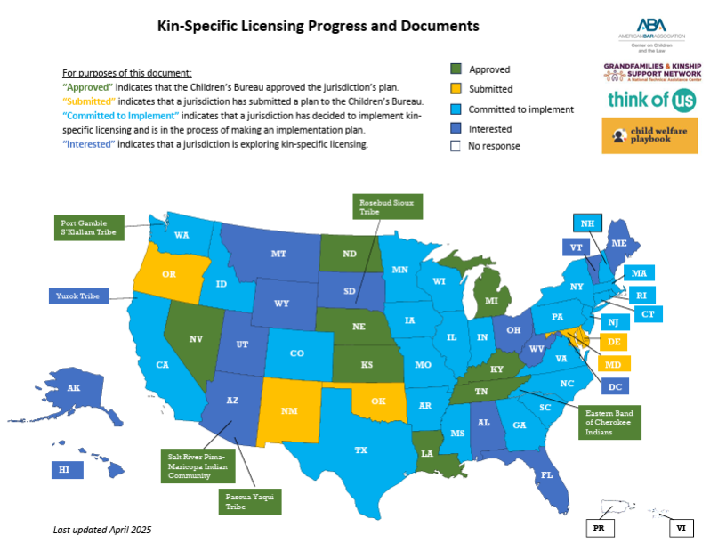
Rapid Uptake!
Available here
Notes:
For latest map, see: https://www.grandfamilies.org/Portals/0/Kin%20licensing%20map/Kin%20licensing%20progress%20map.pdf

Slide 48

Value of the Child Welfare Agency in Supporting Kin

Slide 49
Child Protection & Foster Care
You are needed! Some children and families need your protection and support.
Families should be provided with their options in a balanced way.
The families are their own best experts.
The goal is to license/approve more kin as foster parents by making that pathway more accessible – and to stop placing children in unlicensed/ unapproved homes that do not receive foster care maintenance payments.
Safe enough to place, but not safe enough to support is over!
49

Slide 50
Scenario 1
Situation
If approved/licensed as foster parent
Parent is severely mentally ill, and the child welfare agency knows it
Agency finds an aunt willing to care for child
They don’t provide options to the aunt; instead, they tell her to go to court and get legal custody – unilaterally assuming that it’s the family’s best interest
Parent no longer talks to her sister – she thinks of her as an enemy who went to court and proved to the court that she was unfit to parent
Sister caregiver and child would be financially and otherwise supported
Wouldn’t have to sue sister and prove her “unfit” – sister vs. sister in court
Parent would have access to case management, a plan, and more of a chance to reunify with the child
50
Notes:
Virtually – will share situation and then ask for what would happen if approved/licensed in chat.
In person – small break outs are given situations – the second column will be blank for them to fill out and then discuss as a group.
You can pick and choose among the situations on slides 51-53 and do the activities that best suit your jurisdiction.

Slide 51
Scenario 2
Situation
If approved/licensed as foster parent
The police are called to a family’s home and arrest the parents.
The child welfare agency comes to the home to remove the child. Grandma was called by the parents and is already there.
The agency doesn’t provide options to Grandma. They say you can take the child or we will take her and put her with a licensed foster parent.
Grandma takes her, raises her with love and care, but struggles with money to meet the child’s needs.
Parents consent to adoption, and grandma adopts. She has to find a private attorney. It depletes her retirement savings. Because she is now the parent, she can’t get TANF child-only for the child. So, no ongoing financial support.
The parents, child, and grandma would have been supported with services and foster care maintenance payments.
Services for the child would have been facilitated by a case worker.
Attempts would have been made to reunify the child with her parents.
If adoption was agreed upon, Grandma would have had legal help and the child would typically get adoption assistance until adulthood.
51

Slide 52
Scenario 3
Family comment
Response
“We don’t want to be in foster care forever.”
The child and you will not be in foster care forever. We have time frames that we have to follow.
We will try to help the parent reunify with the child.
If that’s not possible, you will typically have a path to exit foster care, with the child, to supported adoption or supported guardianship.
Neither adoption assistance nor guardianship assistance is available unless the child has been in foster care.
52
Notes:
Here are examples of what families may ask workers and responses they can give. We know some states are giving talking points to their workers and this seems to be helpful

Slide 53
Scenario 4
Family comment
Response
“I don’t need to be paid to take care of family.”
You aren’t being paid.
You are being supported to help meet the needs of the child you unexpectedly agreed to raise.
Review the uses of foster care maintenance payments.
Affirm the costs of raising a child.
We value you – we want to support you!
53

Slide 54
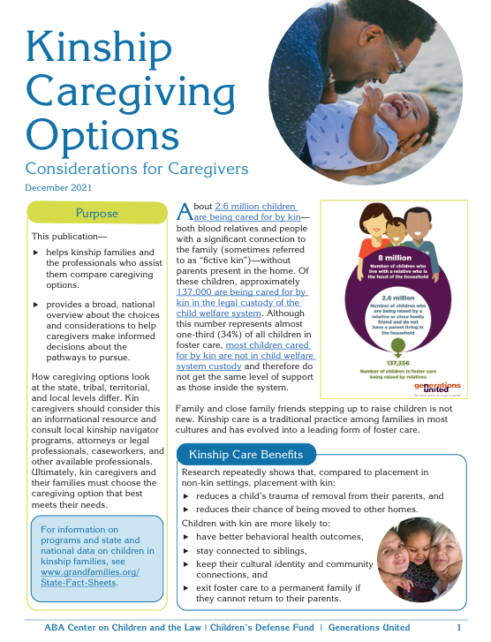
Kinship Caregiving Options
To present options to families in a balanced way, consider using this tool.
Notes:
This tool is very helpful when presenting options to families

Slide 55
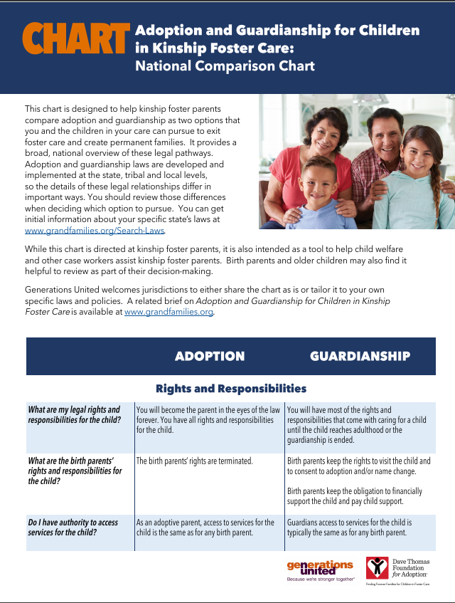
Adoption and Guardianship for Children in
Kinship Foster Care: Comparison Charts
National and state comparison charts
Each chart includes information on:
Rights and Responsibilities
Financial and Legal Assistance
Public Benefits
Health Insurance
Federal and State Tax Credits
Caregiver Successor Planning and Death Benefits for Children
College and Independent Living
www.gu.org/resources/adoption-and-guardianship-for-children-in-kinship-foster-care/
Notes:
States can replace national chart with state-specific chart - https://www.gu.org/resources/adoption-and-guardianship-for-children-in-kinship-foster-care/

Slide 56

Additional Resources

Slide 57
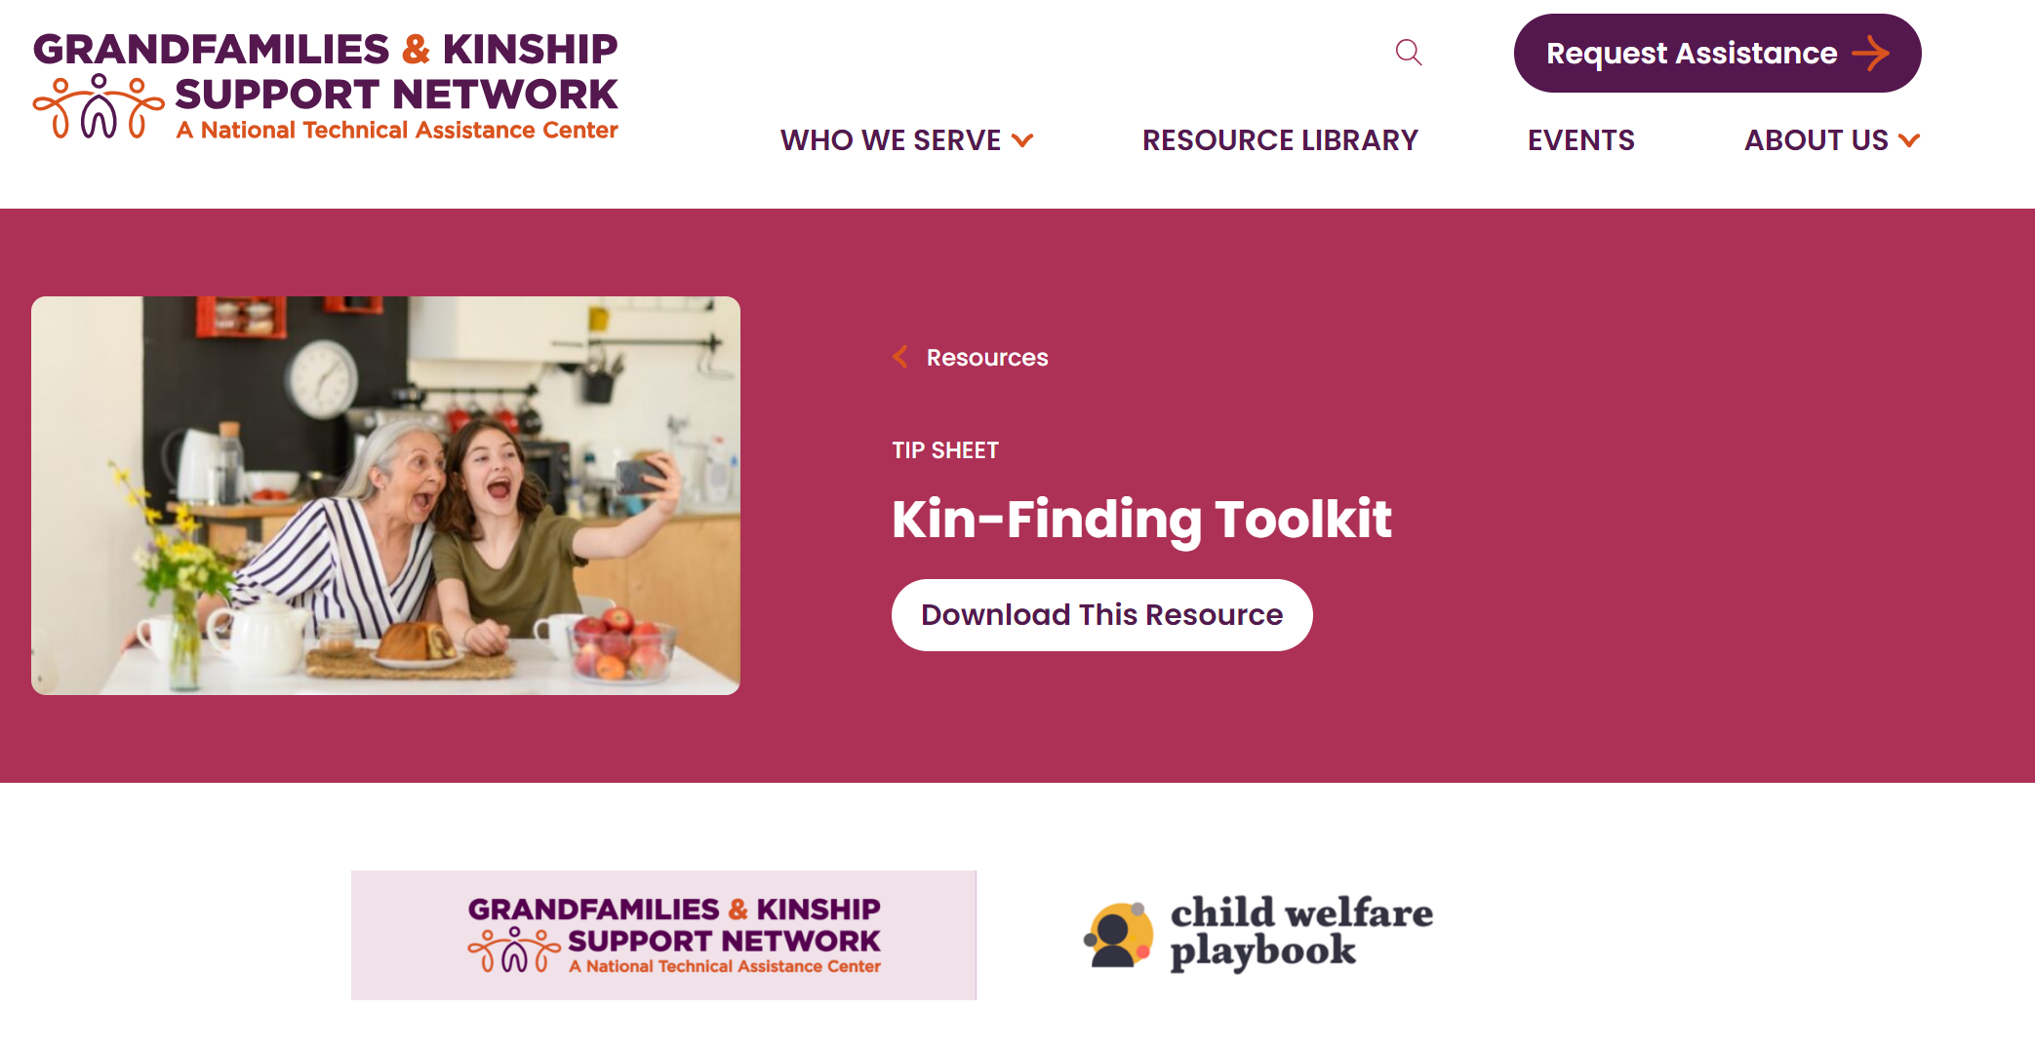
Kin-Finding Toolkit
www.gksnetwork.org/resources/kin-mobilization-learning-collaborative/

Slide 58
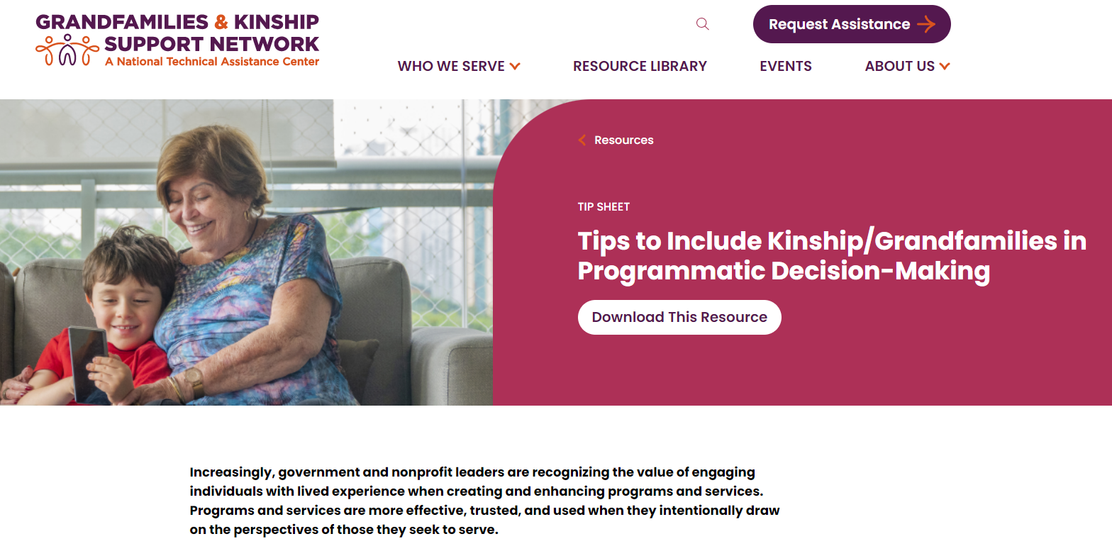
Tips to Include Kinship/Grandfamilies in Programmatic Decision-Making
www.gksnetwork.org/resources/engaging-lived-experience/
58

Slide 59

Strengthen Services & Support
Available at www.gu.org

Slide 60
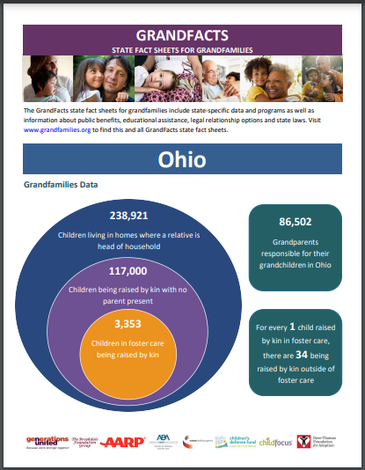
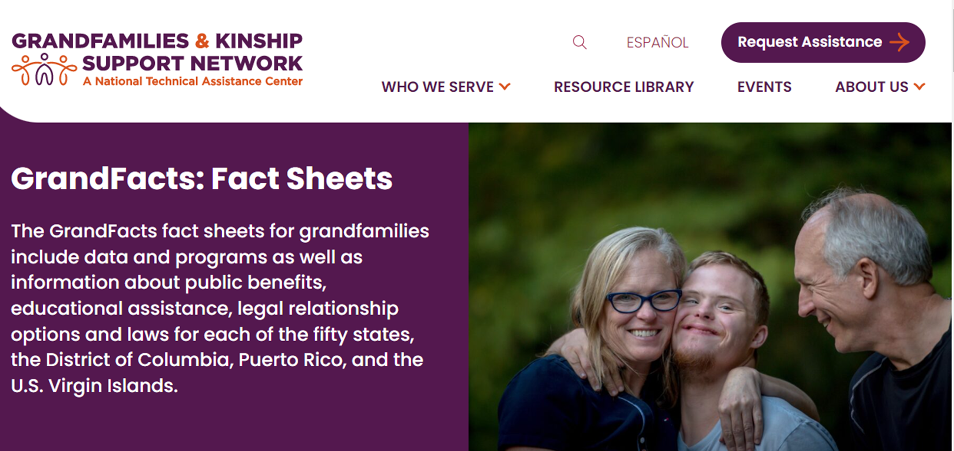
State and Tribal
GrandFacts
60
www.gksnetwork.org/grandfacts-fact-sheets/
Notes:
This sheet is full of organizations serving kinship families in the state, Puerto Rico, US Virgin Islands, and several tribes.
It can help families connect with other local community supports to access resources.

Slide 61
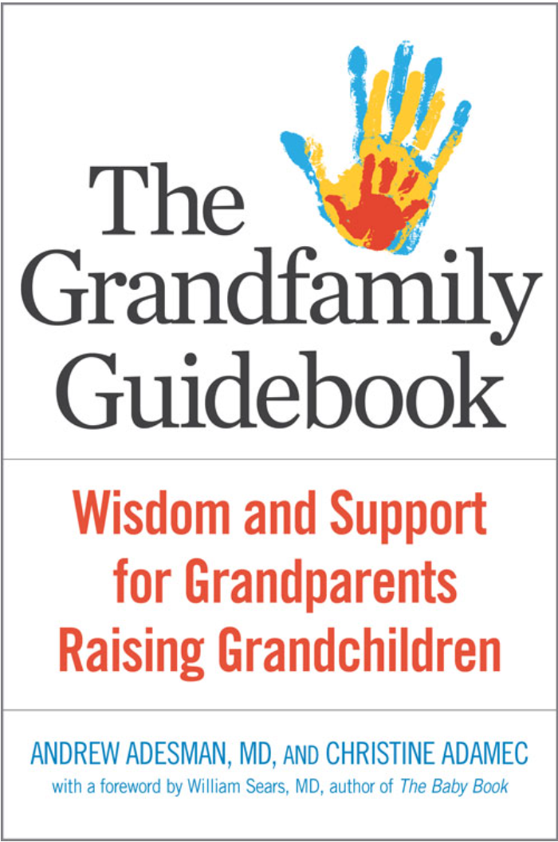

Guidebooks for Caregivers
61

Slide 62
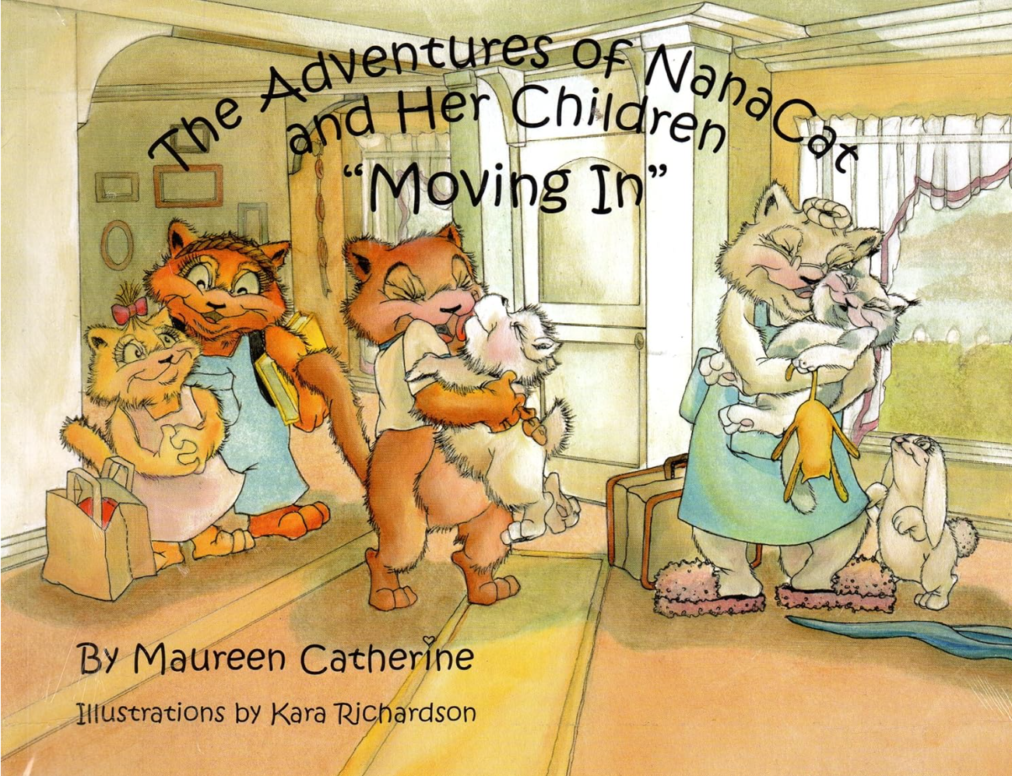
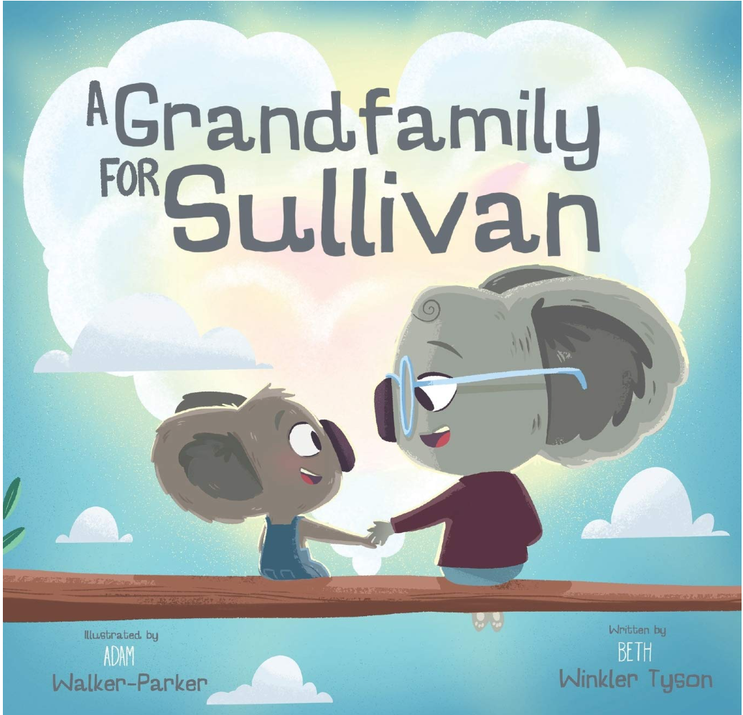

Children’s Books
62

Slide 63


Children’s Book &
Young Adult Novel
63

Slide 64
Add a slide with your website here

Slide 65
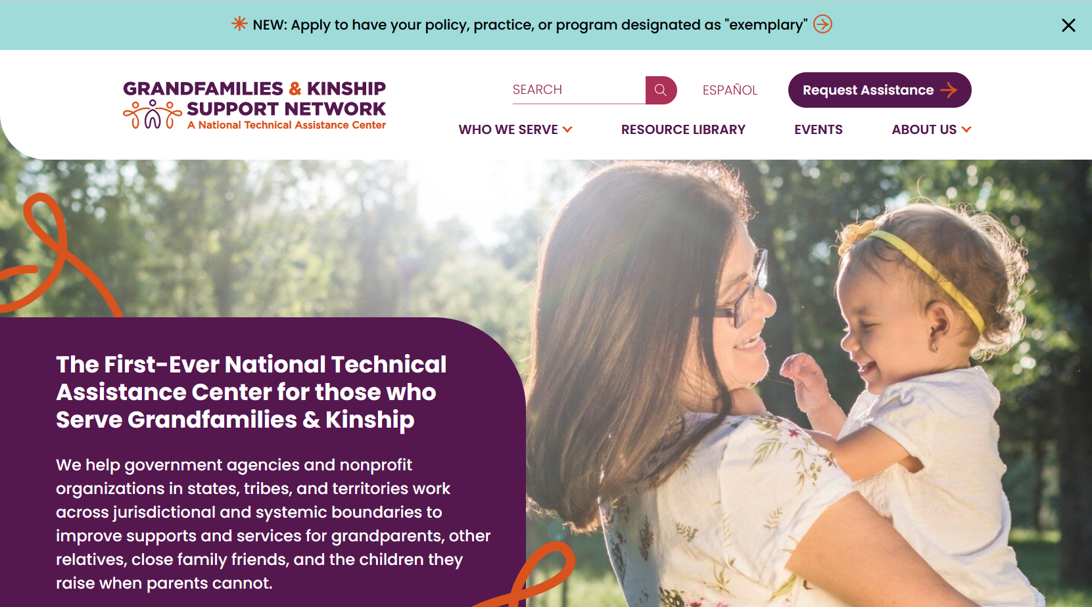
Network website homepage
www.GKSNetwork.org

Slide 66


Stay Connected & Access Support
Sign up for our monthly newsletter
which will provide you with updates on new Network resources.
Request assistance
For the latest updates, follow the Network on LinkedIn!

Slide 67

Insert your contact info here

Slide 68
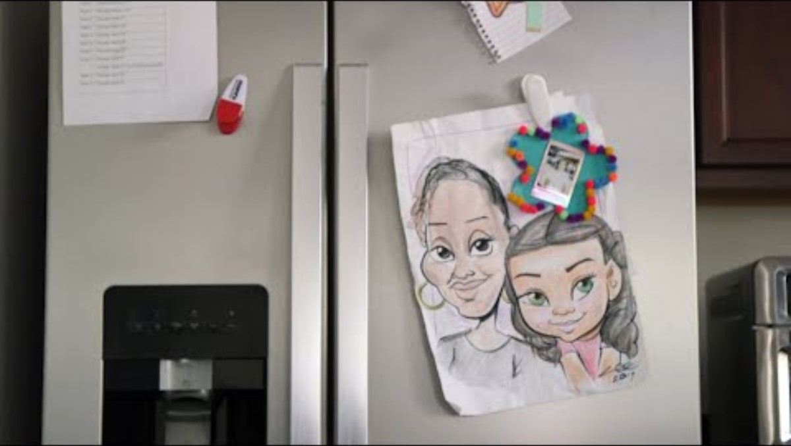
GRAND Voice Genia Newkirk
GRAND Voice Genia Newkirk, https://youtu.be/rbCIpQ3gQ9o?si=1KLCr82ksKtlot3O
68
Notes:
Feel free to use this video elsewhere in the training. We like to end with it, but it may work better for your needs to be used elsewhere or not at all.
The GRAND Voice in this video, Genia Newkirk, didn’t know her niece before agreeing to serve as placement but knew her family and culture. They are thriving.
It was work for the child welfare worker in finding Genia – but worth it for the child and Genia. But know of the inequities –
Genia became licensed, but wasn’t told could adopt with assistance and her state is one of the very few that limits GAP to over age 12 – so didn’t qualify.
They don’t receive any meaningful ongoing financial support – could have gotten Veteran’s benefits if had adopted, but they hadn’t been told that.

Slide 69
Disclaimer

