Slide 1
Legal Relationships and Public Benefits
Insert Date
Presented by …Insert presenter names
Training Template created by the Grandfamilies & Kinship Support Network:
A National Technical Assistance Center
Important note that you may delete before you complete and use this training template:
This is a fillable Power Point template in which you can include specific information for your jurisdiction, as explained in the notes page connected to each relevant slide. It can be used for trainings of staff, other stakeholders, or kinship/grandfamilies in your area. Feel free to add your logo to our logos at the bottom of each slide, along with your relevant contact info and your website or other resource information, as noted.
This template is provided free of charge with the requirement that you do not alter our color scheme or logos where they appear. This resource is made possible through a federal cooperative agreement (see last slide – which you also must keep).
Please reach out to us if we can be of any help with your use of these slides. Email Ana Beltran at abeltran@gu.org with any questions regarding the content of these slides or Maari Weiss at mweiss@gu.org with any formatting questions or accessibility issues regarding these slides.

Slide 2
Introduction
Purpose today – to empower staff or families with basic information about legal relationship options and public benefit programs for grandparents, other relatives, and close family friends who raise children when parents cannot – we refer to this families interchangeably as kinship families or grandfamilies
Please ask questions throughout the training
Notes:
Add any demographic or other basic information as needed for your audience to this introductory slide. You could add the number of children in grandfamilies in your state, for example. That info can be found in the resource on the next slide.

Slide 3
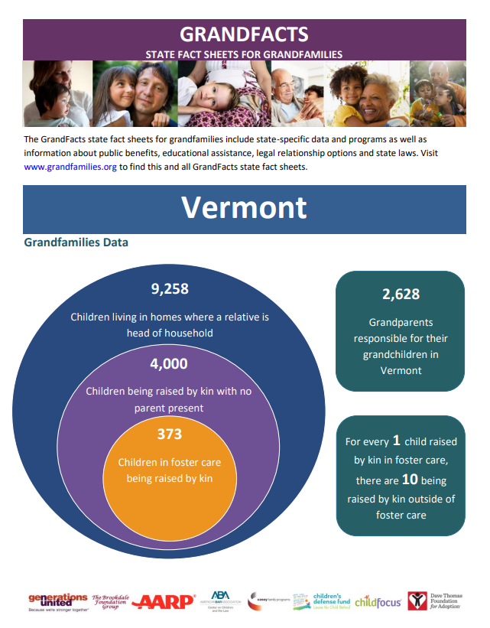
GrandFacts Caregiver Resources https://www.grandfamilies.org/State-Fact-Sheets
Notes:
One of these fact sheets exists for each state, District of Columbia, and Puerto Rico (and soon US Virgin Islands and some tribes). For this slide, use the snipping tool to cut and paste the cover from your jurisdiction’s GrandFacts fact sheet and link directly to your fact sheet.

Slide 4

Legal Relationships

Slide 5
Legal Obstacles
Unlike parents, grandparents and other kin lack an automatic legal relationship to the children they raise
Getting such a legal relationship can be very costly and take a long time
Without it, grandfamily/kin caregivers may not be able to access services and supports for the child
If the child is in foster care with the kin providing the care, the agency has legal custody of the child and can help access services
It is important that kin understand their options
The families are their own best expert, but they need accurate information to make the decision that works for them

Slide 6
Paths to Permanent Kinship Families
INSIDE FOSTER CARE
State has legal custody of the child
Licensed kin:
Monthly financial assistance
Unlicensed kin:
Financial assistance varies
Usually only Temporary Assistance for Needy Families (TANF)
Adoption
Legal Custody
Guardianship
OUTSIDE FOSTER CARE
No automatic legal relationship to grandchildren or other kin
Temporary legal authority possible through power of attorney or consent laws
Only source of ongoing financial assistance typically TANF
Adoption
Legal Custody
Guardianship
Adoption
Legal Custody
Guardianship
Notes:
On this slide – you can edit the legal options to reflect your state, tribe, or territory – you might not, for example, have a consent law, so don’t include mention of that. Also replace TANF with your jurisdiction-specific name, if it’s different.

Slide 7
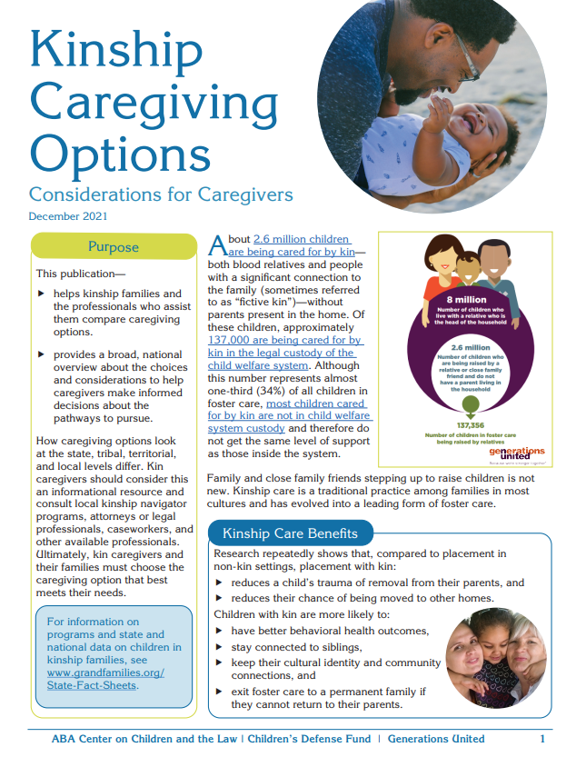
Kinship Caregiving Options
Tool that provides a national overview about choices and considerations to help caregivers both inside and outside the child welfare system make informed decisions about the pathways to pursue
Available at: https://www.grandfamilies.org/Portals/0/Documents/Care-Custody/kin-caregiving-options-dec21%202022-01-10%2022_34_13.pdf
Notes:
This slide can remain the same.

Slide 8
Adoption
Caregiver becomes the parent in the eyes of the law forever
Caregiver has all rights and responsibilities for the child
The birth parents’ rights are terminated but they may have a right to contact or visit
Some relatives do not feel adoption is right for them
  They do not want to change the nature of their relationship with the child or parent
  For example, grandma becomes mom and mom becomes sister
More information at www.grandfamilies.org/Topics/Adoption/Adoption- Summary-Analysis
Notes:
This slide should work for each jurisdiction without modification.

Slide 9
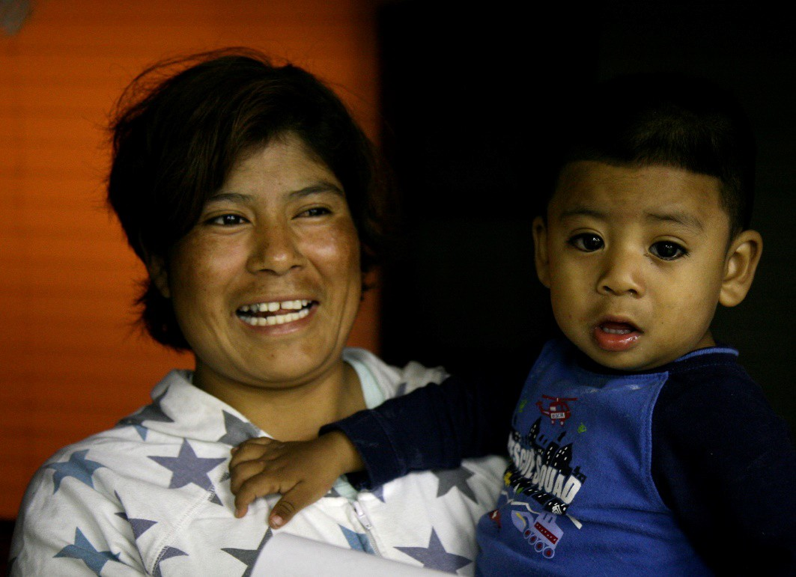
Legal Custody and a Subtype
Legal custodians usually have rights and responsibilities that are similar to legal guardians
Some states use the term “guardianship,” others use “legal custody,” and some use both
De Facto Custody –
  Person who has been primary caregiver for a period of time has same standing as a parent in a legal custody dispute
  Custody is then determined based on the best interests of the child
  Only some states recognize this form of custody
Notes:
On this slide, include any important points regarding legal custody in your jurisdiction, including if you have a de facto custody law. Some jurisdictions may not have “legal custody” as such. If so, omit use of this slide.

Slide 10
Guardianship and its Subtypes
Guardianship by Probate Court –will names guardian and court appoints upon death of parent
Standby Guardianship – pre-appointed guardian steps in after a triggering event
Joint Guardianship – caregiver shares guardianship with parent
Temporary or Short-Term Guardianship – parent appoints person to have temporary rights and responsibilities for child
Limited Guardianship – powers limited in court order
Guardianship by Family or Dependency Court – may be subsidized or unsubsidized, may be state or federally funded (GAP)
Notes:
Edit this slide for the subtypes available in your state, tribe, or territory. You may have “Permanent guardianship,” for example. It’s helpful to include legal citations and links to the law. For example, for Wyoming’s standby guardianship law: https://law.justia.com/codes/wyoming/2010/Title3/chapter2.html Wyo. Stat. Ann. § 3-2-108. If you don’t have “guardianship”, also edit this slide as necessary.

Slide 11
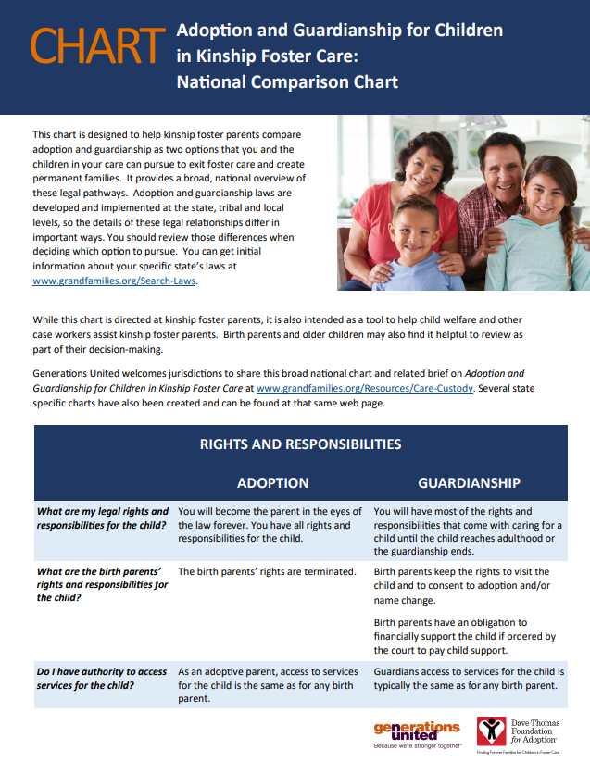
Comparing Adoption and Guardianship
National chart – Adoption and Guardianship for Children in Kinship Foster Care
State-specific charts – if you would like one, contact Chelsi Rhoades at crhoades@gu.org
Brief – Adoption and Guardianship for Children in Kinship Foster Care
Thanks to Dave Thomas Foundation for Adoption
All available at www.grandfamilies.org/Resources/Care-Custody
Notes:
Here you can share your state-specific chart, if you have one. If you don’t, and would like one, please reach out to Chelsi Rhoades at Generations United – crhoades@gu.org

Slide 12

Power of Attorney
Documents that parents complete to confer powers over the care of a child to a named person, with the exceptions of powers to consent to marriage or adoption
Generally, they expire in six months to a year, so may not be the best option for long-term caregivers
Can easily be revoked by parents
Notes:
Include how long your state’s power of attorneys are effective for, along with a citation and link to your state’s law.

Slide 13
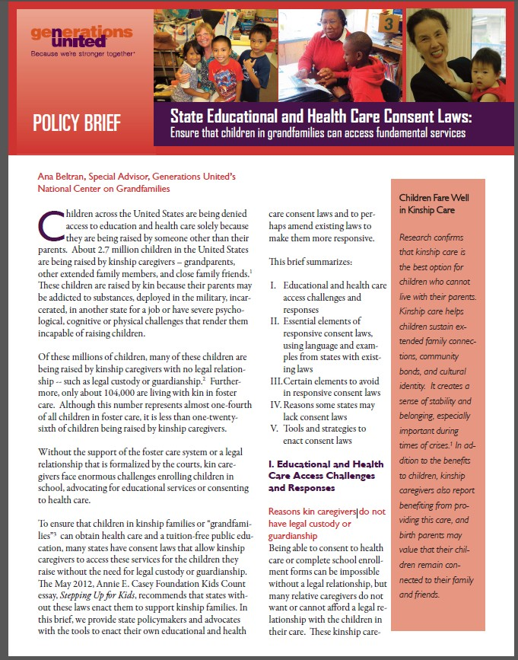
Educational and Health Care
Consent Laws
State-level “consent laws” or “authorization laws” allow a caregiver without legal custody or guardianship to access:
  school enrollment and school services
  health care
  developmental treatment services for children
Generally, these laws allow caregivers to complete an affidavit stating that they are the primary caregiver and that the child lives with them
Montana has a useful model
Click on image for direct link to brief
Notes:
If you have this type of law, add it and its legal citation to this slide. If you don’t have this law, you may want to delete this slide, depending on the type of training. Also, you may also have another kind of temporary legal relationship option in your jurisdiction, which you may want to highlight.

Slide 14

Deciding Which
Legal Path

Slide 15
When Legal Custody/Guardianship
May be Appropriate
Young person has strong bond with parent and does not want to permanently sever parental rights
Parent has a physical or emotional disability and cannot safely care for young person, but familial ties remain
Kin caregiver believes permanently altering family legal ties is not in the best interests of the child or the family
Cultural norms make terminating parental rights (TPR) inappropriate
Child welfare agency cannot prove TPR grounds or caregiver does not want lengthy trial and possible appeal
Notes:
This slide should work for all jurisdictions.

Slide 16
When Adoption May be Appropriate
Terminating parental rights (TPR) makes sense and is in the best interest of the child
Caregiver prefers to obtain all rights and responsibilities over the child
There exits a problematic relationship with the parents
Provides more control than legal custody regarding the birth parent’s access to the child
Tribal customary adoption - transfer of custody of a child to adoptive parents without terminating the rights of the birth parents
Notes:
This slide should work for all jurisdictions.

Slide 17
When A Temporary Legal Relationship May Be Appropriate
The caregiving period is time-limited and well-defined, and the parent will designate the caregiver as the temporary caregiver. Examples:
  Custodial parent is in prison for a short sentence
  Custodial parent needs to undergo medical procedures or rehabilitation
  Custodial parent is traveling for a seasonal job or other opportunity
The temporary legal vehicle provides authority until a more permanent legal relationship can be achieved
Notes:
This slide should work for all jurisdictions.

Slide 18
Hear Directly from Kinship/Grandfamilies As Part of Your Trainings
The Grandfamilies & Kinship Support Network has three caregiver videos, featuring Generations United GRAND Voices. You may download them from the Network website:
Santana Lee: https://www.gksnetwork.org/resources/kinship-grandfamilies-thrive-with-love/
Rosalie Tallbull: https://www.gksnetwork.org/resources/kinship-grandfamilies-thrive-with-perseverence/
Keith Lowhorne: https://www.gksnetwork.org/resources/kinship-grandfamilies-thrive-with-peer-support/
Notes:
In your training, include caregiver stories about how they made their decision. It’s very helpful to hear directly from the families. On this slide are three links to 3-minute long caregiver videos that the Network produced. You’re welcome to use one, but it’s even better to get local voices.

Slide 19

Public Benefits

Slide 20
Monthly Financial Assistance
Potential sources of financial assistance for relatives raising children:
  Foster care maintenance payments
  Adoption Assistance – for special needs children being adopted from foster care
  Guardianship Assistance – typically for those exiting foster care only
  Temporary Assistance for Needy Families (TANF)
Notes:
Include any other programs specific to your jurisdiction – and make sure that you call these programs by their local names. For example, TANF is often called something else.

Slide 21
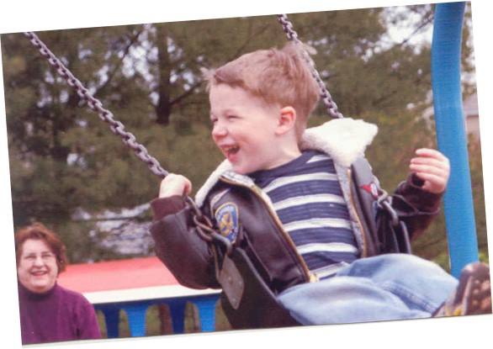
Adoption Assistance
Adoption assistance is monthly financial assistance up to the foster care rate for those children adopted from the child welfare system with “special needs”
Special needs are defined by each state, and typically include more than what is commonly referred to as “special needs”
Special needs can include being part of a sibling group, being a teenager, etc.
For your state, see https://nacac.org/help/adoption-assistance/adoption-assistance-us/state-programs/
Notes:
Modify the slide to include what your jurisdiction means by “special needs” and include links to your specific information about adoption assistance (both federal and state funded). NACAC has website pages devoted to each state.

Slide 22
Guardianship Assistance Program (GAP)
Only for children who are with a relative in licensed foster care - it allows children to exit foster care into the permanent care of that relative
The state, territory, or tribe provides the child with monthly financial support using federal funds
Basic eligibility requirements for federal GAP:
  Adoption and reunification are not appropriate options for the child
  Child must be Title IV-E income eligible for federal GAP
  Child must live with a licensed relative foster parent for six consecutive months prior to guardianship
  Ineligible siblings can qualify if a sibling in the same home is eligible
Notes:
Omit this slide if you don’t have GAP – a map reflecting where those programs exist can be found here - https://www.grandfamilies.org/Topics/Guardianship-Assistance . Also, insert mention of a state-funded guardianship program, if you have one.

Slide 23
Temporary Assistance for Needy Families (TANF)
Two types of grants:
  Child-only grants
    Available based on child’s income
    Usually not sufficient to meet child’s needs
  Family grants
    Larger than child-only grants
    Subject to federal work requirements and time limits
For more information, see factsheet for caregivers and policy brief
Notes:
Include state-specific information and website links on this slide. If your jurisdiction calls it something other than TANF or child-only, use the terms used in your area.

Slide 24

Insert State Name – Support Comparison
Outside the Foster Care System or Outside Licensed Kinship Foster Care Temporary Assistance for Needy Families (TANF) “Child-Only” Grants | Licensed Kinship Foster Care Foster Care Maintenance Payments | Guardianship Assistance and Adoption Assistance for Eligible Children Exiting Foster Care
One Child $ /month Must apply for Medicaid separately or Automatic Medicaid with a TANF child-only grant | One Child Lowest rate $ /month Automatic Medicaid | One Child Lowest rate $ /month Automatic Medicaid
Two Children $ /month Must apply for Medicaid separately or Automatic Medicaid with a TANF child-only grant | Two Children Lowest rate $ /month Automatic Medicaid | Two Children Lowest rate $ /month Automatic Medicaid
Three Children $ /month Must apply for Medicaid separately or Automatic Medicaid with a TANF child-only grant | Three Children Lowest rate $ /month Automatic Medicaid | Three Children Lowest rate $ /month Automatic Medicaid
Notes:
Here’s a template you can complete with your state, territory or tribal name and dollar amounts. For Medicaid and TANF, pick which option is appliable to your area.

Slide 25
Social Security:
Old-Age, Survivors, and Disability Insurance
Children being raised by kin may be eligible if the child’s parent is collecting retirement or disability insurance benefits or if the parent was fully insured when he or she died
Kin can apply for benefits on behalf of the child based on the work record of the child’s parent
The child may qualify based on a grandparent’s work record https://www.ssa.gov/people/parents/
Notes:
It’s important to emphasize that the third bullet only applies to grandparents’ work records – not any other kin caregivers. Children cannot qualify based on the work record of anyone other than a parent or grandparent.
This slide can remain the same for each jurisdiction.

Slide 26
Supplemental Security Income
Program administered by the U.S. Social Security Administration
There’s a screening tool to find out if an individual qualifies: https://ssabest.benefits.gov/
Provides benefits for individuals who are elderly, blind, or have disabilities and who have limited income and assets
Also provides cash benefits to children who are blind or have other serious disabilities; for children to qualify, they must be under 18 and meet the SSI disability, income, and asset criteria
Notes:
This slide can remain the same for each jurisdiction.

Slide 27
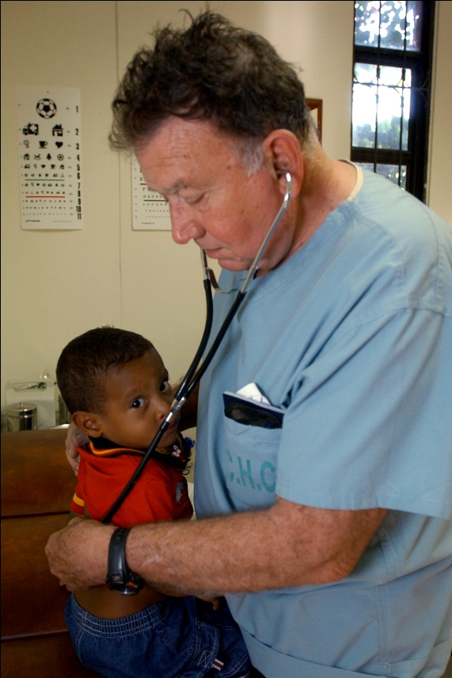
Health Care: Medicaid and CHIP
As with children being raised by parents, children being raised by kin should be able to access public health insurance
Caregivers do not need legal custody or guardianship of the children
Guides for each state: https://www.aarp.org/aarp-foundation/our-work/income/public-benefits-guide-senior-assistance.html?cmp=RDRCT-89c79c71-20201223
Notes:
Change the link to the direct link to your state’s guide.

Slide 28
Food and Nutrition Programs
Supplemental Nutrition Assistance Program (SNAP) – formerly known as “Food Stamps”; caregivers do not need legal custody or guardianship of the children to apply – www.fns.usda.gov/snap/ and https://www.gksnetwork.org/resources/snap-facts/
Women, Infants and Children (WIC) Program – can help eligible caregivers meet nutrition needs of children they raise under age 5; caregivers do not need legal custody or guardianship of the children, but children must have certain types of health conditions to qualify – www.fns.usda.gov/wic
National School Breakfast and Lunch Programs – free or low-cost meals for eligible students; caregivers do not need legal custody or guardianship, and they should ask the child’s teacher or principal for an application
New Resource: “Together at the Table: Supporting the Nutrition, Health, and Well-Being of Grandfamilies,” the 2022 State of Grandfamilies Report, published by Generations United – https://www.gu.org/resources/state-of-grandfamilies-report-2022/
Notes:
Change or add anything that’s specific to your area.

Slide 29
Child Care
The Office of Child Care in the U.S. Department of Health and Human Services administers the Child Care and Development Fund (CCDF)
CCDF assists low-income families in obtaining child care so they can work or attend training/education
Work with the jurisdiction’s child care agency. For a list, see https://www.acf.hhs.gov/occ/contact-information/state-and-territory-child-care-and-development-fund-administrators
Notes:
Modify this slide with your jurisdiction-specific information.

Slide 30

Education
With a legal relationship to the child, caregivers should be able to enroll children tuition-free in public school
Without a legal relationship to the child, it will depend on the state and locality
Each state has a McKinney-Vento federal homeless act liaison who can help enroll “unaccompanied youth” in school and connect the child to services
For special education benefits, caregivers should not be required to have legal custody or become a “surrogate parent”
Notes:
Modify this slide to reflect what is done in your state, tribe, or territory. Do you have open enrollment? Do you use McKinney-Vento to declare the children “unaccompanied” and access school enrollment that way? Do you have an educational consent law?

Slide 31
Housing:
Family Unification Program
The Family Unification Program (FUP) is a U.S. Department of Housing and Urban Development program that provides Public Housing Authorities with funding for Section 8 housing vouchers for families who the child welfare agency has "certified" as having children at risk of entering foster care because of the lack of adequate housing
Some states define “family” as parent-child families and exclude grandfamilies, whereas others include grandfamilies
Notes:
Ask the Public Housing Authority in your area and find out if they have FUPs and how they define “family.” Then you can modify this slide accordingly.

Slide 32
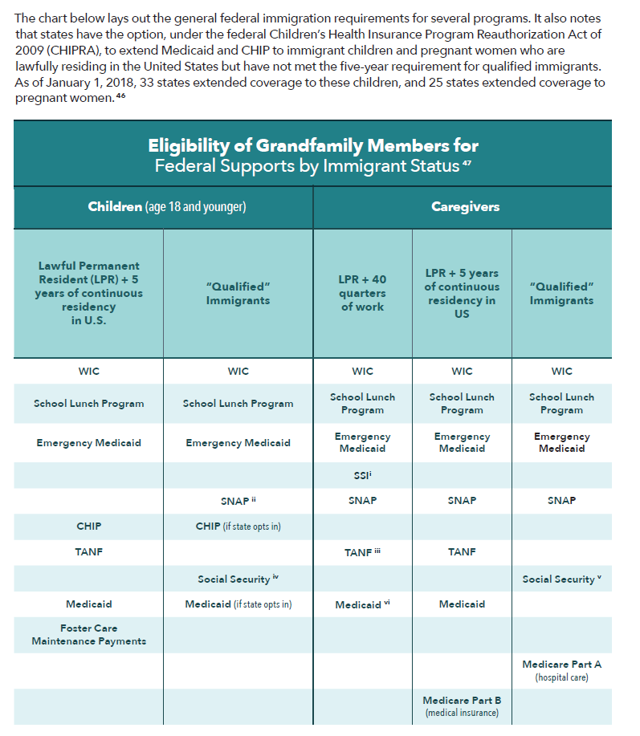
Restrictions for Lawfully Residing Immigrant Children and Caregivers to Access Benefits
For states that have expanded Medicaid and CHIP to immigrant children/pregnant women, see: https://www.medicaid.gov/medicaid/enrollment-strategies/medicaid-and-chip-coverage-lawfully-residing-children-pregnant-women
Source: Generations United, State of Grandfamilies Report (2018) www.grandfamilies.org/Portals/0/Documents/Grandfamilies-Report-SOGF2018.pdf
Notes:
You can keep this slide as is, if it’s helpful to your population.

Slide 33
National Family Caregiver Support Program (NFCSP) and Native American Caregiver Support Program (NACSP)
Provide 5 types of supportive services to family caregivers and relatives aged 55 and older who are the primary caregivers of children (with or without legal relationships to the children):
  Assistance to caregivers about available services
  Assistance to caregivers in gaining access to services
  Individual counseling, organization of support groups, and training caregivers
  Respite care
  Supplemental services on a limited basis
Area Agencies on Aging (AAAs) or tribal organizations provide these services or contract for their provision
Notes:
You can keep this slide as is.

Slide 34
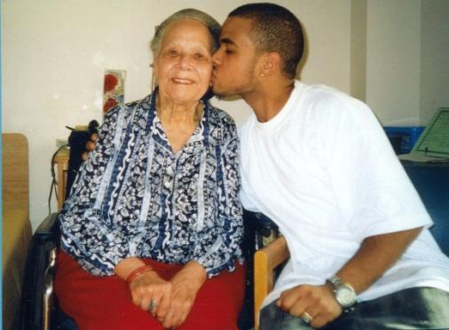
NFCSP and NACSP cont’d
AAAs and tribal organizations may use additional funding sources to try to reach the majority of caregivers who are under age 55
Our partner, USAging, is soon releasing a fact sheet and report on AAAs and tribal organizations and their use of NFCSP and NACSP for kinship/grandfamilies – check https://GKSNetwork.org often
AAAs can be found here: https://eldercare.acl.gov/Public/Index.aspx
Notes:
Include info re: which AAAs or tribal organizations in your area provide supports to kinship families, and who to contact.

Slide 35
Tax Credits:
Earned Income Tax Credit (EITC)
This tax credit is refundable so even workers who don’t earn enough to pay taxes can get cash from the IRS
Qualifying children:
  Includes all relatives (and steps)
  Must be under age 19 (or 24 if a full-time student)
  If the child is permanently and totally disabled, there is no age requirement
  Must have lived with the relative for more than ½ the year
www.irs.gov/individuals/article/0,,id=96406,00.html
Notes:
This can remain the same. Add a bullet if your state has a state earned income tax credit. Many states do, and that credit can be claimed on state income tax returns.

Slide 36
Child Tax Credit
For kinship caregivers both inside and outside child welfare involvement with dependent children through age 17
Eligibility:
  Relationship: any related child (except cousins) or foster child (both related and not related) - fictive kin, such as a godparent or close family friend, are only eligible if they are the child’s foster parent
  Residency: the child must live with the caregiver for more than half the year
  The child must have a Social Security number
  The caregiver and child do not need to have a legal relationship
For tax year 2021, this tax credit was refundable
https://www.gu.org/app/uploads/2021/06/Grandfamilies-and-the-Child-Tax-Credit.pdf
Notes:
Add any state-specific tax credits to this – otherwise the slide can remain the same.

Slide 37
Adoption Tax Credit
Credit for qualifying expenses to adopt children from in and outside the foster care system
For those adopting from foster care, can claim the total credit without showing expenses
If adopting outside of foster care, can deduct up to full amount based on actual adoption expenses
In tax year 2022, the maximum amount is $14,890 per child www.irs.gov/taxtopics/tc607.html & https://nacac.org/help/adoption-tax-credit/adoption-tax-credit-2022/
None of these tax credits are counted as income and they will not jeopardize other benefits
Notes:
Add any info if your state has a state adoption tax credit – several do. You’ll also want to share orally that there is no federal or state guardianship tax credit.

Slide 38

Alternative Care Planning

Slide 39
Alternative Care Planning for Kinship/Grandfamilies Outside of Foster Care
Informal Agreement | Caregiver can collect evidence that they’re raising the child (school records, health care records, any health care affidavit, tax returns, TANF child-only or other benefits received for the child) and how they are related to the child (birth certificate, family records) Caregiver can plan with a trusted person by typing out wishes, signing the resulting document, and sharing with the trusted person and anyone else important to family. May also notarize the paper.
Power of Attorney Delegation of Parental Authority | Caregiver can work with the parents to plan for where the child will go if they die.
Guardianship | Caregiver may be able to name successor guardian through guardianship process.
Adoption | Caregiver can name guardian in will. Caregiver may be able to name standby guardian to take over if caregiver becomes disabled.
Notes:
Please tailor this chart to any nuances in your state, tribe or territory. Things to possibly change include (1) omitting “delegation of parental authority” if your jurisdiction does not have such a law; (2) changing guardianship to legal custody, if that’s the legal mechanism used in your jurisdiction; (3) deleting “may be” in guardianship item re: successor guardian if a guardian can name a successor guardian; and (4) omitting standby guardian if no such law exists in your area.

Slide 40
Alternate Care Planning for Kinship Families Inside Foster Care or Who Have Exited Foster Care
Foster Care | Caregiver can work with the child’s case worker to make sure they have another family member or close family friend identified to care for the child if caregiver dies or can no longer care for the child.
Guardianship | As part of the process of becoming guardian and the child exiting the foster care system, the caregiver may be able to name a successor guardian to take over if they die
GAP (Guardianship Assistance Program) | The GAP agreement must be in place BEFORE getting the guardianship court order. The caregiver will name a successor guardian to take over. That successor does not have to be licensed or a relative to get the monthly financial assistance.
Adoption | After the adoption process is complete, the adoptive parent can create a will and name a guardian for the child, just like any birth parent.
Adoption Assistance | As part of this process, the caregiver can name a successor guardian to take over if they die. If the new caregiver then adopts the child, they may be able to receive the adoption assistance.
Notes:
Most of this chart should apply fairly universally across the country, with the exception of the row regarding GAP. Please delete the GAP row if you work in one of the 10 states without GAP or mention that it doesn’t exist in your community, but it does exist in over 50 other jurisdictions. Knowing that it exists in neighboring jurisdictions, for example, can be helpful to staff, other stakeholders, and families. See map on https://www.grandfamilies.org/Topics/Guardianship-Assistance for where GAP exists.

Slide 41
Add a slide with your website here

Slide 42
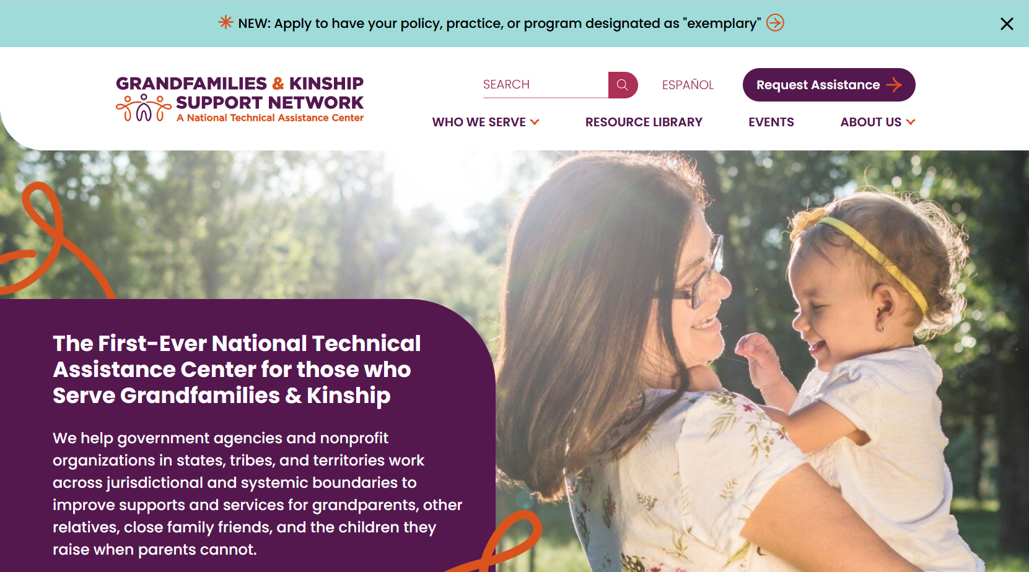
www.GKSNetwork.org

Slide 43
Notes:
Must keep this slide in, as noted on cover of template.

Slide 44

Insert your contact info here

