Slide 1
Grandfamilies Pre-Conference
GRAND Strategies to Embrace the Unique Service Needs of Kinship Families
Generations United 22nd Global Intergenerational Conference
Wednesday, July 26th
1 to 4 PM
Notes:
Melissa

Slide 2
Welcome and Agenda
Presentations from an array of kinship navigator programs, focused on a particular promising practice
    Montana/Wyoming, combining efforts
    Washington, aging and child welfare working together
    Florida, peer to peer navigation
    Maine, legal guide
    South Carolina, engaging partners & funders
Break
Reaching and serving racially and ethnically diverse grandfamilies
Panel Discussion
Individual Action Item
Wrap Up

Slide 3
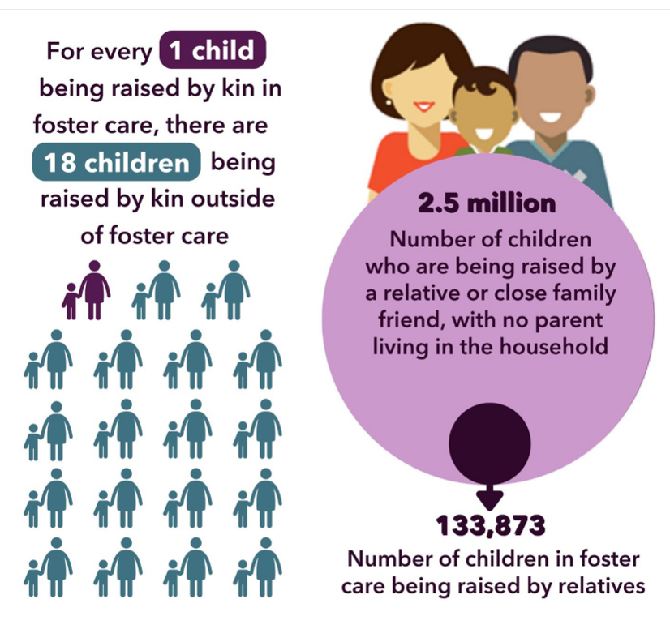
Children in Kinship/
Grandfamilies
See: “Kinship/Grandfamilies: Strengths and Challenges” and the Network’s webpage on kinship data

Slide 4
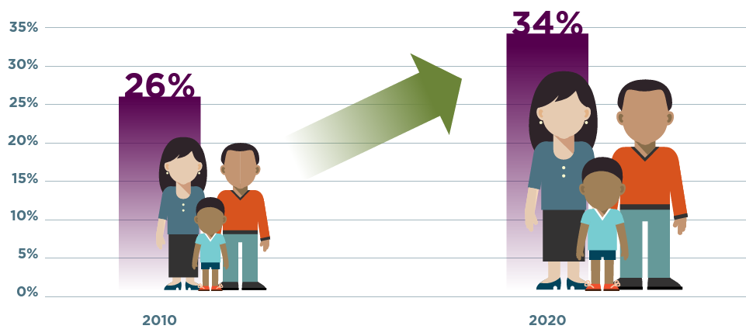
Percentage of Children in Foster Care Being Raised by Relatives
National data are not publicly available on the percentage of these children who are with licensed relatives.

Slide 5
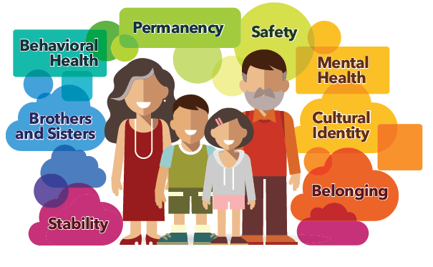
Kinship/Grandfamilies Strengths: Children Thrive
Learn more about kinship/grandfamilies’ strengths and challenges

Slide 6

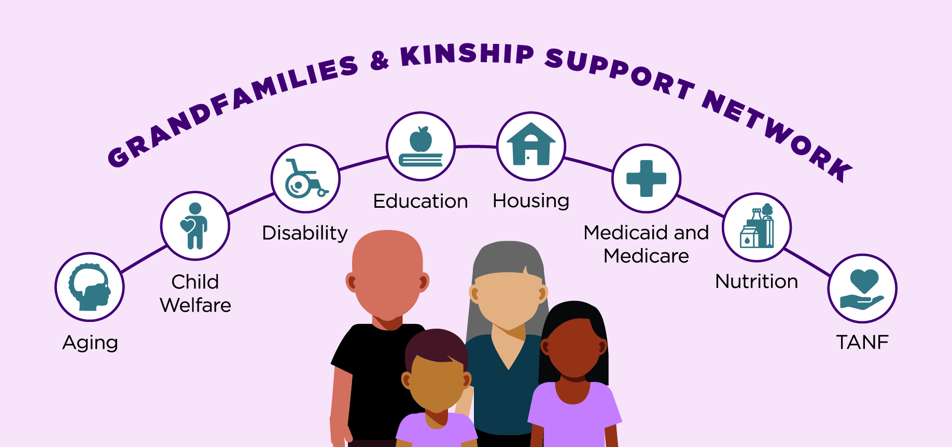
$10 million for 5 years, awarded as a cooperative agreement in September 2021, overseen by the Administration for Community Living (ACL)
Generations United has worked on behalf of and with grandfamilies/kinship families since 1997
Purpose is to provide technical assistance to the array of state, tribal, and territorial government agencies and nonprofit organizations that serve kinship families
Not designed to help the families directly
6

Slide 7





National Partners
7
Notes:
NCBA -National Caucus and Center on Black Aging
NICWA-National Indian Child Welfare Association

Slide 8
Subject Matter Experts
Alexandra Ashbrook, JD Food Research and Action Center (FRAC)
Terry Cross, DHL National Indian Child Welfare Association (NICWA)
Joseph Crumbley, PhD
Angelique Day, PhD, MSW University of Washington
Gail Engel GRAND Voice
Jatrice Martel Gaiter, JD Volunteers of America (VOA)
Marina Nitze New America Foundation Fellow
Melinda Perez-Porter, JD Relatives as Parents Program (RAPP)
Heidi Redlich Epstein, JD, MSW and Emily Peeler, JD, MSW ABA Center on Children and the Law
Andrew Russo, MA National Family Support Network
Sarah Smalls GRAND Voice
Tyreasa Washington, PhD, LCSW Child Trends
Ruth Anne White, PhD National Center for Housing and Child Welfare
Nancy Young, PhD Children and Family Futures
8

Slide 9
How We Help
Learning Collaboratives and Information Dissemination
A Centralized Hub
The Network hosts webinars and facilitates learning collaboratives.
Individual Assistance
We respond to individual requests for help from government agencies, and nonprofit organizations.
Targeted, Specialized Support
For jurisdictions that want and are ready for a larger investment of effort, the Network will help optimize their collaborative approaches and improve their services. Solutions will be replicable for others.
The Network is elevating exemplary kinship/grandfamily practices and programs from around the country on its website at www.GKSNetwork.org.

Slide 10
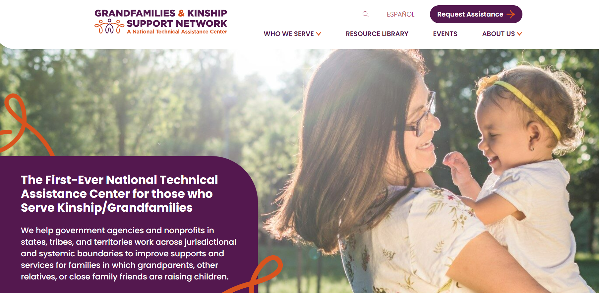
www.GKSNetwork.org

Slide 11


Stay Connected & Access Support
Sign up for our monthly newsletter,
which will provide you with updates on new Network resources.

Slide 12
12

Slide 13

National Center
on Grandfamilies

Slide 14
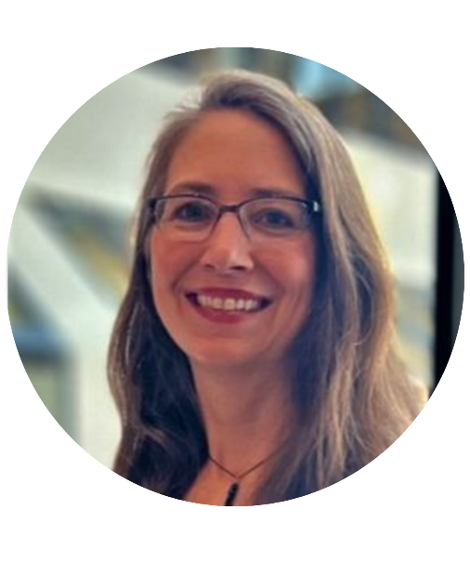
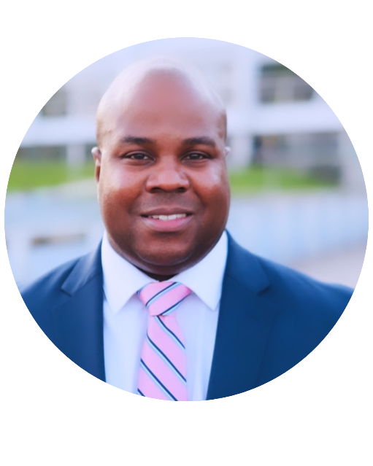
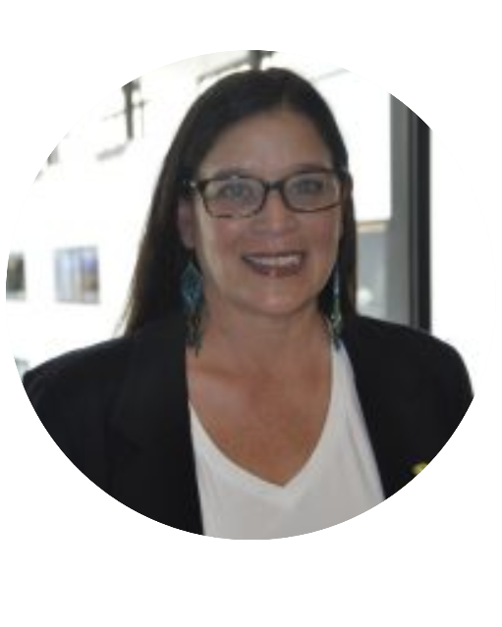
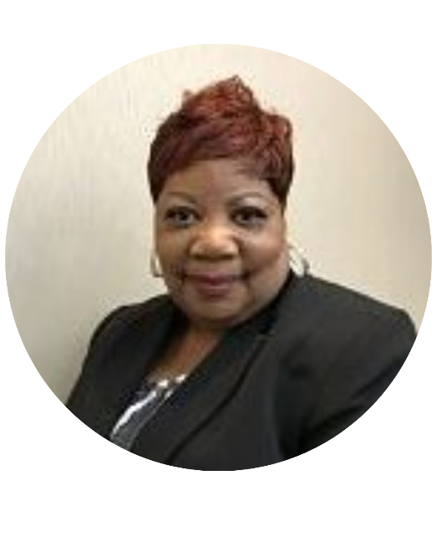
National Center on Grandfamilies Staff
Jaia Peterson Lent
Deputy
Executive Director
Jamarl D. Clark
Assistant Director, National Center on Grandfamilies
Robyn Wind
GRAND Voices
Support Coordinator
Karen Gillespie
Grandfamilies
Project Coordinator

Slide 15

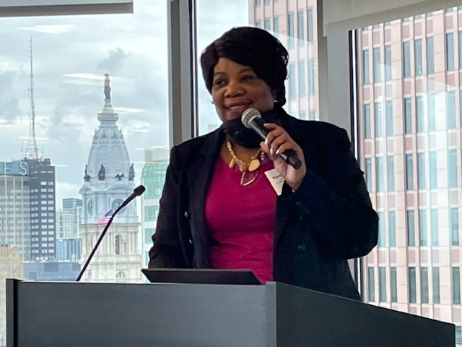
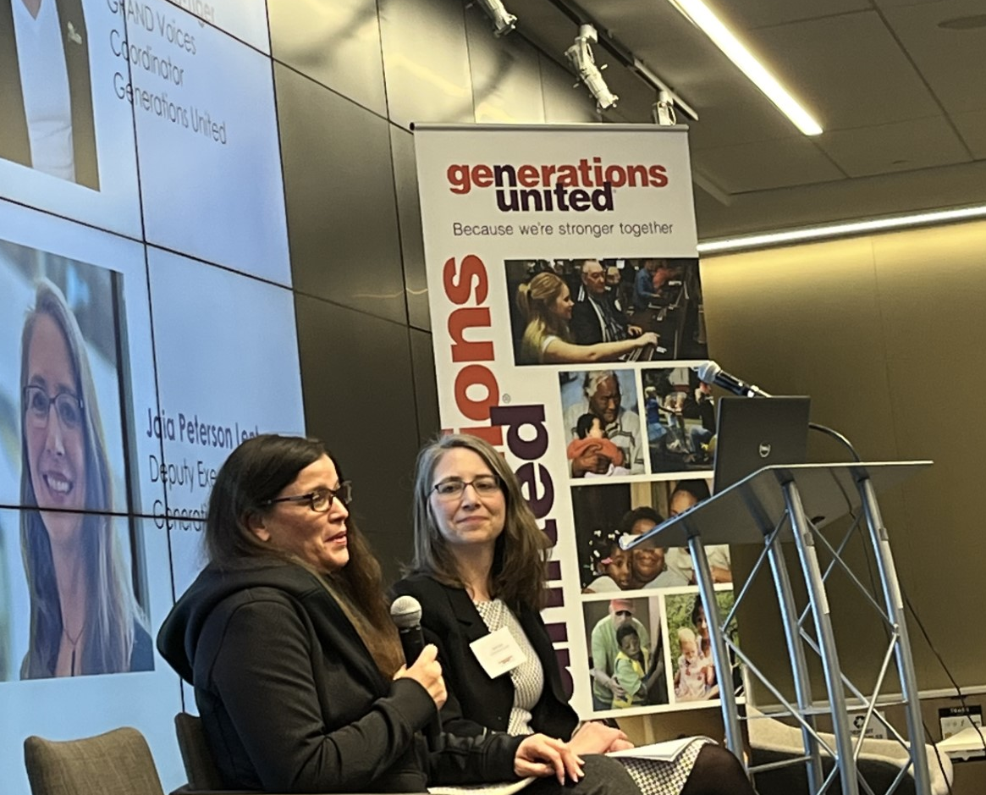
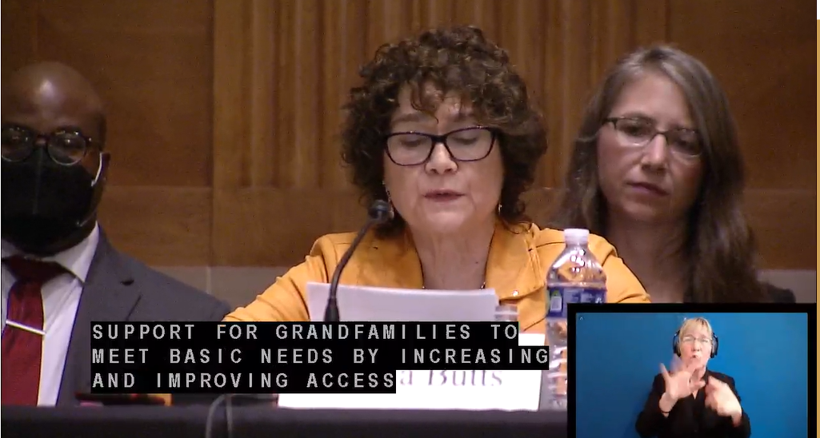
National Center on Grandfamilies
FOUNDED in 1999
GUIDED by GRAND Voices
– a network of caregiver advocates
Notes:
Generations United’s National Center on Grandfamilies is a prominent advocate for families led by grandparents, other relatives, and close family friends. They are driven by GRAND Voices, a national network of grandfamily caregiver advocates. The Center works with caregivers and organizations to establish a national agenda that supports these families.

Slide 16
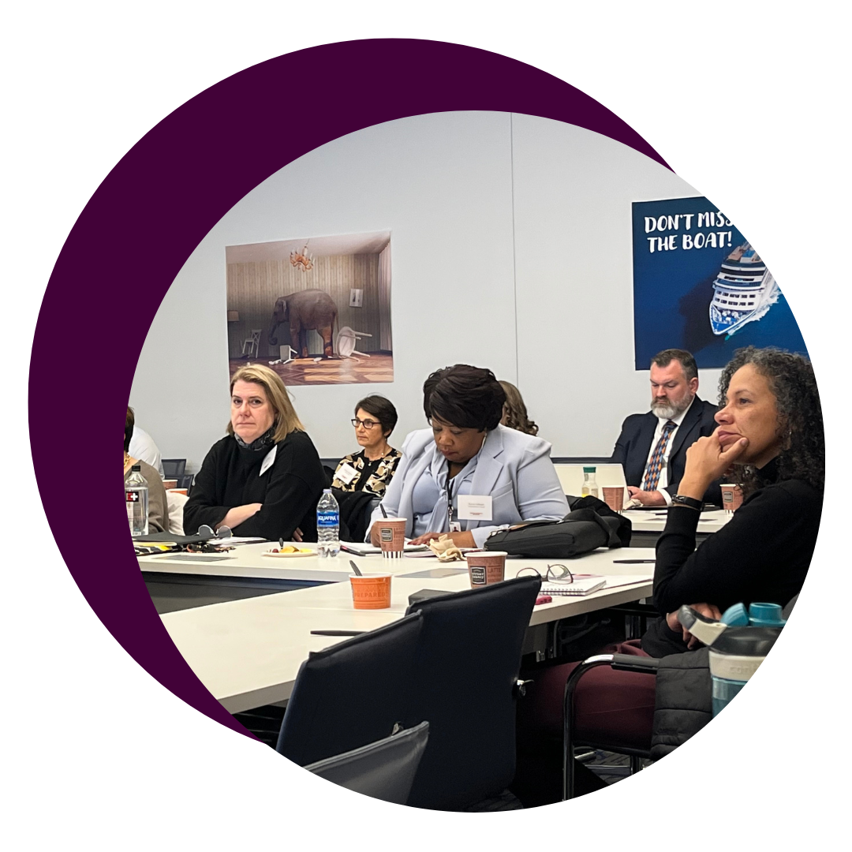
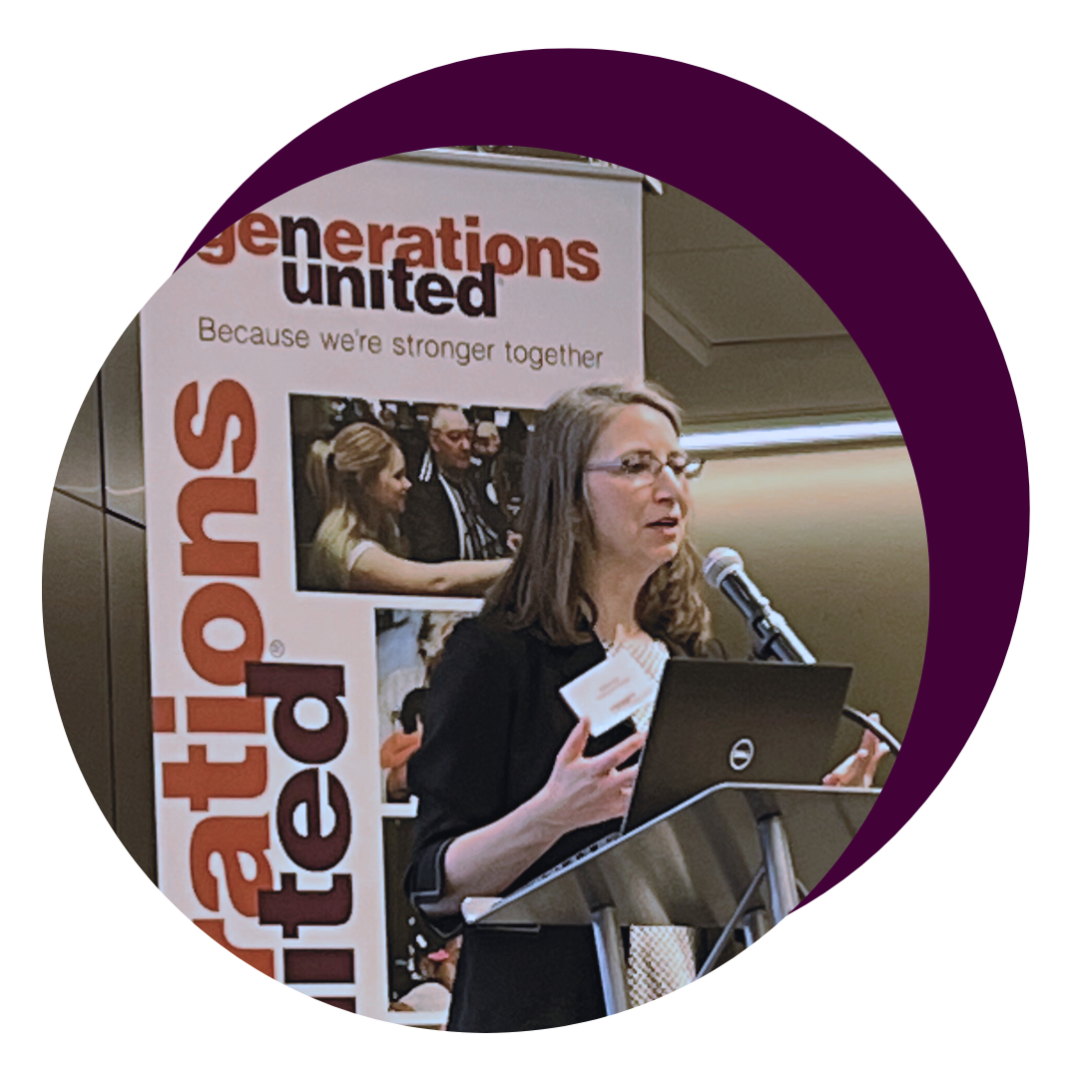
Sets Collective Agenda
As part of our efforts to support grandfamilies, we have organized four national symposiums in the past with experts in the field.
We have led in setting a united agenda for grandfamilies and coordinating collective efforts among national leaders.
To ensure regular communication, we hold quarterly calls.
Our latest achievement is the creation of the "Kinship Unity Agenda".

Slide 17



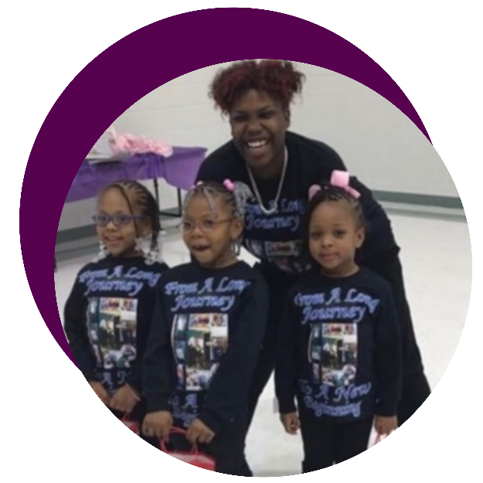
Elevates Grandfamily Voices
Over 80 GRAND Voices from 46 states, 12 tribes, and DC are supported through regular meetings, training, travel support, and networking opportunities.
GU shares updates on policies, programs, and resources, and offers training on advocacy, personal stories, fundraising, and accessing resources.
Peer-to-peer calls showcase the successes and wisdom of GRAND Voices.
Notes:
Generations United’s GRAND Voices is a national group of grandparents and other relatives raising children, with representation from virtually every state and many tribes, that guides the work of the Center. We support, train and engage GRAND Voices and young people raised in grandfamilies to inform policies and practice, address service gaps, and advocate for better outcomes.
Established in 2014 with 5 members
Initial support from Casey Family Programs, enhanced by W.K. Kellogg Foundation racial equity initiative (J. talking points)

Slide 18
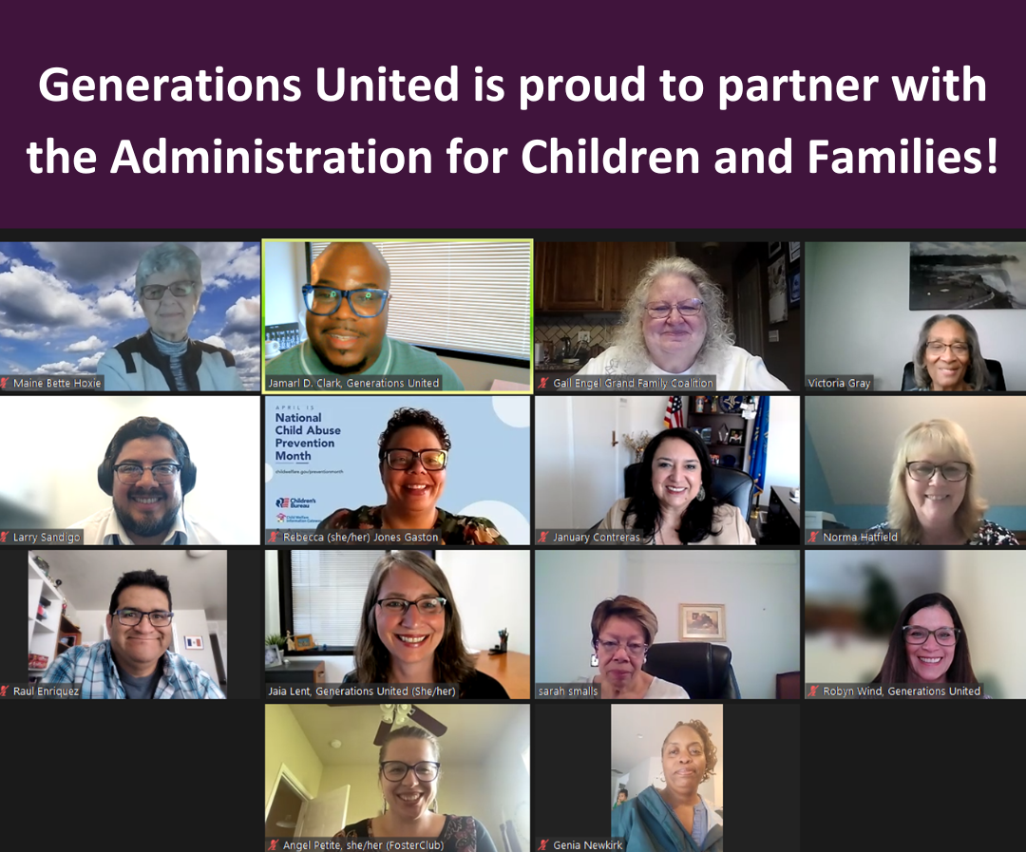

Advocates for Policy Change
Trusted voice on Capitol Hill
Advocates for improved policies for grandfamilies
Focus on child welfare reform
Specialized federal housing assistance for grandfamilies
Inclusion of grandfamilies in the Older Americans Act

Slide 19
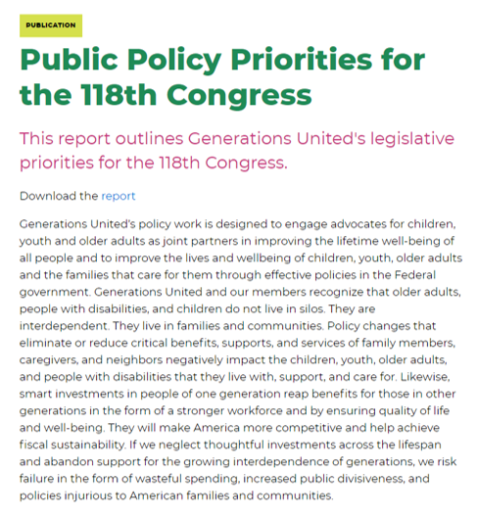

Resources for other grandfamilies- serving organizations,
policymakers, and advocates

Slide 20


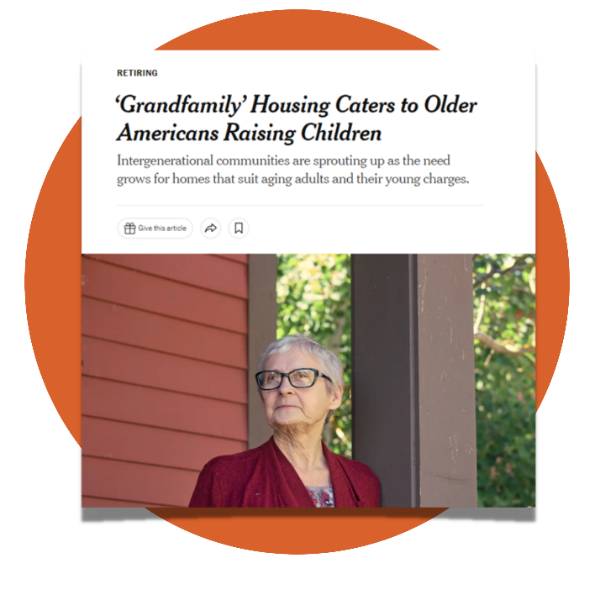
Promotes Positive Messaging
Grandfamilies Come Under Pressure
-Wall Street Journal, 2009
The Rise of the Grandfamily
-Washington Post, 2019
Grandfamily Housing Caters to Older Americans
-New York Times 2021
Strain on 'grandfamilies': Grandparents raising grandkids face high levels of food insecurity.
-USA Today 2022
Notes:
Generations United's is the go-to group for media seeking expert commentary on grandfamilies. Our awareness raising efforts have resulted in coverage in the Wall Street Journal, Washington Post, New York Times, NPR and ABC News. Our communications efforts led to reframing the way we talk about families, leading with strengths and moving the term grandfamilies into the country’s vernacular.

Slide 21


Shares Key Research, Information
& Resources: State of Grandfamilies Report
https://www.gu.org/explore-our-topics/grandfamilies/state-of-grandfamilies-in-america-annual-reports/
Notes:
Through our annual State of Grandfamilies report, fact sheets, policy summaries and toolkits, Generations United shares complex information in clear and consumable ways to help policy makers, practitioners, educators, community leaders, the media and grandfamilies.
This report series shines a light on the challenges grandfamilies face and the incredible service they provide our country. Each report includes infographics that show the latest data on the number of children who live in grandfamilies and offers recommendations to help guide the development of supportive policies and services for grandfamilies. Each issue has a unique focus on a particular issue affecting the families.

Slide 22
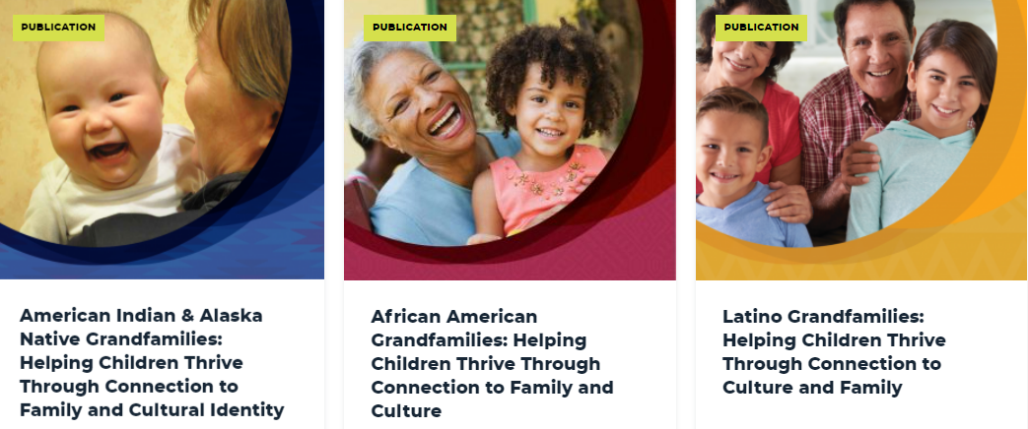
Racial Equity Toolkits for Serving Grandfamilies
https://www.gu.org/racial-equity-toolkits-featuring-grandfamilies/
Notes:
This resource is designed as a quick reference tool for practitioners and advocates working with grandfamilies and kinship families who identify as

Slide 23
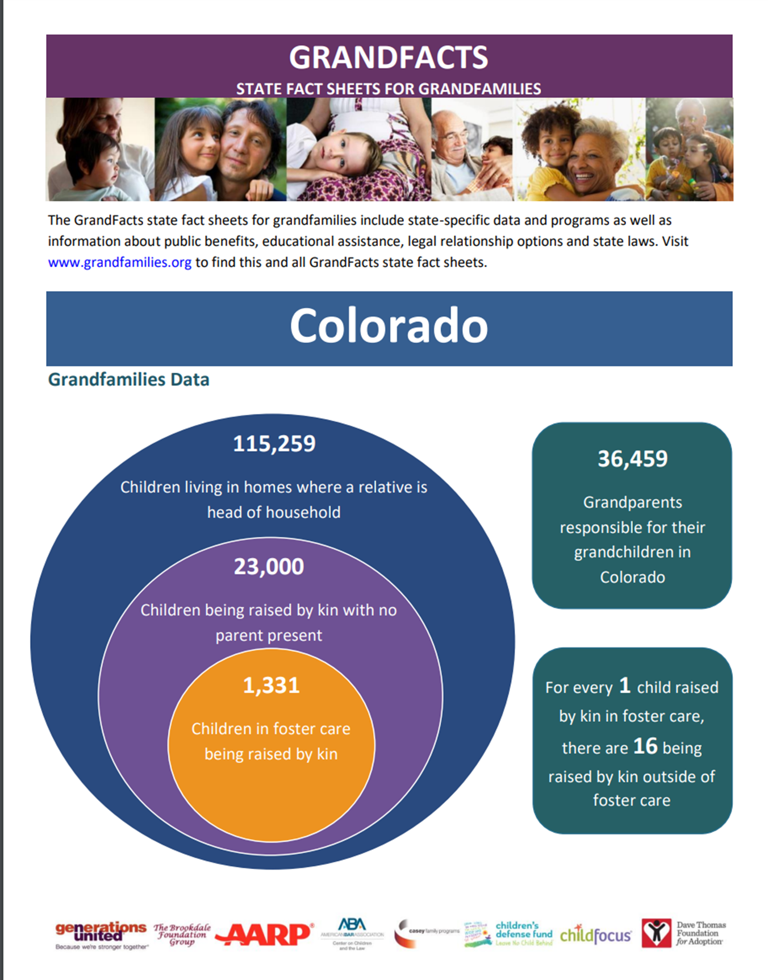
Grand Facts
State Fact Sheets
www.grandfactsheets.org
All 50 States and the District of Columbia Includes information on state specific
• Data
• Programs
• Public Benefits
• Education
• Legal
Notes:
These 52 fully updated state-specific GrandFacts Fact Sheets provide:
Data
Key state and local programs and resources
Public benefits
Educational assistance
Legal relationship options
State laws

Slide 24
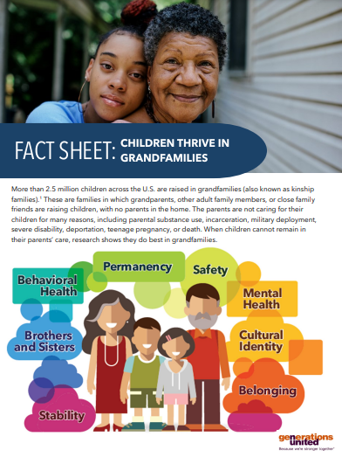
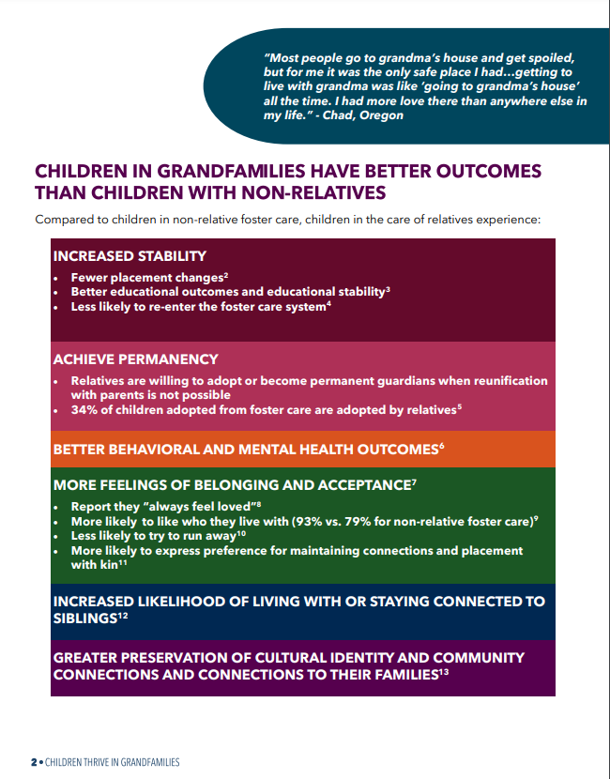
Fact Sheet: Children Thrive in Grandfamilies
Fact sheet highlighting the experiences of children in relative care.

Slide 25
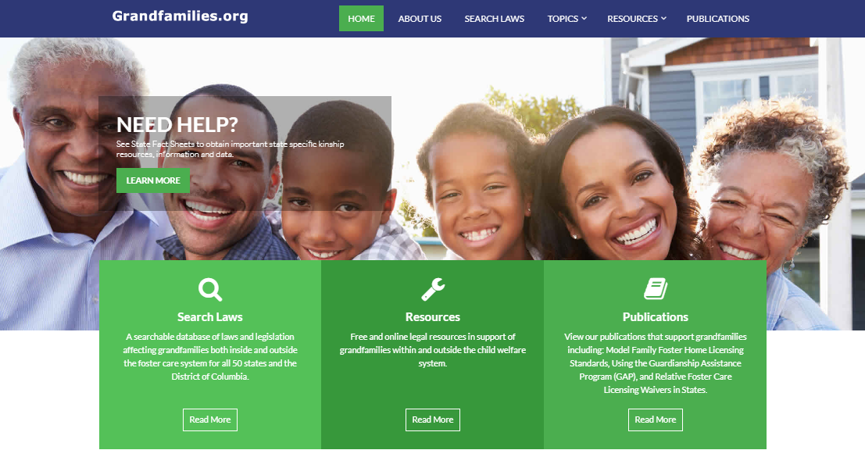
www.grandfamilies.org
A collaboration of the ABA Center on Children and the
Law, Generations United, and Casey Family Programs

Slide 26
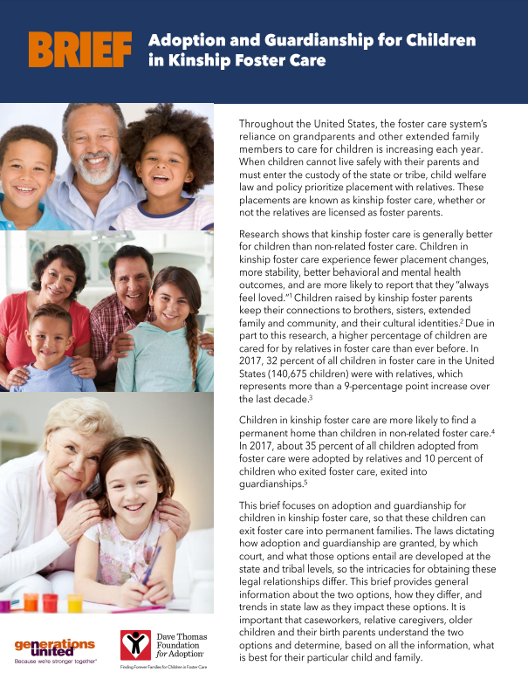
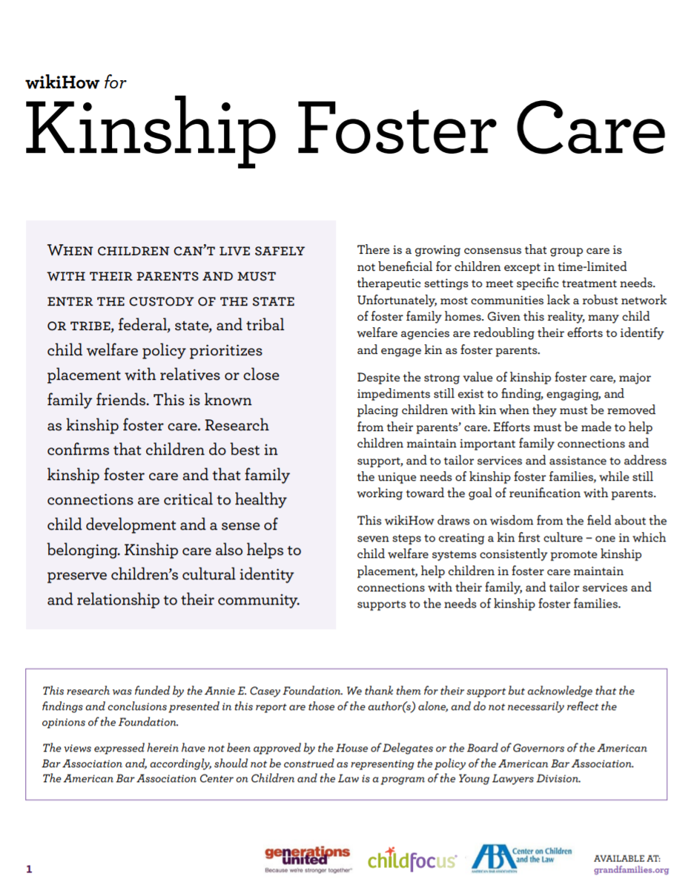
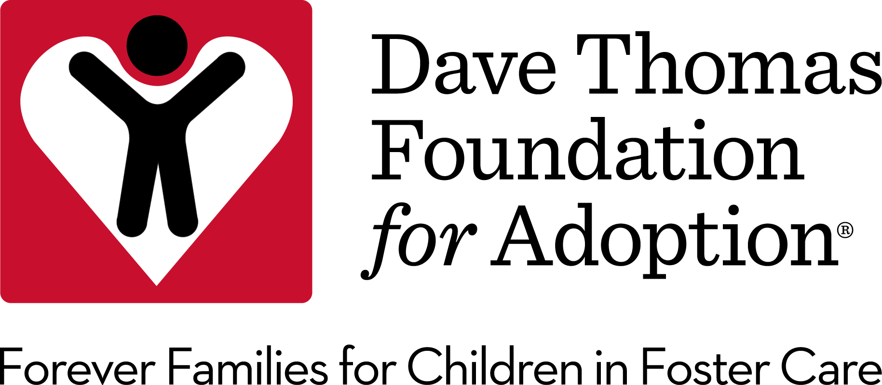
Resources for
child welfare agencies
Notes:
Generations United with support from the Dave Thomas Foundation for Adoption, created the following brief, national comparison chart, and state-specific charts that focus on adoption and guardianship for children in kinship foster care so that these children can exit foster care into permanent families.

Slide 27
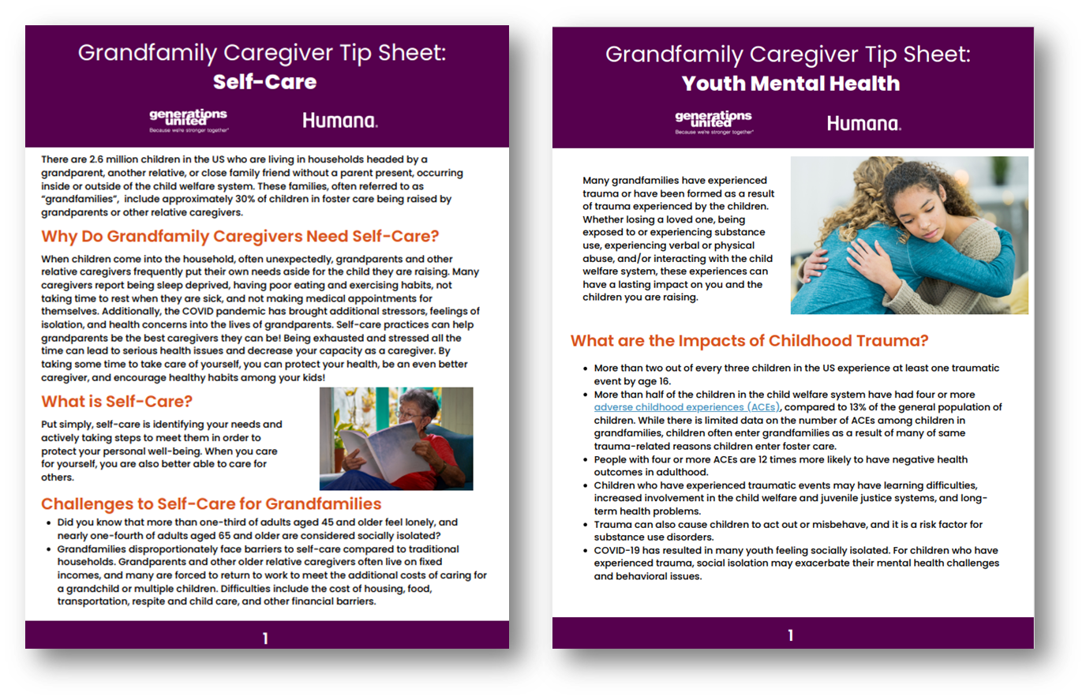
Resources for Grandfamilies
Grandfamily Caregiver
Tip Sheets
https://www.gu.org/resources/grandfamily-caregiver-tip-sheets/
Notes:
Generations United with support from our partner Humana, developed tip sheets on self-care and youth mental health for grandfamily caregivers. These tip sheets are filled with helpful information and resources for grandfamilies.

Slide 28
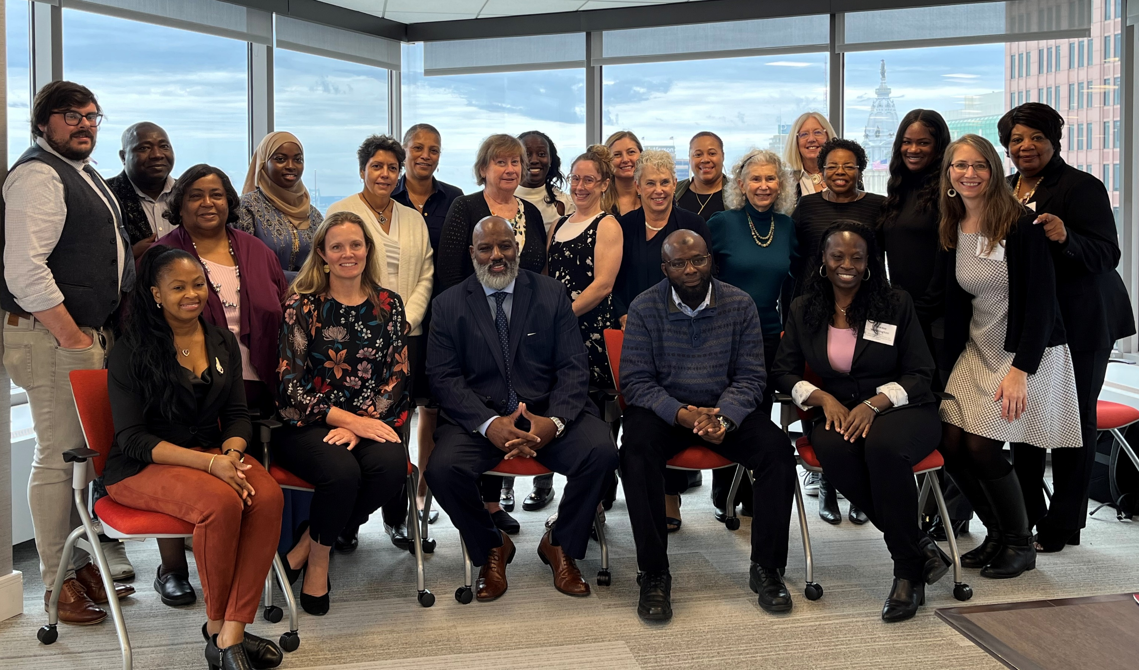



Learning Community/Resources
Kinship Navigator Collaborative (KNC)- Vermont, Maine, Wyoming, Montana
William Penn Grandfamilies Programs Learning Network
Mental Health/Support Groups-Humana
Presentations, trainings and resources related to public policy and advocacy
Notes:
William Penn Foundation has awarded over $2.8 million in three-year grants to eight organizations in Philadelphia, focusing on improving services for "grandfamilies" where grandparents or older relatives are primary caregivers. The funds will support case management, resources, support groups, education, and emergency funding for basic needs.
The Humana Foundation has funded Generations United to expand mental health services in Louisiana and Florida. The project will provide technical assistance, peer support, and capacity building for support groups in collaboration with Children Home Network in Florida and Grandparents Raising Grandchildren Information Center of Louisiana.
Generations United, in partnership with Casey Family Programs and the University of Washington, established the Kinship Navigator Learning Collaborative (KNC) to support over 2.5 million children raised by grandparents and relatives. The KNC program provides information, referrals, and follow-up services to help caregivers access the resources they need. Generations United manages the KNC, offering support to jurisdictions implementing and evaluating the program in Maine, Montana, Wyoming, and Vermont.

Slide 29






Other Current Projects
Annie E. Casey Foundation Community-Based Kinship Design
Family Voices United Partners-Working alongside birth parents and youth in foster care
Plaza West Grandfamily Community Life Housing Project
Funders

Slide 30
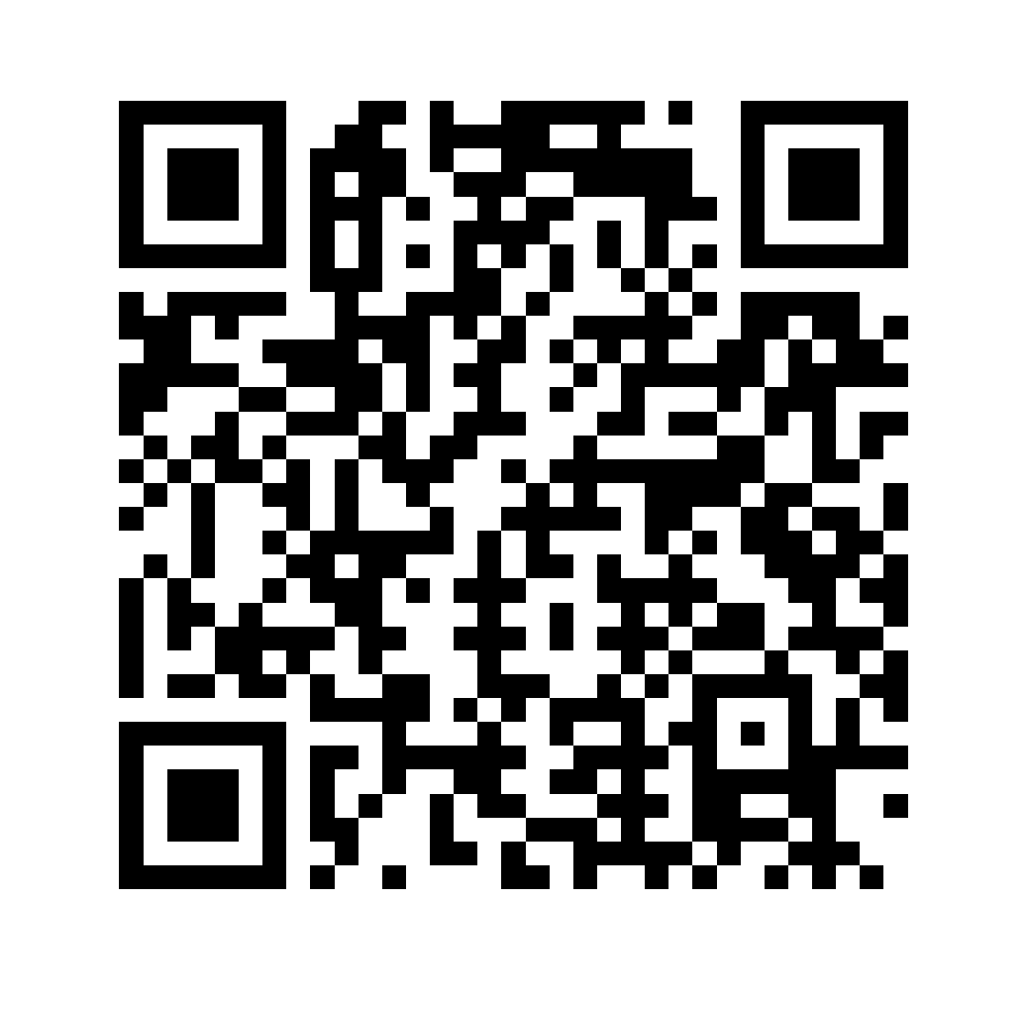
Stay Connected &
Learn More
Get updates on grandfamily resources, policies, and programs with our monthly Grandfamilies Alert e-newsletter for advocates and allies. Sign-up TODAY!
Learn more here gu.org

Slide 31

Thank you!

Slide 32

Montana & Wyoming Kinship Navigator Programs
Joining Forces

Slide 33

Agenda
Montana Kinship Program
Kinship Connections of Wyoming
Kinship Navigator Collaborative
Joining Forces
Final Goals

Slide 34


Montana Kinship Program
20+ years of Grandparents Raising Grandchildren peer support groups in conjunction with Montana State University Extension
  Offered statewide Information & Referral ‘warm’ line
Montana rebranded (MTKNP) & added Case Management in 2021 using Title IV-B Navigator funds
Program Staff: 1 FT Program Manager/Lead Navigator, 2 PT Student Interns

Slide 35


Kinship Connections of Wyoming
Program created from the ground up in 2019 using Title IV-B Navigator funds
Piloted program in Natrona & Laramie Counties in 2020
Designed to do both Information & Referral and Case Management with existing I & R channel of Wyoming 211
Program Staff: 1 FT Program Manager, 1 FT Kinship Navigator
Joined the Kinship Navigator Collaborative in 2021

Slide 36
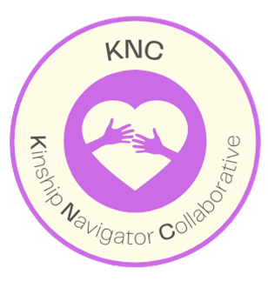
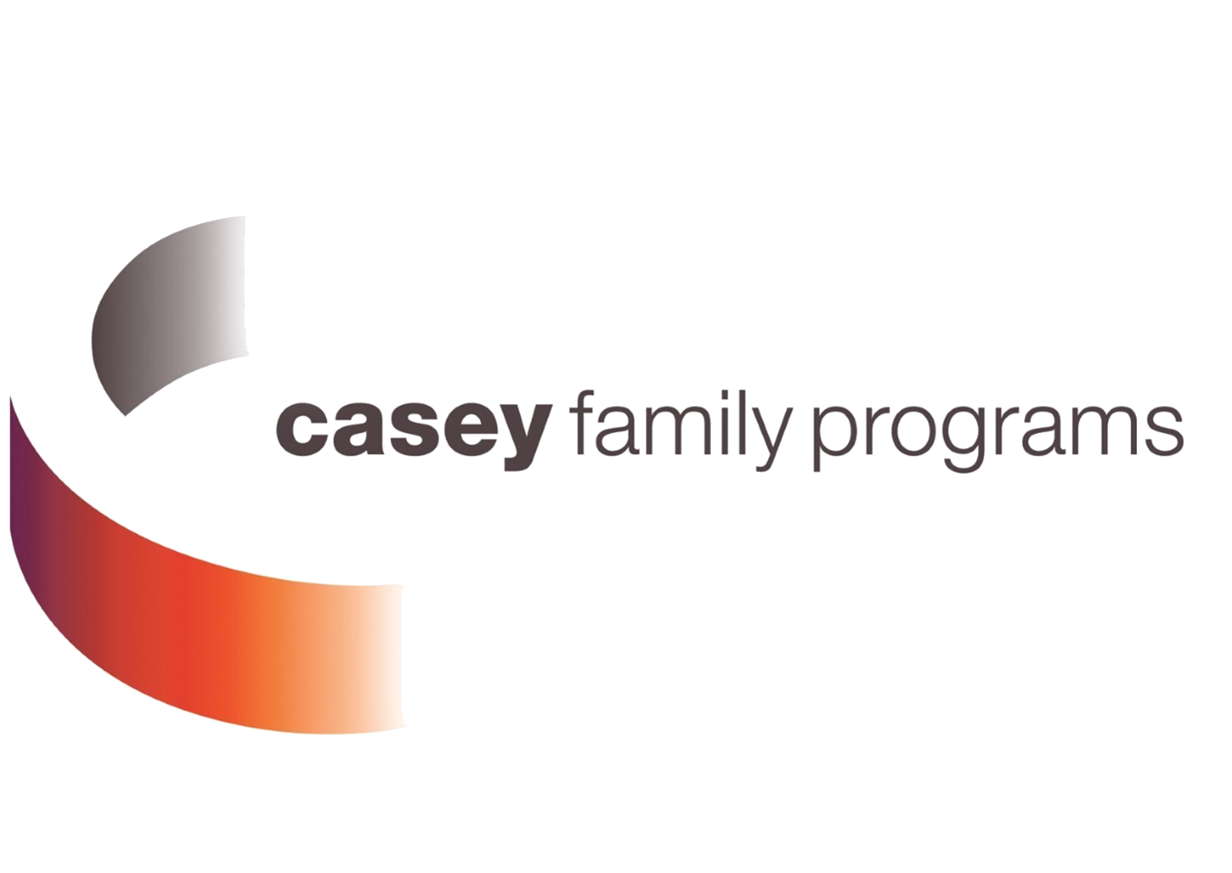


Kinship Navigator Collaborative
Maine, Montana, Vermont & Wyoming
Support kinship families caring for their children – safety, stability, permanency
Build community capacity to link families with community resources
Bring together states / jurisdictions / tribes that have yet to stand up a Kinship Navigator model to agree on common programs elements
Ensure this common Kinship Navigator model meets federal requirements for KN programs (and lessons learned over time
Ensure evaluations in the multiple sites meet the rigorous standards to build evidence so it can be positively rated by the Family First Clearinghouse, and be eligible for ongoing, future entitlement funding and reimbursements

Slide 37
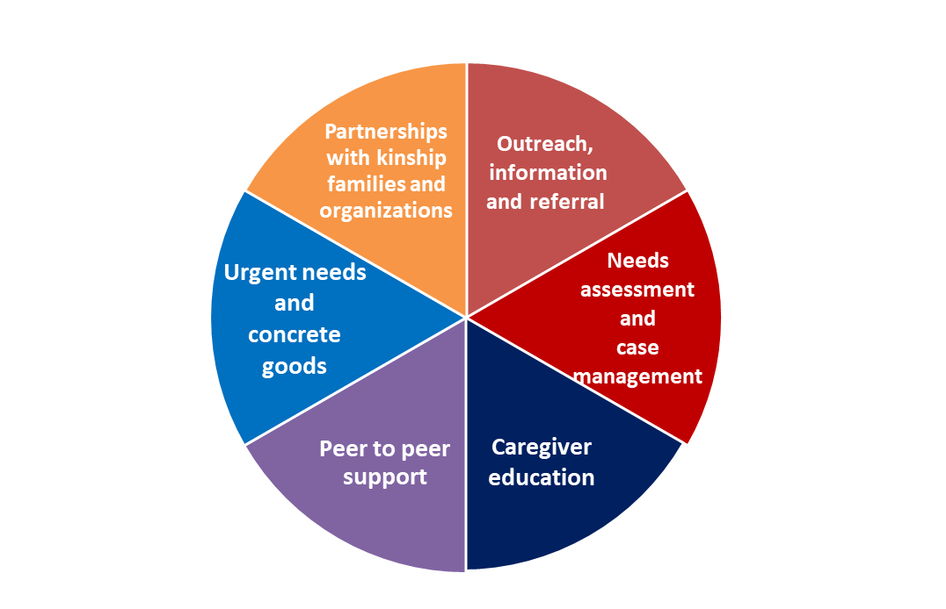
Benefits of the Collaborative
Technical support and guidance from Casey Family Programs, Generation United and Dr. Angelique Day from the University of Washington.
Design and completion of a program manual for an evidence-based program.
Development of the program wheel that outlines all needed components submit to the Clearinghouse.
Peer support and guidance in developing all processes, forms and manuals.

Slide 38
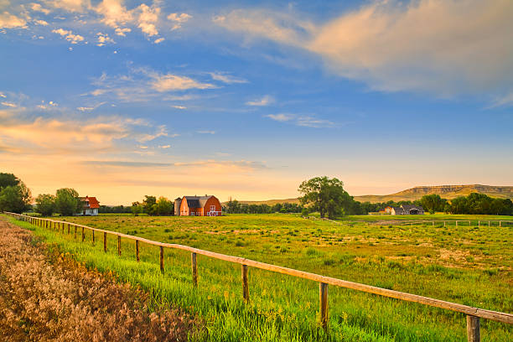

Why we joined forces
Montana and Wyoming are both rural frontier states with lower populations than many states applying for funding.
Both states have purposes and challenges of rural states in meeting guidelines for Clearinghouse approval.
  Ability to compete with larger states for funding opportunities
Both states have strengths to bring a willingness to work together to form a joint program and evaluation
Continue to have work guided by the collaborative, at times shaping the directions of the collaborative and providing insights based on what each state has already begun to develop.
Both states are on board to develop joint plans to meet both navigator and evaluator needs, and ultimately those of the kinfamilies, and state/federal funding partners.
No other programs have submitted to the Clearinghouse with a program for evaluation that serves both formal and informal caregivers.

Slide 39
Dual State Partnerships
Combine all workflow processes, procedures, and forms
Created combined job descriptions
Created combined caregiver education and support groups (control)
Data sharing agreements
De-identified client and family ID’s
Joint data imports
Combined Focus Groups
Combined published articles

Slide 40
Challenges
Raising statewide awareness to increase referral numbers
Improving and mastering the new processes and procedures
Obtaining closure and 6-month post surveys from caregivers
Lack of mental health resources

Slide 41
Kinship Navigator Dual Evaluation
Child Safety
Placement Permanency
Caregiver Well-Being
Access to Resources
Quasi-experimental evaluation by Montana State University and University of Wyoming evaluators.

Slide 42

Final Evaluation Goals
Completed program manual
~ Including evaluation process, program processes, program forms
250 participants enrolled in the study– completed to 75% fidelity
Submission of our combined program evaluation to the Federal Clearinghouse for review
Acceptance/Compliance with Federal Clearinghouse Standards
~ Access to Title IV-E funding
Provide a program approved by the Clearinghouse designed for any state to use and build a program around

Slide 43
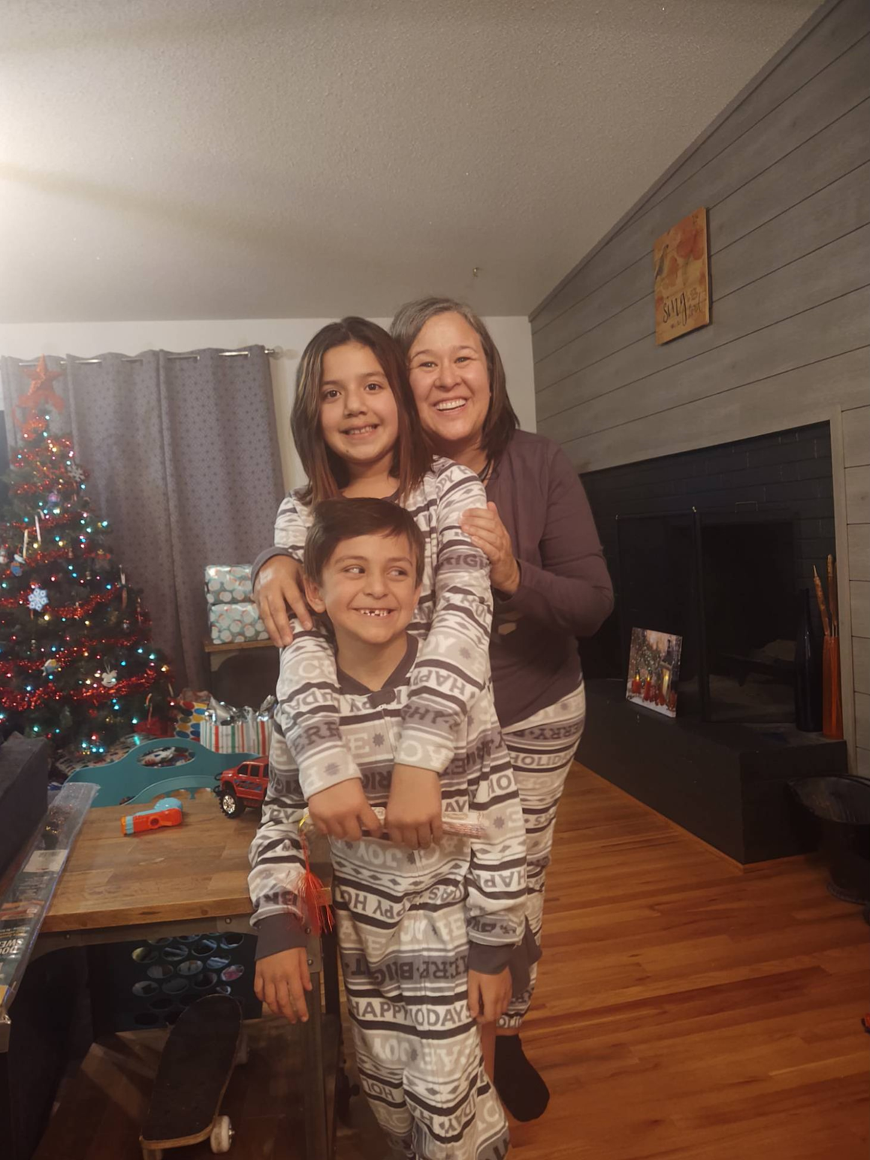
But don’t take our word for it….
Was very grateful for the help and support the program offered.
Great program, helpful. Gabby is amazing!
Thank you for everything! We really need this program in our state. Chandra was amazing for us!
Just knowing all the resources available is helpful when needed.
The MTKNP helped so much when things got tough financially and we were so behind in our electric bill we were facing shut-off. I was stuck everyday wondering if we would have lights when I came home from work – it sucks! Heidi helped pay the outstanding amount and we were able to come up with the rest. This program is a god-send – you have no idea the relief I have. Beyond appreciated!
Thank you again for your support and guidance! I can’t tell you enough how incredible it feels in this moment to have an advocate in our corner helping us navigate all of this.”

Slide 44
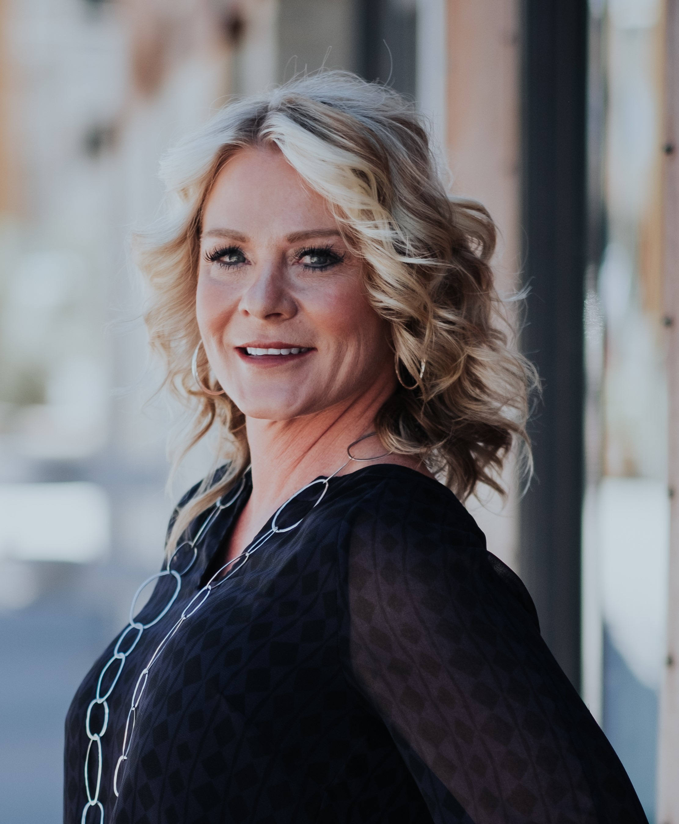
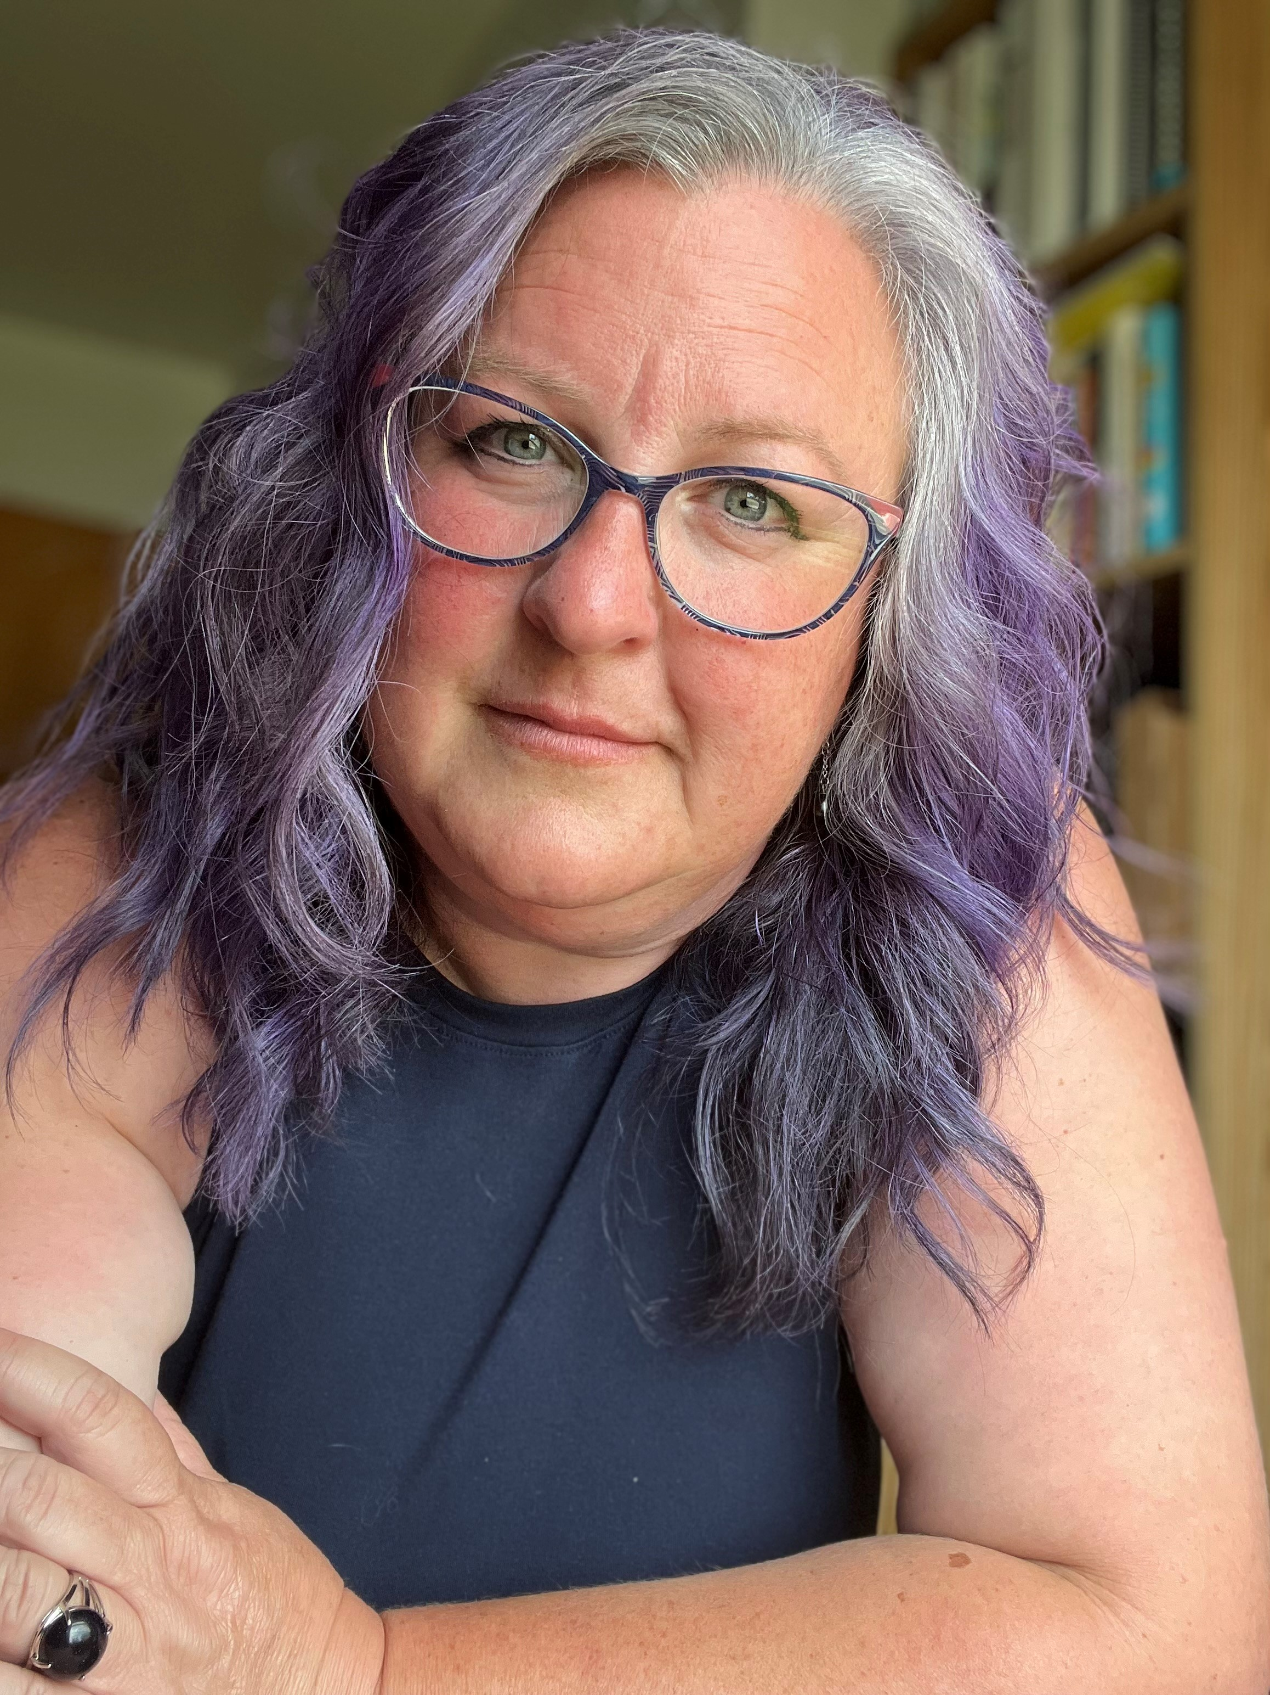
Heidi Lester
Chandra Ortiz
Program Manager/Lead Navigator
mtknp@montana.edu
406.994.3395
Program Manager
navigator2Wyoming211.org
307.287.4645

Slide 45

Q & A

Slide 46
Pre-conference Workshop: Grandfamilies/Kinship
July 26th,2023
Washington State Kinship Navigator
Rosalyn Alber Program Manager

Slide 47

Washington State Kinship Navigator
History of the KNP in Washington
Unique structure and benefits of KNP
Where we are going

Slide 48
Washington Kinship History Timeline (Option #1)
2001
Relative Support Services Fund
2002
Kinship Care Work Group
2003
Kinship Navigator pilot projects
2007
2023
Kinship Navigator Program
Navigator expansion
2016
Tribal Kinship Navigator

Slide 49
Unique Business Structure
Kinship Navigator
DCYF
(IV-E)
ALTSA
(state $)
Area Agency on Aging
Department of Children Youth and Families (DCYF)
Aging & Long-Term Support Administration (ALTSA)
Area Agency on Aging (AAA)

Slide 50
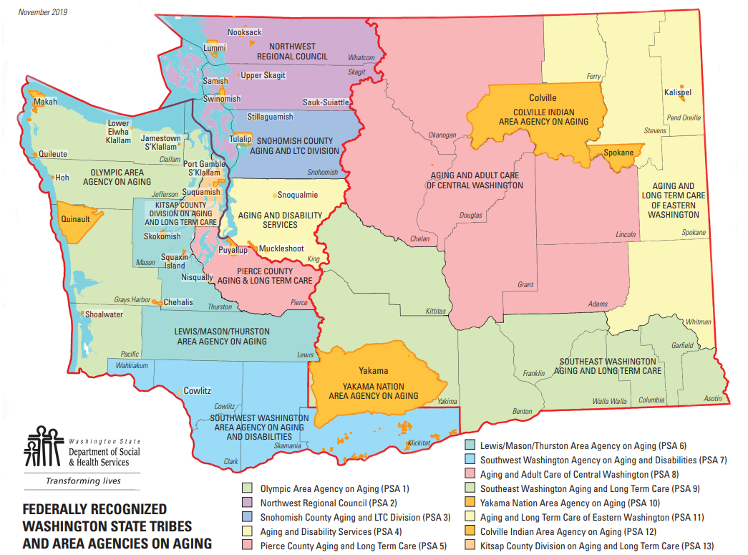
Add a Slide Title - 1

Slide 51
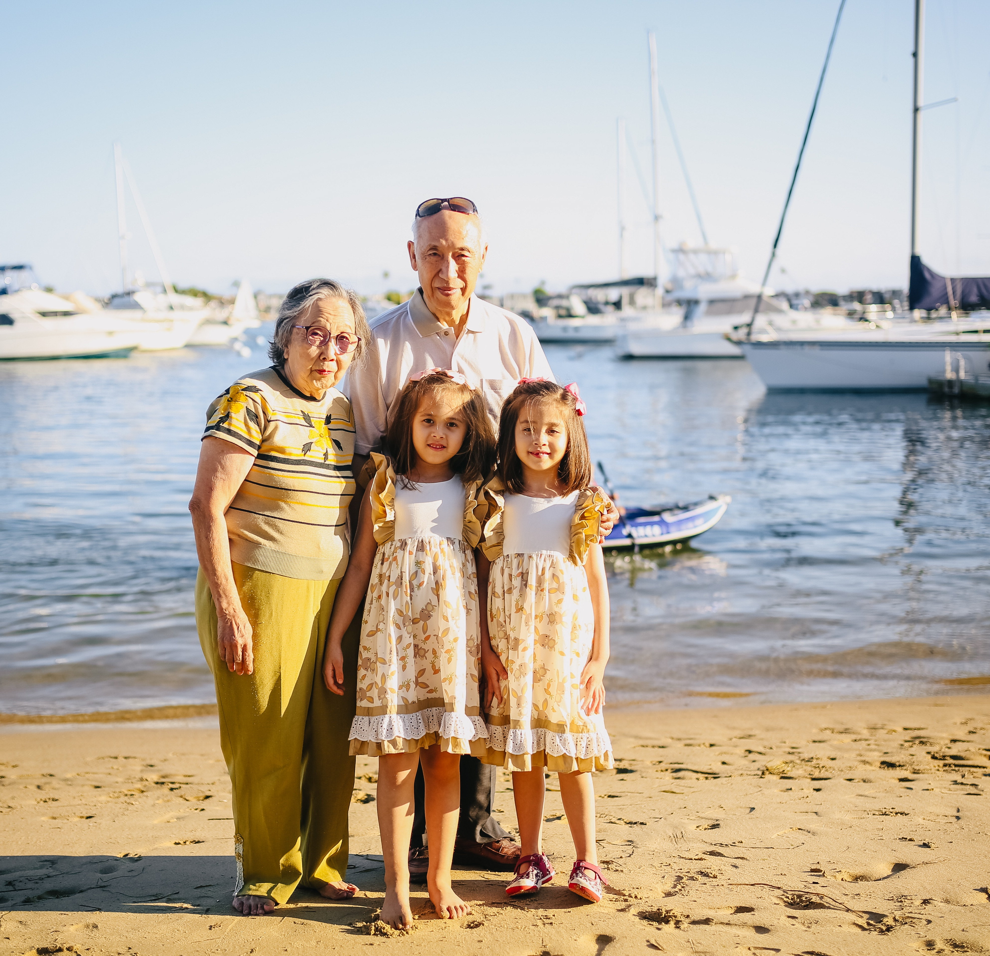
Benefits to KNP structure
Serving all Kinship Caregivers
Navigators with lived experience
Navigators build trust with caregivers

Slide 52
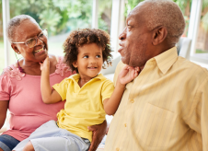
Where we are going: Come to our presentation Thursday July 27th 10:15-11:00
Currently in the fifth year of an evaluation research project
We will be presenting on our six month findings and first submission to the IV-E Prevention Services Clearinghouse for the Case Management Model

Slide 53
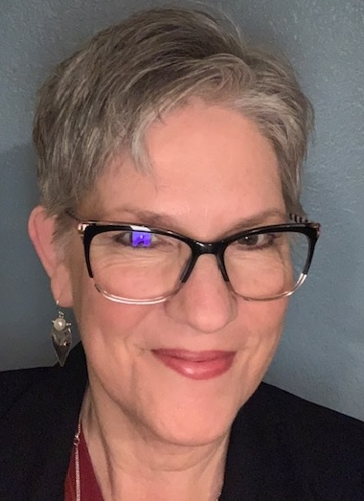
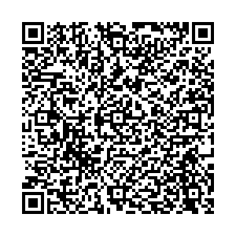
Contact information
Rosalyn Alber
ALTSA Kinship Program Manager
rosalyn.alber@dshs.wa.gov
Scan QR code for contact information

Slide 54

Kinship Navigator Program
KIN-TECHTM
Peer to Peer Navigation
Presenter: Larry Cooper, MSW, LCSW

Slide 55
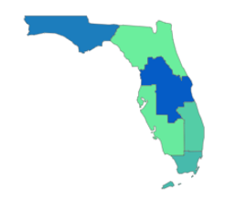
Children’s Home Network
Florida
Two Decades of experience with kinship systems of care
KIN-TECHTM implemented in 8 counties in Florida
KIN-TECHTM replicated in Delaware
Rated as “Supported” by Research in the California Evidence Based Clearinghouse for Kinship Navigator Program with Informal and Formal Kinship Families
Informal and Formal, Peer-to-Peer, and case management and family support
Over 100 national presentations, publications and other dissemination activities
National Leadership: National Grandfamilies Advisory Board (GU), National Grandfamilies and COVID 19 Study, Grandfamilies Outcome Workgroup (GrOW), and Editorial Board of Grandfamilies Journal, Research, Policy and Practice.

Slide 56


Prevention Focus
Coordinated Central Intake
888-920-8761
Navigation Services
Support Groups
Early Childhood Interventions
Health and Wellness
Benefits Connection and Enrollment
Community Collaboration
www.childrenshomenetwork.org
Children’s Home Network-Kinship Navigation model- KIN TECHTM

Slide 57
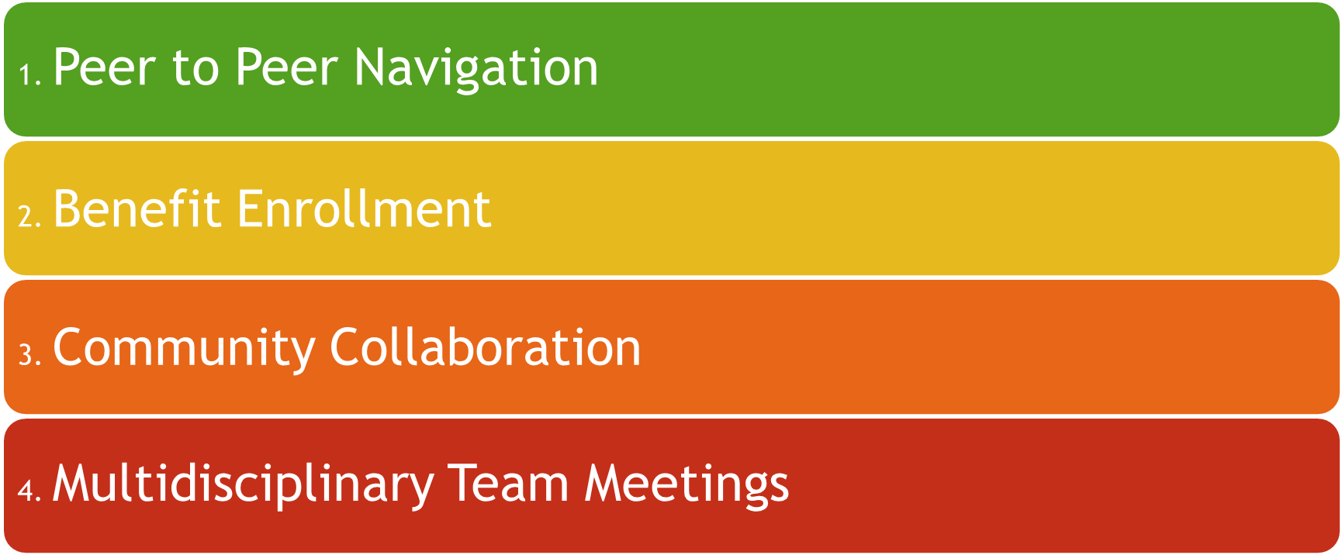
Children’s Home Network
Kinship Navigation model
KIN-TECHTM

Slide 58
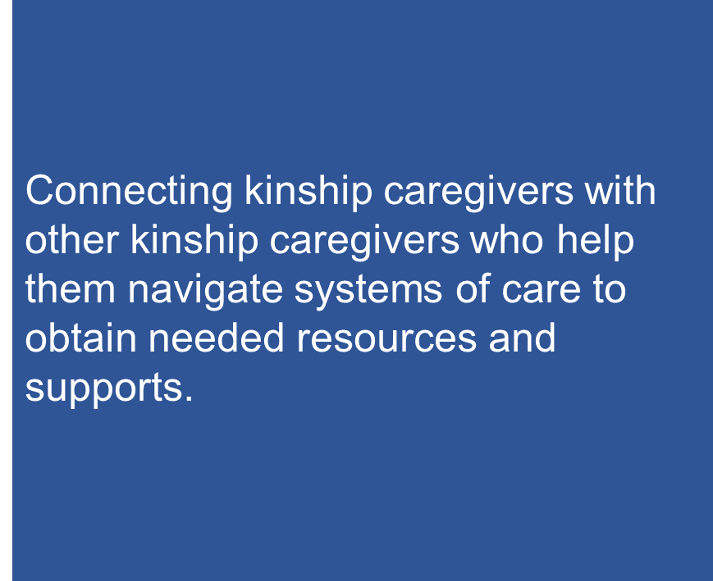


Slide 59

Benefits Application and Enrollment
Kinship Navigators work shoulder to shoulder with kinship caregivers to apply and enroll in benefits, and follow up to ensure these supports are secured and in place for the family.

Slide 60
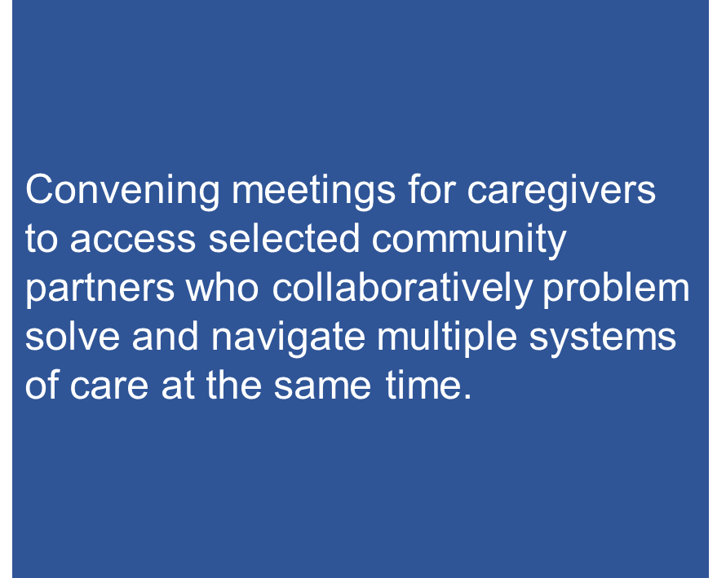

Slide 61
Publications
Carter, S., Littlewood, K., Cooper, L., Spadola, C.E., Rosenthal, M., Bennett, R.L., & Pandey, A. (2023). Time for Me: Development and results of an RCT of a kinship navigator self-compassion and care toolkit for caregivers by caregivers. Children and Youth Services Review, 152, 107076, https://doi.org/10.1016/j.childyouth.2023.107076
Littlewood, K., Cooper, L., Rosenthal, M., Averett, P., Pylant, J., Bennett, R., & Spadola, C.E. (2023) Supporting the lived experience through the implementation of peer-to-peer kinship navigation services, Journal of Human Behavior in the Social Environment, https://doi.org/10.1080/10911359.2023.2187914

Slide 62

Questions

Slide 63
Contact Information
Larry Cooper, MSW, LCSW
Executive VP of Innovation
lcooper@childrenshomenetwork.org
www.childrenshomenetwork.org
888-920-8761

Slide 64
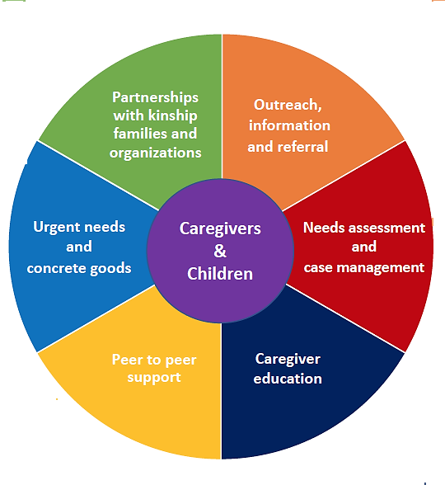
The Kinship Program

Slide 65
OUTREACH, INFORMATION AND REFERRAL
Email list serve
  Constant contact/Marketing cloud
  Bi-Monthly e-newsletter
Website
  Contact forms
  Interactive county contact map
Social media
  Facebook
  Instagram
  Twitter
  LinkedIn
Referrals
  211, WIC, DHHS, VLP, AAA’s, TANF, SNAP, food banks, probate court’s, community agencies, and school districts.
Tangible Materials
  Fliers & posters
  Welcome letters & packets
  Quarterly newsletter

Slide 66
NEEDS ASSESSMENT AND
CASE MANAGEMENT (NAVIGATION)
Intake, Prescreen, Needs Assessment, Goal Setting, FIdelity Tracking Sheet have been built into the data system
Database automation was created to help provide task reminders and reduce documentation.
Designated staff to do case closure surveys and and 6 month post closure surveys.

Slide 67
CAREGIVER EDUCATION
National Training Development Curriculum
Foster Parent College
Legal and public benefits
Unique state approved trainings

Slide 68
PEER SUPPORT
Lived experience
C.A.R.E.S. Meetings (Connecting, Advice, Resources, Education, Support)
Additional peer support
  Mentors
  Family events

Slide 69
URGENT NEEDS AND CONCRETE GOODS
Community Grants
Private Funders
In-Kind donations
Resource Rooms & Clothing Closets
Discount Card Program
BackPack Programs
Holiday Gift Giving Program

Slide 70
PARTNERSHIP WITH KINSHIP FAMILIES
AND ORGANIZATIONS
Advisory counsel (quarterly meetings)
Employees with lived experience
UMO School of Social Work
  Research projects
On going survey feedback
  Trainings
  C.A.R.E.S.
  Satisfaction Survey

Slide 71
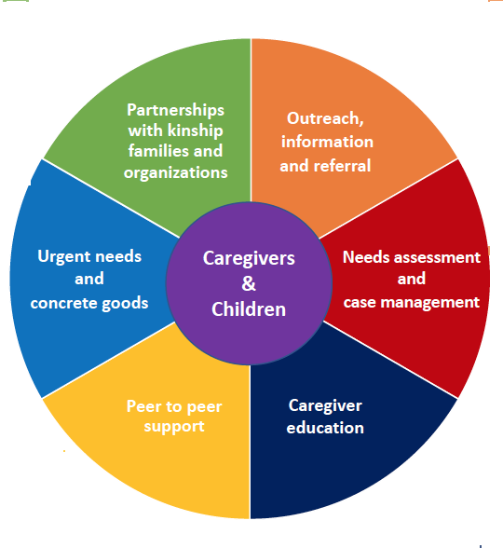
Advisory counsel (quarterly meetings)
Employees with lived experience
UMO School of Social Work
  Research projects
On going survey feedback
  Trainings
  C.A.R.E.S.
  Satisfaction Survey
Social media
  Facebook
  Instagram
  Twitter
  LinkedIn
Email list serve
  Constant contact/Marketing Cloud
  Bi-Monthly e-newsletter
Tangible Materials
  Fliers & posters
  Welcome letter & packet
  Quarterly Newsletter
Website
  Contact forms
  Interactive county contact map
Referrals
  211, WIC, DHHS, VLP, TANF, SNAP AAA’s, food banks, probate court’s, community agencies, and school districts.
Community Grants
Private Funders
In-Kind donations
Resource Rooms & Clothing Closets
Discount Card Program
Backpack Programs
Holiday Gift Giving Program
Emergency Financial Assistance
Camperships
Data System with built in, intake, prescreen, needs assessment, goal setting and fidelity tracking sheets
Automation to help Navigators with reminders and reduce time spent documenting.
Designated staff to do surveys
Lived Experience
C.A.R.E.S. Meetings (Connecting, Advice, Resources, Education, Support)
Family Events
NTDC
Foster Parent College
Legal and Public Benefits
Unique state approved trainings
Notes:
16 unique trainings:
Adoption & Foster Nutrition
Adoption: What is Normal
Allegation Prevention & Protocol
Assessing Attachment: A look at Attachment Theory and Emotional Coaching
Building Healthy Relationships
Courthouse Basics
Day-to-Day living with children with prenatal substance exposure
In It For The Child
Mandated Reporter Training
Parenting Life Skills
Positive Discipline
Reasonable & Prudent Parenting
Resources for Success
Self-Care for Foster, Adoptive & Kinship Parents
Starting and Maintaining Support Groups
Understanding Safety and Awareness
Understanding Boundaries as a Resource Parent
Working With and Valuing Birth Family Connections
Your Special Needs Child in the Community

Slide 72
The HALOS Community and Donor Engagement
Brennyn Colombo
July 26, 2023
Notes:
Do an introduction
Name, position, how long at HALOS

Slide 73
What is HALOS?
HALOS is a 501(c)(3) nonprofit organization that serves kinship caregivers and the children in their care in Berkeley, Charleston, and Dorchester counties of South Carolina
16 full time staff
  Doubled in size since 2017
  2 ½ full-time Kinship Navigators who together served almost 700 different families last year
Providing Kinship Navigation and varied other supports since 2008
Notes:
HALOS is a 501c3 nonprofit organization that serves kinship caregivers in the Tri County
We have 16 full time staff and have doubled in size since 2017.
We currently have 2 ½ full time Navigators who together served almost 700 different families last year
HALOS Has been providing support since 2008, but we did not know to call it “Navigation” at the time. It was resource and referral with add on optional services that are outside of the scope of Navigation
Varied other supports prior to navigation services or “Tack on Services” = Drives, support groups, family events, mentoring and educational programing

Slide 74
COMMUNITY OUTREACH
Outreach is a term used broadly to describe the community connections Navigators make in their daily work, which serves many purposes:
1. Continuously explore and note resources and services available within the community that can be of any assistance to kinship families, in order to make the highest quality referrals
2. Promote the organization’s services and other kinship support programs to community agencies and institutions, in order to raise awareness and inform providers of their ability to make referrals for their own clients; establish cross-referral systems
3. Create and maintain partnerships with community agencies and institutions committed to improving the standard of care for children and families
Notes:
Outreach is naturally a part of the Kinship Navigator role, in order for providers to have a thorough understanding of kinship family needs, the systems they interact with, as well as the composition of the community where kinship families live and where they receive care.
We have also been able to add an Outreach Coordinator role in the past 2 years that specializes in community outreach
Our navigators and outreach coordinator utilize outreach daily by exploring new resources that may be of use to CGs, as well as ensuring they are the highest quality. Also by promoting our work to other organizations in that search for resources, we are creating partnerships to establish cross referral systems.
The most successful outreach we have done has been through DSS and other community agencies.
We do not pay for marketing as it does not reach them where they are. This has been adjusted based on kinship caregiver advice, and we promote ground level, grassroots outreach methods. (don’t take out paid ads)
Messaging/verbiage – not everyone knows what kinship care is, to include the caregiver (ensuring differing messages for caregivers and donors)

Slide 75
START WITH EXISTING RESOURCES
What organizations in your community aid clients with…?
Housing
Food pantries
Clothing closets
Financial assistance
Medical and Dental services
Mental Health services
School Support
Legal services
Childcare
Respite
Disability & Special Needs
Employment
Child advocacy
Notes:
Think about which organizations and resources are already in your community and have the ability to group by type of resource and geographic location,
Our navigator have a thorough understanding of any applicable eligibility criteria to ensure we are not referring CGs to organizations that will not be able to serve them
Partnering with 2-1-1, compiling and sharing with other orgs as you go
We also use the “kinship lens” to help caregivers pinpoint what will help and why. Letting the CG be the expert in stating what they need
Where can your organization reach out to for services that you are unable to provide (cross referral) ?
If you need one place to start to find families to serve, get into your local schools (admin, guidance counselors, teacher. They know who is in the school and will be motivated to get their families connected to services. They likely have staff that know other resources and would be eager to share)

Slide 76
PARTNERING WITH CHILD WELFARE
Collaboration with county and state DSS/DCFS is critical
  Regular contact with child welfare staff recommended
  Highlighting how your organization support can reduce caseworker burden
Understanding Economic Services
  SNAP, TANF, ABC, Child Support
Individual, team, and department relationships – build trust so caseworkers become confident in referring to your organization
Your organization should consider what are common child welfare practices/processes that Navigators and families need to be aware of.
Notes:
Organizational collaboration with county and state DSS/DCFS is critical to reaching kinship families and raising awareness
Regular outreach/contact with child welfare staff recommended - It helps maintain attention towards kinship families, promotes their interests, reminds busy caseworkers of the support programs you have available and how to refer and gain a better understanding of case timelines
Case Timelines – families are often left in the dark about case timelines and in some cases the information may be incorrect. What the policies are vs what is actually being done. Timelines are not always followed by state agencies
Understanding of Economic Services available, how to direct caregivers to the correct place/department; knowing where to ask for help
SNAP, TANF, Child Support, ABC vouchers

Slide 77
PARTNERSHIPS: LESSONS LEARNED
Cohesive materials and varied ways of getting the word out to caregivers and community partners
  Attending community events
  Printed materials available that have been vetted by caregivers - Flyers, brochures, translated materials
  Website
  Text messages
Ask caregivers about messaging!
Collect feedback from caregivers regarding the quality of services received from your organization & community partners
******Creating relationships and compiling community resources and takes time & care*******
Notes:
All staff members have been involved in outreach and it so important we now have a full time outreach person.
Have cohesive materials with a variety of ways to contact caregivers, partners, and donors to include attending events, printed materials, and having an easily accessible website. All dependent on the budget – do not spend money where there is none. We have also incorporated CGfeedback to ensure our message resonates with them and reaches them where they are.
Ensuring the quality of the services that CGs are referred to through direct feedback (don’t keep sending CGs somewhere that they say won't/can’t help them, or are rude/judgemental in providing services if possible).

Slide 78
Sources of Funding Over Time
Individuals - $176,000 in FY18 to $452,000 in FY23
Government - $0 in FY18 to $328,000 in FY23
Foundations - $65,000 in FY18 to $276,000 in FY23
Organizations (corporations/civic groups/religious orgs) - $100,000 in FY18 to $142,000 in FY23
Fundraising events (1 per year, focus on sponsorships) - $35,000 in FY18 to $98,000 in FY2
In-kind donations (pass through donations of school supplies & holiday gifts)
Notes:
These are the main sources of our funding and we are able to directly see the growth from 2018 to 2023
Individuals have always been the largest source of funding for HALOS and we recommend that as a focus for new and emerging navigation programs (if you have a grant or government funding to start your program, focus on garnering support from individuals to become sustainable)
Government funding started after the Michelle H class action federal lawsuit brought against the SC DSS regarding the health and safety for the children in foster care, but now continues because of the Family First Act
VOCA is included in Gov - the children have been potentially victims of crime
Duke would be included in the foundations category- this number is not shown in FY23
Fundraising events are the least efficient way to fundraise but it is good to have 1 signature event annually to help promote the organization

Slide 79
REACH OUT & CONSULT!
Brennyn Colombo Khalilah Sumners
Kinship Navigation Manager Program Director
843-304-0611 843-990-9565
brennyn@charlestonhalos.org Khalilah@charlestonhalos.org
www.charlestonhalos.org
www.kinshipsc.org
Notes:
l

Slide 80
Donor Retention Strategies
Communicate impact of gifts to donors through:
Donation thank you letter mailed within 48 hrs of gift
Quarterly printed newsletters mailed
Bi-monthly e-blasts
Personal updates with top donors
Grant reports and site visits
Social media
Careful solicitation:
Focus is on major gifts!
Most donors only get 1 appeal letter/year (lapsed donors receive 2)
Appeal letter includes amount of last donation and asks for specific amount (an increase over prior year)
Soft asks - remit envelope in newsletters and donate button on e-blasts
Notes:
Donor retention strategies will include a thank you letter mailed quickly after receiving each donation
We also provide separate quarterly newsletters to donors and caregivers with tailored messages to showcase the impact donations have for our families or which events and services may be currently available for our families.
we are also able to provide grant reports and in person site visits to donors as requested
Careful solicitation refers to the retention of individual donors
We mail 1 appeal letter annually that includes the amount of the last donation and requests a higher amount for this donation, unless their donations have lapsed and then we would make a second appeal
Our physical and virtual appeals will always include a remit envelope or donation button so they can quickly and easily identify how to donate

Slide 81
CONNECT WITH NATIONAL KINSHIP RESOURCES
GENERATIONS UNITED
www.gu.org
BROOKDALE FOUNDATION
www.brookdalefoundation.org
CHILD WELFARE LEAGUE OF AMERICA
www.cwla.org
ANNIE E. CASEY FOUNDATION
www.aecf.org
CHILD TRENDS
www.childtrends.org
CHILDREN’S DEFENSE FUND
www.childrensdefense.org

Slide 82
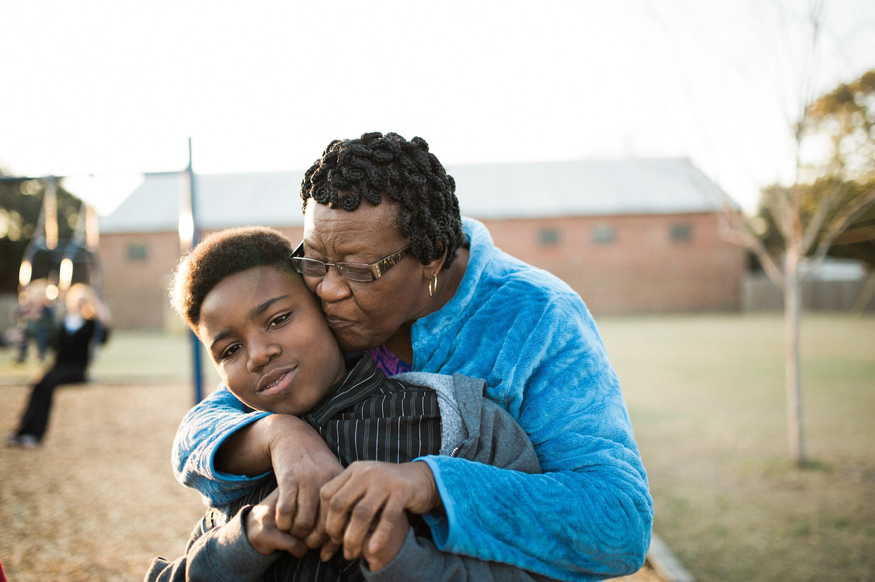


Slide 83

Unaccompanied Immigrant Children (UC) Kinship Families
Emily Smith Goering, MSW, PhD
Generations United, Preconference Session
7.26.2023

Slide 84
Unaccompanied immigrant children (UC) are children under the age of 18 who cross into the United States with no lawful immigration status and with no parent or legal guardian in the United States that is immediately available to provide care.
Other terms used include: Unaccompanied minors, unaccompanied alien children
Source: Office of Refugee Resettlement, Programs: Source: Office of Refugee Resettlement, General Data: https://www.acf.hhs.gov/orr/about/ucs/facts-and-data#Incoming%20Referrals
Notes:
https://www.acf.hhs.gov/orr/programs/ucs/about

Slide 85
Record numbers of UC have been arriving in recent years.
Source: Office of Refugee Resettlement, General Data: https://www.acf.hhs.gov/orr/about/ucs/facts-and-data#Incoming%20Referrals

Slide 86



They tend to be teenagers, are more likely to be male, and overwhelmingly arrive from Central America.
72% are between the ages of 15 and >18
64% are male and 36% female
Home country: 47% Guatemala, 29% Honduras, 13% El Salvador, 11% ‘other’
Source: FY22 (October-September), Office of Refugee Resettlement, General Statistics: https://www.acf.hhs.gov/orr/about/ucs/facts-and-data

Slide 87

The ‘typical’ pathway for UC from arrival to release.
Apprehended by Homeland Security & Border Patrol
Receives initial screening of eligibility to remain in the U.S.
Child crosses the U.S./Mexico border
Transferred to ORR custody within 72 hours
ORR locates, screens, and coordinates placement with a sponsor
Released from ORR custody once sponsor accepts transfer of UC
Placed in an ORR shelter
Approx. 30 Days
Immigration Forum, Fact Sheet: https://immigrationforum.org/article/fact-sheet-unaccompanied-migrant-children-uacs/

Slide 88
60% of UC released to sponsors are released to kin.
Source: FY21 (October-September), Office of Refugee Resettlement, Latest UC Data: https://www.hhs.gov/programs/social-services/unaccompanied-children/latest-uc-data-fy2021/index.html

Slide 89
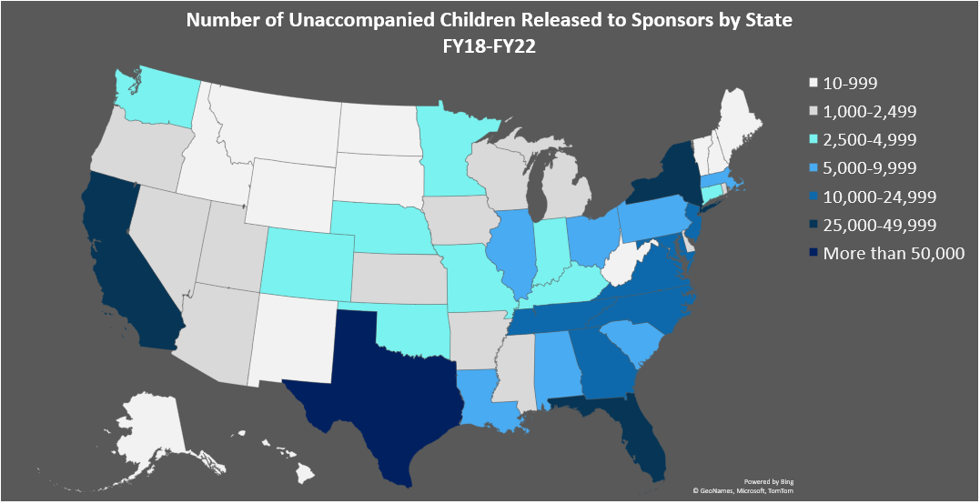
We have data at the state and county level about where UC are released.
Source: Office of Refugee Resettlement, Children Released by State: https://www.acf.hhs.gov/orr/grant-funding/unaccompanied-children-released-sponsors-state
Notes:
https://www.acf.hhs.gov/orr/grant-funding/unaccompanied-children-released-sponsors-state

Slide 90






The challenges faced by UC kinship families are the same as other kinship families but often with an added layer of complexity.
Physical & Mental Health
Finances/Lack of access to public benefits
Legal
Child Welfare
Education
Housing
Source: Grandfamilies Kinship Support Network: https://www.gksnetwork.org/resources/grandfamilies-kinship-families-strengths-challenges/ and https://www.gksnetwork.org/wp-content/uploads/2022/08/Ana-Beltran-Overview.pdf
Notes:
https://www.gksnetwork.org/resources/grandfamilies-kinship-families-strengths-challenges/

Slide 91
Kinship programs should explore supports for UC kinship families in their community.
Connect & Learn
Assess the Needs
Develop Expertise
Create Culturally Responsive Services
Build Relationships & Referral Process

